Slide 1
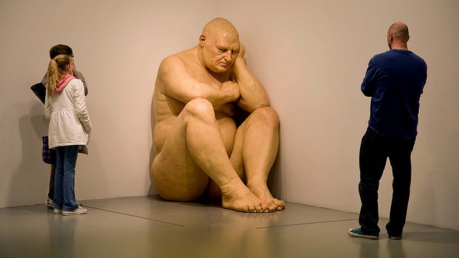

Slide 2
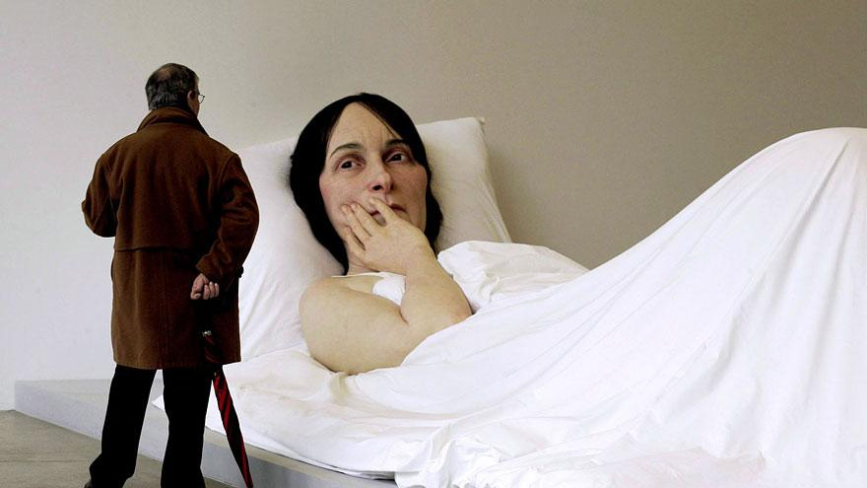

Slide 3
RON MUECK
Big Man, 2000
In Bed, 2005

Slide 4
Easter Sunday
It’s her third Easter in this place. When I arrive, I always have trouble recognizing her because her face never looks the same. Today her mouth is twisted to the right. I have brought her a chocolate hen. The piece I break off is too big, she can’t put the whole thing into her mouth; it slips out, she tries to catch it but clutches her chin instead. This scene, and all the other ones when she grabs at nothing, are the ones I find the most afflicting. After that, she kneads a lump of chocolate instead of bringing it to her lips, then makes a few unsuccessful attempts to eat it. By now she is smothered in chocolate. At this point, everything gets out of hand: horror has ceased to matter, it has even become necessary. Go on, spread it all over yourself, make a real mess of it. I can feel anger swelling up inside me, anger that comes straight from my childhood – an impulse to break everything, dirty everything and roll in the mud. Now this rage is directed against her. After I have fed her and wiped her mouth: “Do you still have all your teeth: Because my dentures are…” (the last word is muffled.) I tell her not to worry, I’ll have another set made; I tell her the first thing that comes into my head, like one does with children.
My mother’s neighbor is in tears, sobbing in her wheelchair. I offer her a chocolate but she shakes her head, raising her ugly, puffed face. It breaks my heart. So does the following scene: as I bend forward to check the safety catch of my mother’s wheelchair, she leans over and kisses my hair. How can I survive that kiss, such love, my mother, my mother.
By Annie Ernaux
Originally published in French as LA VIE EXTERIEURE Editions Gallimard, Paris, 2000

