Slide 1


Addiction Treatment
Response to Emergency and Beyond
Kristin Nolan, MA, MBA,
Senior Vice President of Behavioral Health

Slide 2
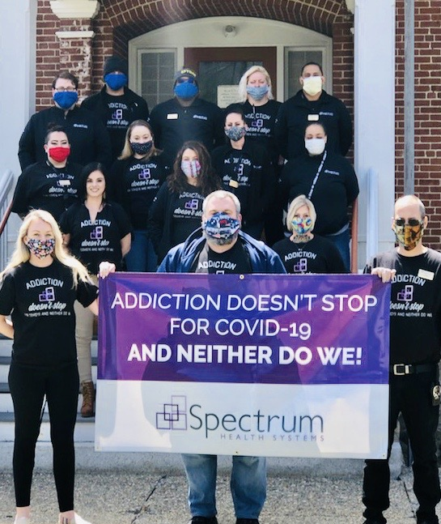

Spectrum Health Systems – What we do
Not-for profit organization
Founded in 1969 in Massachusetts
1,500 employees
5 states
This presentation will focus on our model of care in Massachusetts providing community-based addiction treatment services
Overview of Programs & Services

Slide 3
Spectrum’s Continuum of Care
Inpatient Services Westboro & Weymouth
Acute Detoxification and Clinical Stabilization
Longer-term Residential Treatment
Outpatient Services
MOUD (methadone, buprenorphine, naltrexone)
Rapid-access HUB for Buprenorphine/naltrexone
Intensive Outpatient Treatment Outpatient Counseling
Peer Recovery Support Centers
Outpatient Locations
Framingham
Haverhill
Leominster
Milford
Millbury
North Adams
Pittsfield
Saugus
Southbridge
Waltham
Weymouth
Worcester Lincoln St.
Worcester Merrick St.
Worcester Pleasant St.
Overview of Programs & Services

Slide 4
Inpatient/Residential Levels of Care
Acute Treatment Services- ATS
Inpatient “detox”-requires medical monitoring of withdrawal symptoms
Active 5-7 days typical length of stay
Clinical Stabilization Services- CSS
Individuals may have post acute withdrawal symptoms
May admit without need for detox first (non daily use, on MAT, stimulant use)
Requires intensive clinical monitoring; 2-4 weeks average length of stay
Residential
Often structured but level of structure depends on program
Varied length of stay by program type/patient need (1-3 mos, 6-9 mos, 1 year)

Slide 5
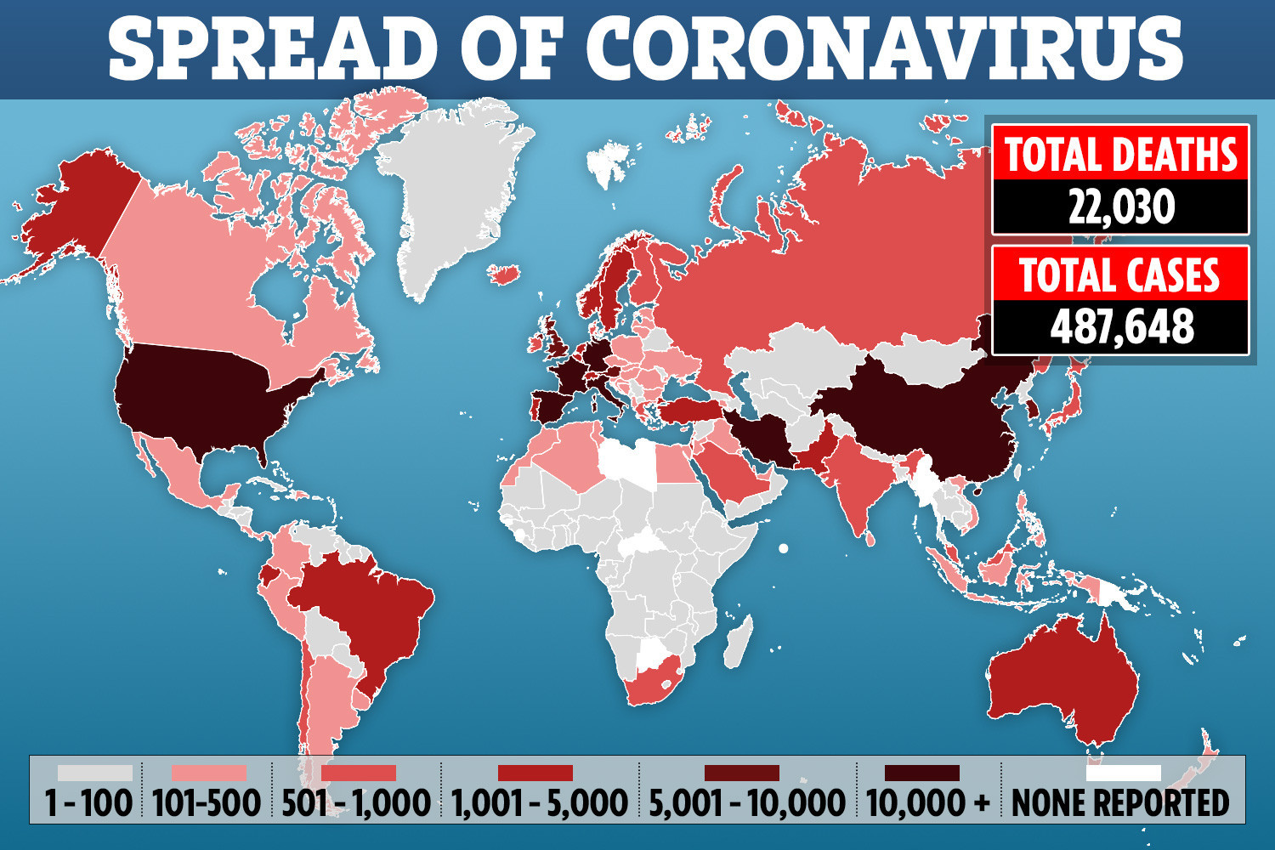
MARCH 2020

Slide 6
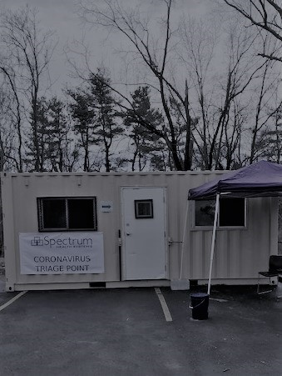
Implement a centralized Intake point for all programs on campus
Temperature checks
COVID-19 screening form

Slide 7
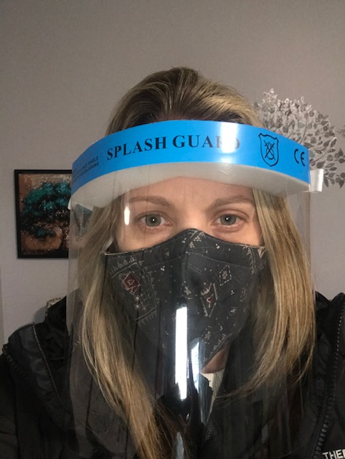
Number one priority: Make sure staff feel safe
We made an organizational decision that our response to this pandemic would only be as good as our staff
Options for level of PPE according to role and personal preference, always more, never less

Slide 8

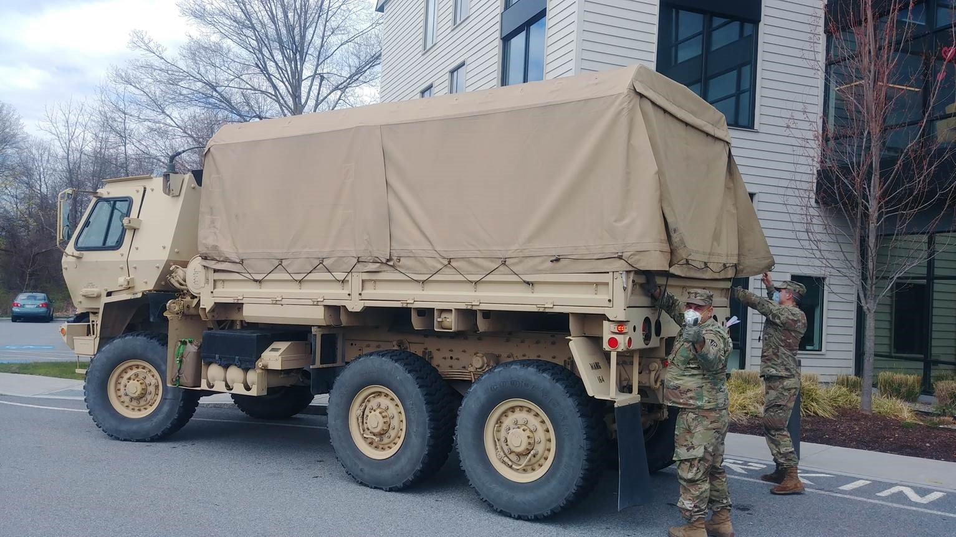
Response To Pandemic
Personal Protective Equipment (PPE) for all staff
MEMA provided PPE free of charge but we were still challenged to find items they didn’t have available.

Slide 9
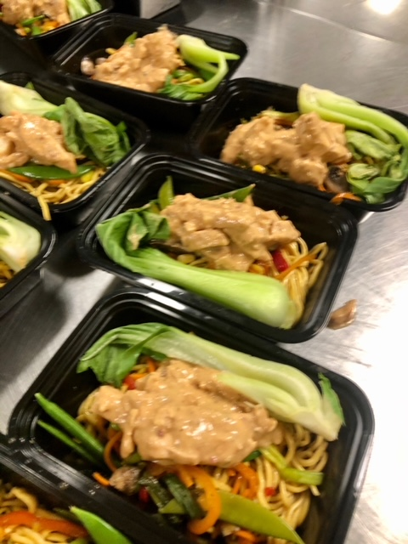
Response To Pandemic
Worked with food vendor to develop an emergency response plan
Find a way to keep the patients separated by unit while still providing three meals per day
Delivered food to eight different units

Slide 10
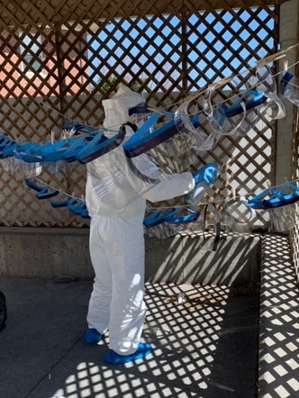
What to do with a positive case ?
We made decision early on to be transparent and communicate as much information as possible to staff and patients.
Create checklist to follow for each case
Closed down units where there were positive cases for 14 days to new admissions but offered patients ability to stay

Slide 11
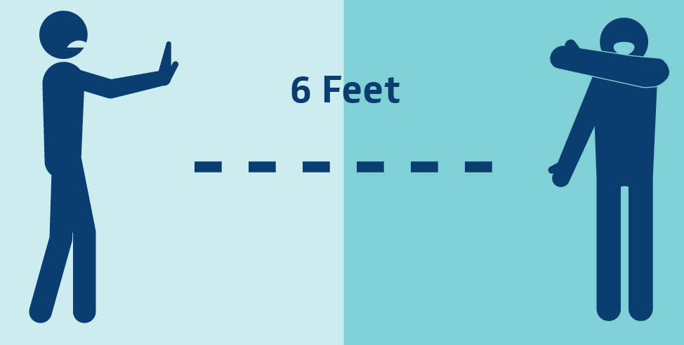
Response To Pandemic
Challenges with providing adequate clinical services in congregate care settings were immediately addressed
Reduced group sizes to allow for social distancing within the program- this was accomplished both by reducing the volume of groups but also offering multiple smaller groups covering the same topic
Conducted both group and individual sessions outside weather permitting and when possible utilizing outdoor recreation areas

Slide 12
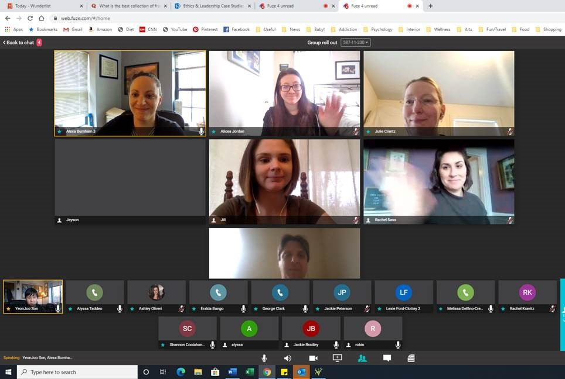
Response to Pandemic
Created a telehealth environment within the program for assessments and individual counseling sessions using both video and telephonic means to conduct sessions with the patient in 1 room and the clinician in the other
Focused clinical content on most relevant topics including overdose prevention and aftercare planning

Slide 13
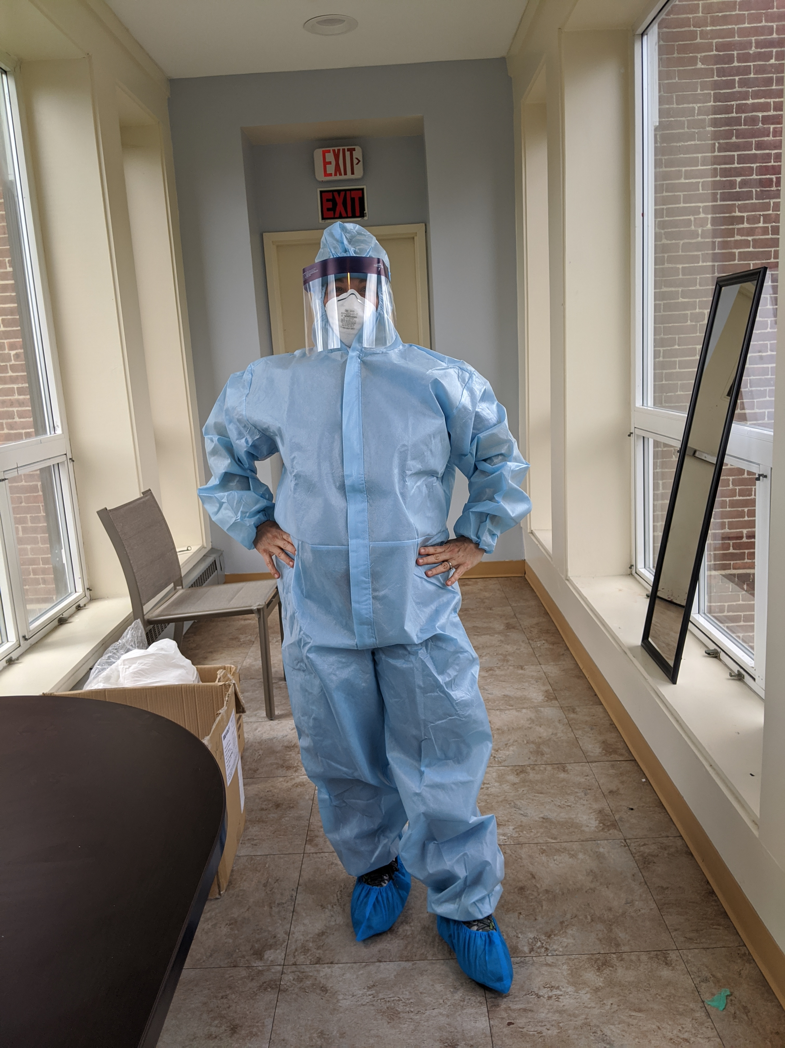
Launch a Specialty Unit to treat addiction & COVID-19
In response to both the COVID 19 pandemic and the continued need to respond to addiction treatment needs Spectrum, with the support of DPH and BSAS, has created a cohorted, isolated withdrawal management unit and clinical stabilization unit for patients who are COVID-19 positive on our Westborough campus.

Slide 14
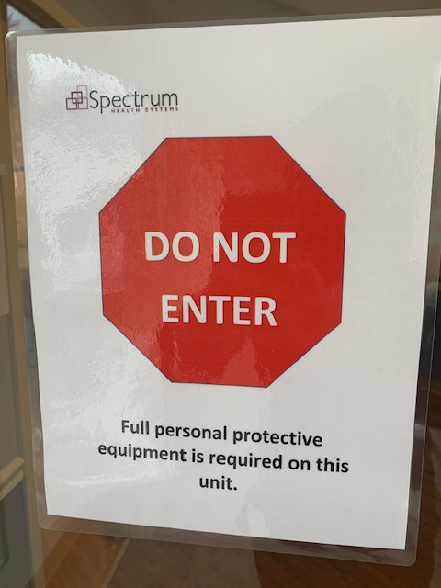
Specialized Unit
The goal of this unit to provide treatment to patients who are testing positive and thus prevent those patients from being placed into other community-based programs where they would expose other patients and staff to known active COVID infection
Clinical services are provided entirely by telehealth via tablets provided to each patient- utilizing doxy.me for clinical assessments and sessions
The tablets also have preloaded clinical materials as well as links to online self-help meetings and recovery content

Slide 15
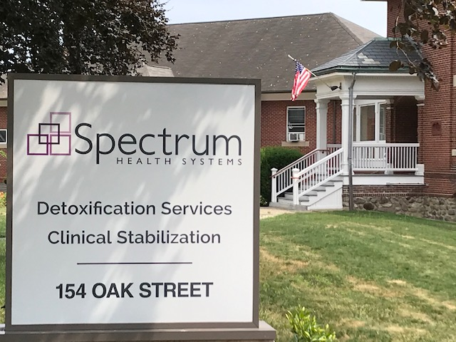
Think outside the box!
Where to locate the unit?
A “clean” area to don PPE and a “soiled” area to doff PPE
We didn’t have a perfect space, but we made it work

Slide 16
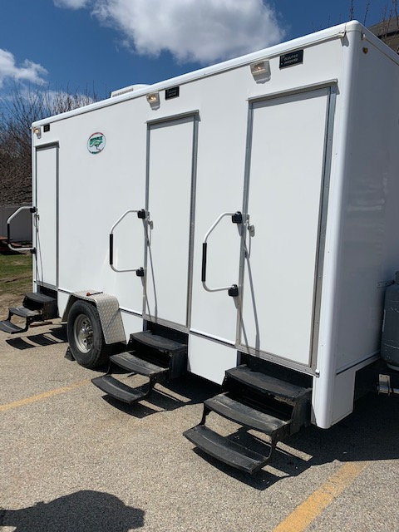
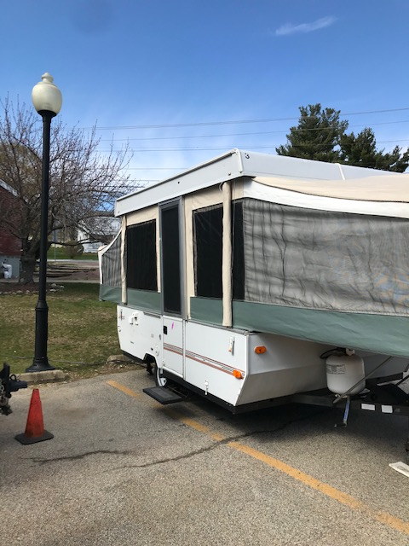
Think outside the box!
Where will staff on the specialized unit take their meal breaks?
Where will staff on the specialized unit use the facilities and change after their shift?

Slide 17
CASE STUDY
Gabe W. is a middle-aged man with an opioid use disorder
Gabe admitted to Spectrum CSS program on 8/28/2020
Gabe tested positive for COVID-19 on 9/10/2020 and was transferred to our specialty unit
Gabe tested negative for COVID-19 and was non-symptomatic. Transferred back to CSS on 9/20/2020
Gabe completed CSS and entered long –term residential treatment on 9/22/2020 where he remains today

Slide 18
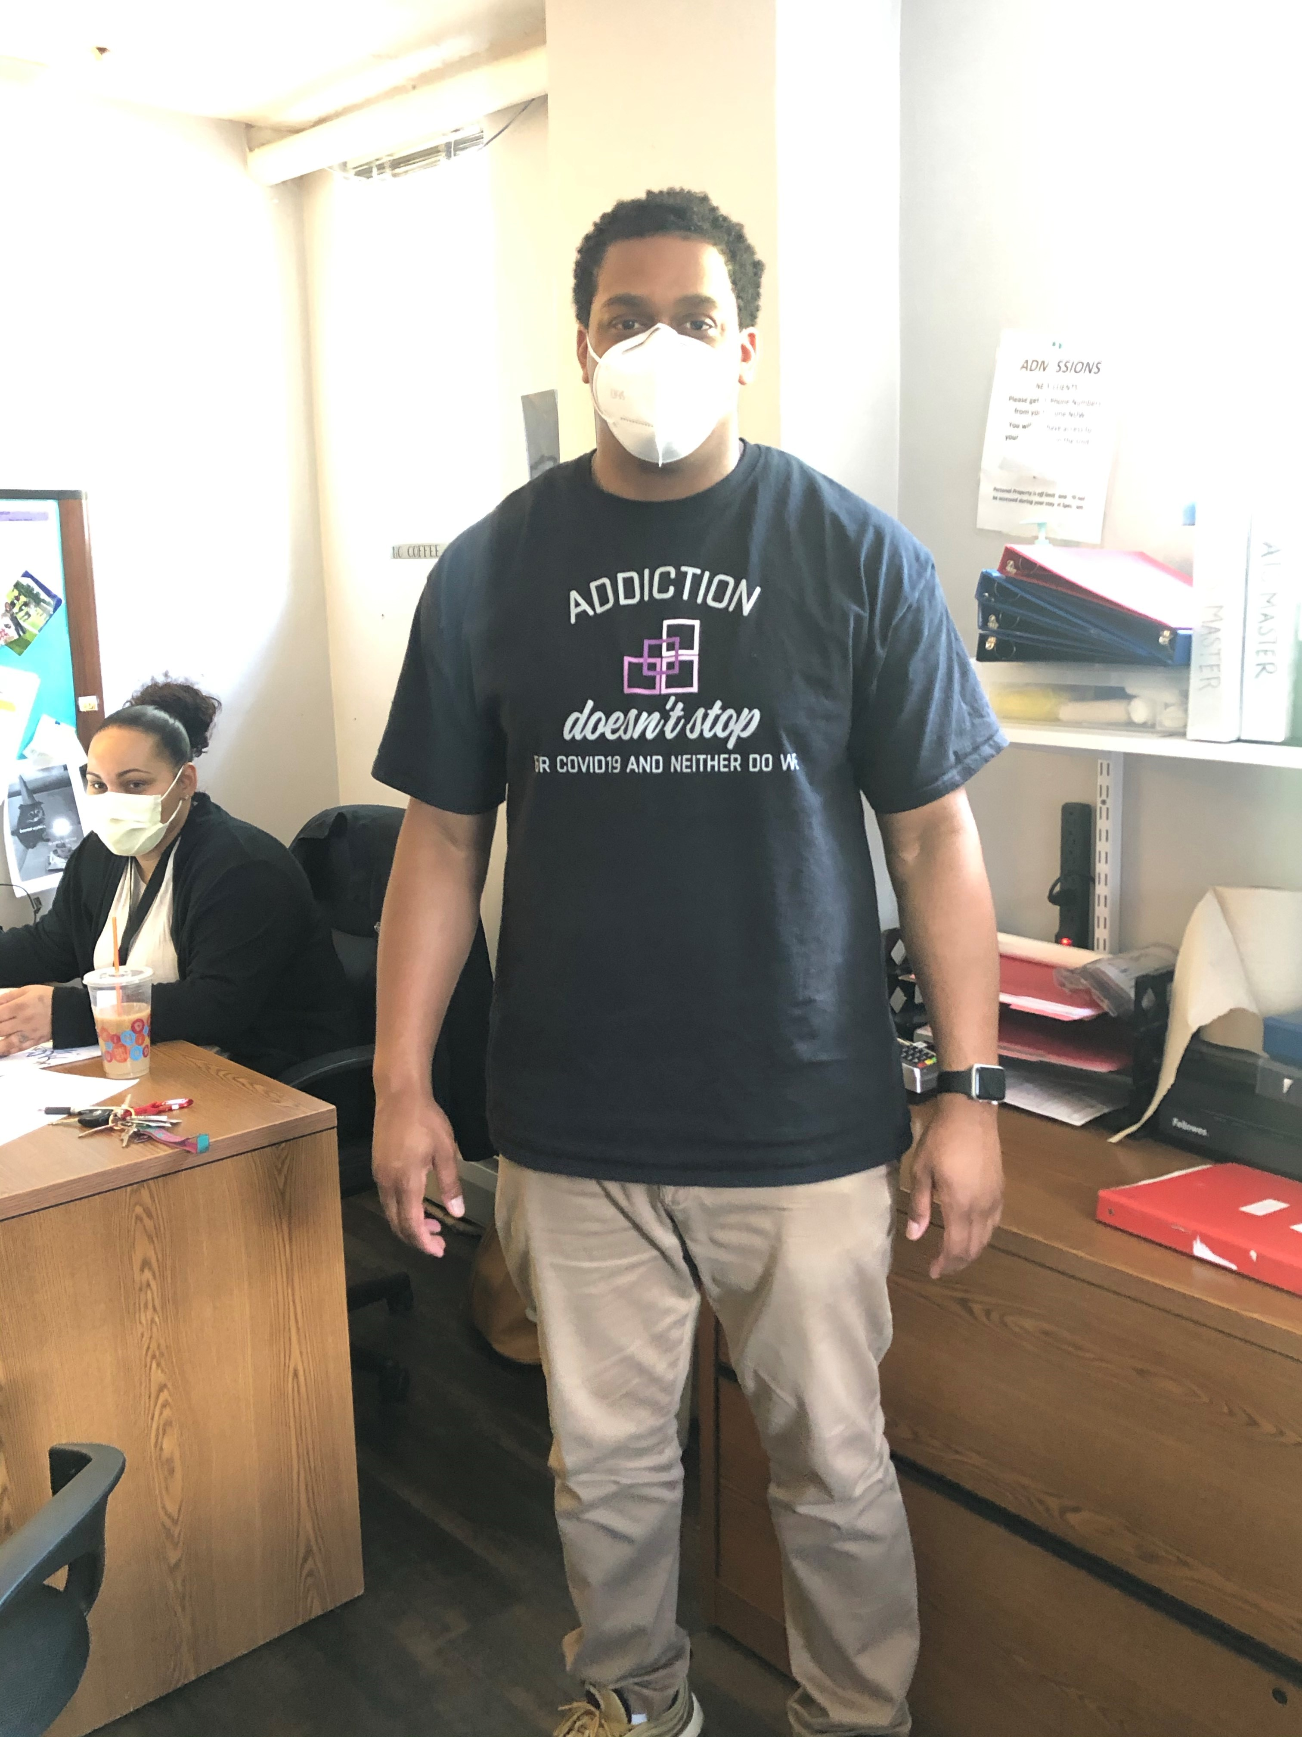
How to recognize staff’s work?
Provided staff with an hourly “hazard pay” increase for hours worked on site
Offered staff weekly lunches
Purchased small gifts for staff to recognize efforts

Slide 19
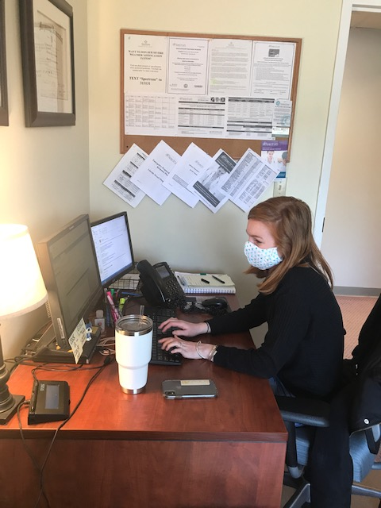
Telehealth Implementation in Inpatient Setting
Lessons Learned
When conducting assessments, clinicians found it helpful to have printed versions and “cheat sheets” available to patients to pre-complete some of the questions
“It’s super easy and helpful with social distancing in inpatient” and “the patients seemed to appreciate being able see who they are talking to.”
Although telephonic sessions are easy to implement and don’t require a lot of technology- conducting sessions via the phone requires a great deal more work for the clinician

Slide 20

Substance Use Treatment Considerations during COVID-19
Social isolation is challenging to all but particularly for those either striving for or in recovery- ensuring connectedness is important to support recovery
Isolation is also dangerous- the increased likelihood of substance use alone or hidden from household member increases the risk of overdose
Immediate access to care has never been more important
Education about overdose prevention is crucial at all points in the recovery process

Slide 21
Future of Addiction Treatment - Reimbursement
We know that this population has difficulty keeping up with the requirements of their insurance and therefore it becomes inactive, this has become more complicated with the pandemic because people are moving around more
It’s imperative that insurance verification take place daily and that we immediately work with a patient if his/her insurance become inactive to ensure reinstatement in a timely manner
Providers much be diligent in following the ever-changing reimbursement landscape; it’s important to make sure you are contracted to provide telehealth services and these codes are “unlocked”
for your agency
It’s important to attend informational sessions hosted by payors and read all guidance carefully to ensure the revenue cycle is not
interrupted

Slide 22
Future of Addiction Treatment beyond the pandemic
The ability for SUD treatment providers to adjust practices to respond to rapidly changing needs will continue to be necessary
Flexibility in how screening is conducted, how care is provided, and what aftercare planning looks like will continue to evolve as the pandemic evolves
We need to continue to find new ways to reach individuals in need, their families and loved ones to support the increased likelihood and risk of substance use over time
Telehealth is likely here to stay – its time to look at ways we can adapt this practice to provide seamless care across an individual’s recovery and across the broader healthcare system
Virtual platforms allow providers to provide care, communicate with providers across the care continuum

