Slide 1


Research Summary
COVID-19 Pandemic Impact on Patients, Families and Individuals
in Recovery from Substance Use Disorders
Jessica Hulsey
Addiction Policy Forum

Slide 2
Survey
COVID-19 Pandemic Impact on Patients, Families and
Individuals in Recovery from Substance Use
To better understand the impact of COVID-19 on individuals with substance use disorders (SUDs), the Addiction Policy Forum with funding support from NIDA administered a survey to our network of patients, families and survivors between April 27 and May 8, 2020.
The survey population comprises individuals who meet the following criteria:
Individuals with an active substance use disorder (SUD), in recovery from a SUD, receiving treatment for a SUD or a family member impacted by addiction.
1,079
Complete Surveys
533
Incomplete Surveys
46/50
States
Over the age of 18
COVID-19-related treatment service disruptions among people with single- and polysubstance use concerns, Mellis, Potenza, Hulsey – October 2020
Journal of Substance Abuse Treatment

Slide 3
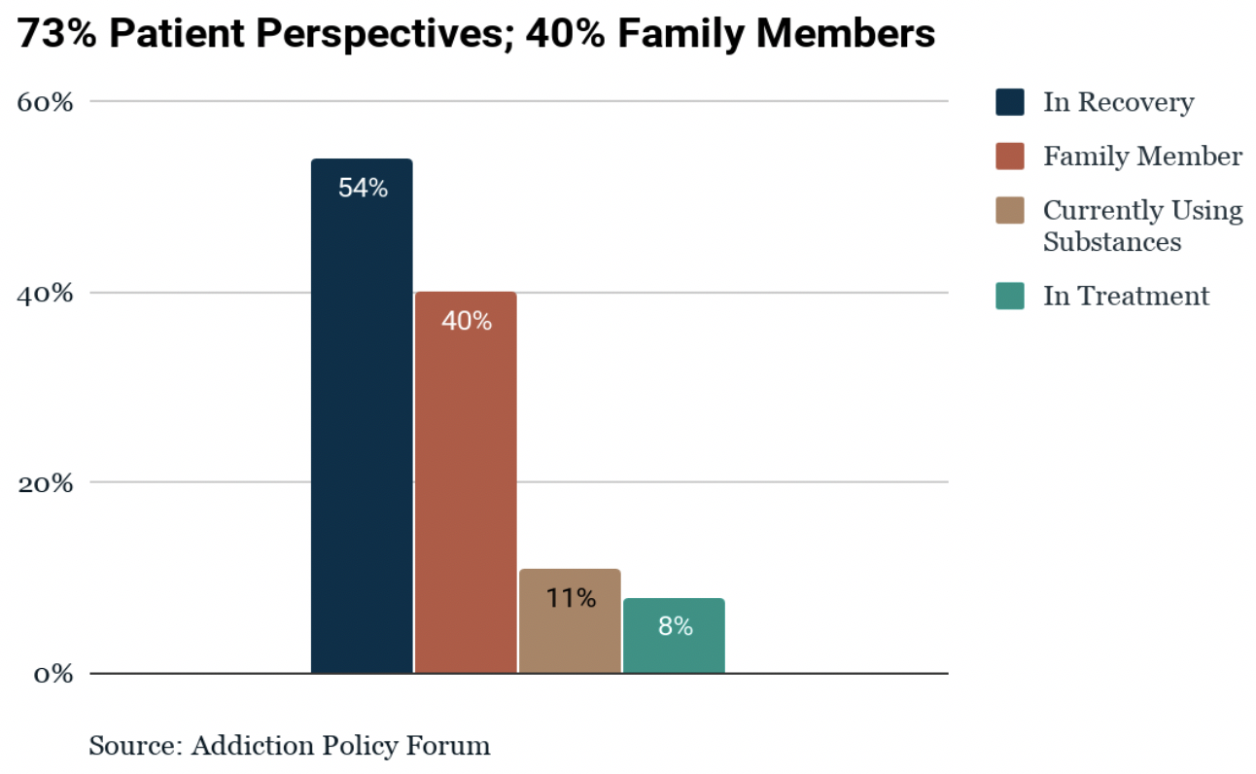
Results
Respondents from a Broad Cross-Section of SUD Impact
COVID-19 Pandemic Impact on Patients, Families and Individuals in Recovery from Substance Use
Addiction Policy Forum
N=1,079

Slide 4
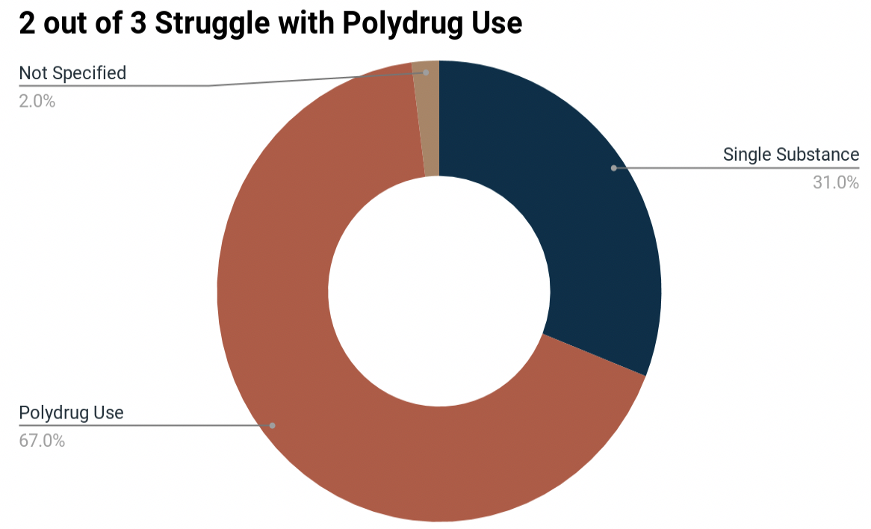
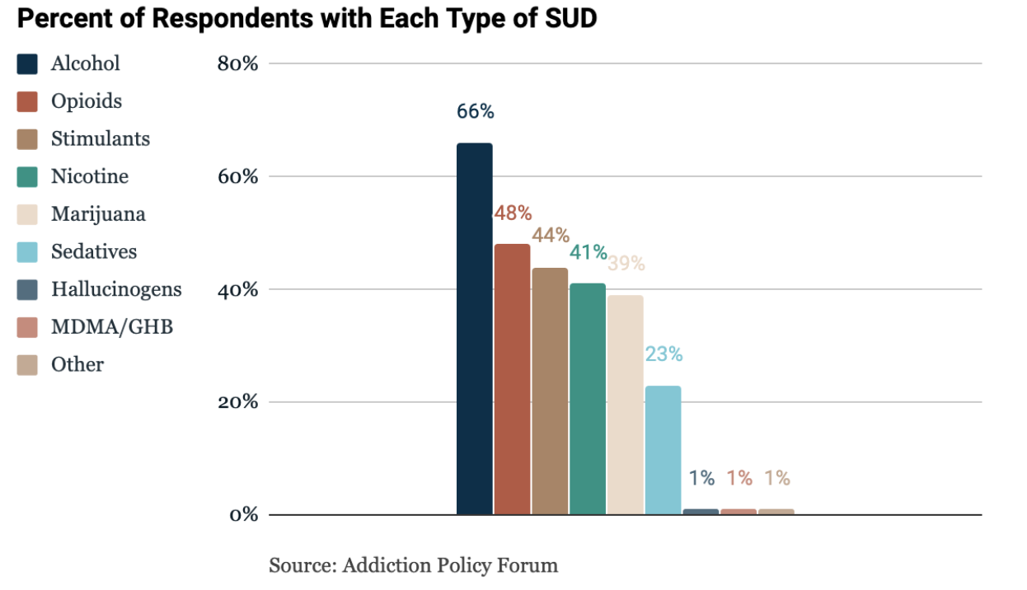
Results
Sixty-seven percent of respondents reported polydrug use, meaning more than one substance of issue was reported, while 31% reported a single drug of concern.
Types of SUD
COVID-19 Pandemic Impact on Patients, Families and Individuals in Recovery from Substance Use
Addiction Policy Forum
N=1,079

Slide 5
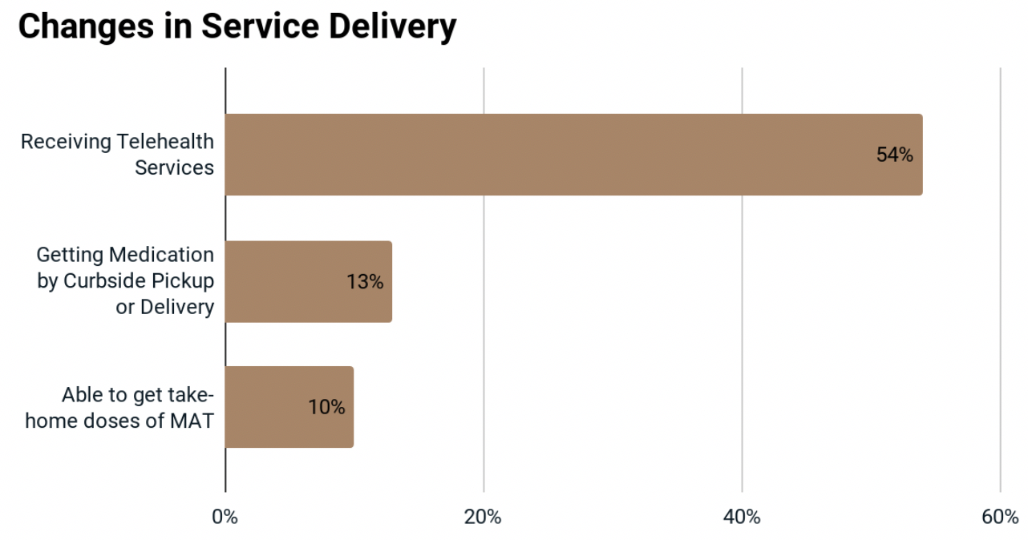
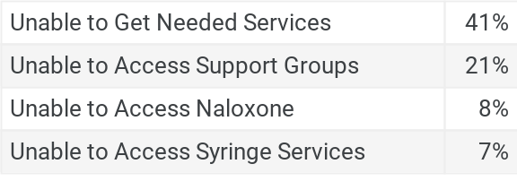
Results
Reduced Access to Treatment and Recovery Services During the Pandemic
1 in 3 respondents report changes or disruption in treatment or recovery support services
How Treatment is Changing
Among patients and families reporting changes in their service delivery, many report accessing modified access points.
Categories of Service Disruption
COVID-19 Pandemic Impact on Patients, Families and Individuals in Recovery from Substance Use
Addiction Policy Forum
N=1,079

Slide 6
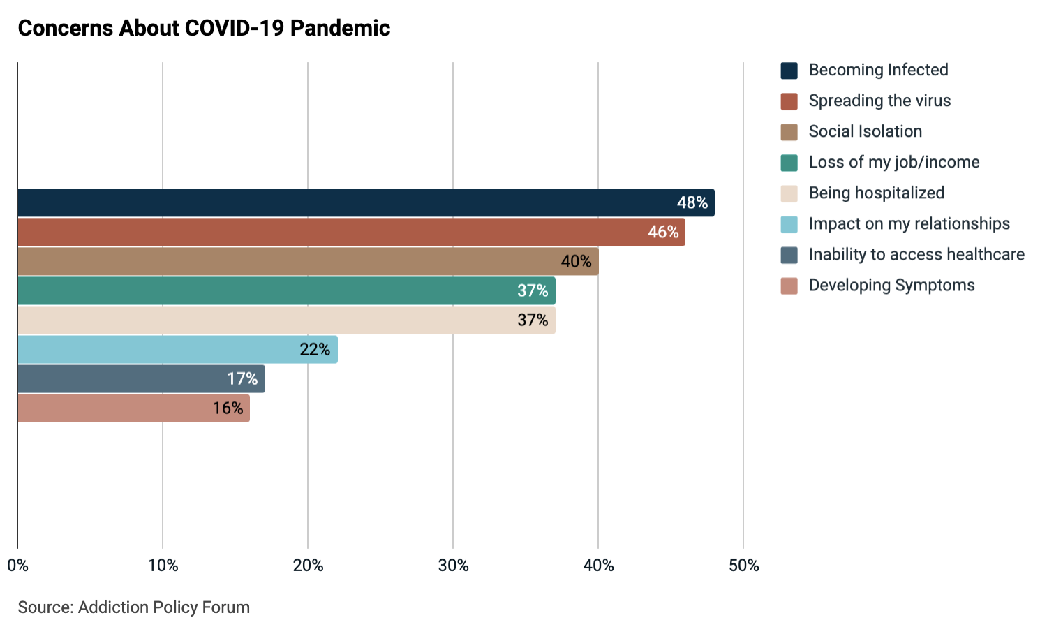
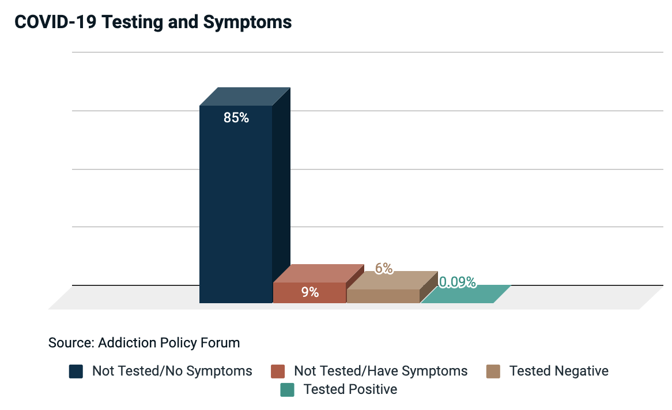
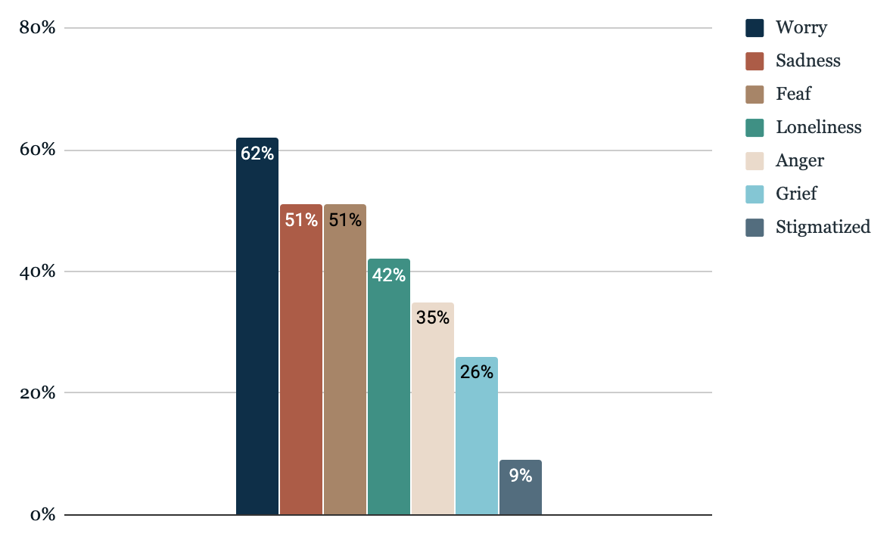
Results
COVID-19 Effects and Concerns
Overall, 74% of respondents say they had noticed changes in their emotions since the pandemic began. The percentage of those who reported emotional changes was higher among those who have had changes in treatment access. Among those who reported changes in treatment access, 87% report emotional changes.
Percent of Responses Endorsing Emotional Changes
COVID-19 Pandemic Impact on Patients, Families and Individuals in Recovery from Substance Use
Addiction Policy Forum
N=1,079

Slide 7
Results
Substance Use Behaviors & Overdoses
Percentage of Respondents Reporting Overdose by US Census Region
Twenty-four percent of responses indicate that their/their family member’s substance use has changed because of COVID-19. Of these, 83% say that that change was counter therapeutic, and substance use increased.
Nationwide three percent of respondents report a non-fatal overdose and 1% report a fatal overdose has occurred since the pandemic began. The South Atlantic region reported the greatest number and percent of overdoses.
6%
3-5%
1-2%
0%
COVID-19 Pandemic Impact on Patients, Families and Individuals in Recovery from Substance Use Disorders
Addiction Policy Forum
n=1,079

Slide 8
Results
Patient Perspectives
“
“
“
I would say living in a recovery through this time and not being able to be active in meetings has been disappointing when they keep liquor stores and weed shops open. This society is so twisted.
“Many people are dying from overdoses due to lack of face to face treatment being able to get admitted into residential treatment facilities.”
“I've known a few people who have started using again that had multiple years of recovery. This has made me anxious about my own recovery even though I haven't been tempted to use or planning to use.”
“
“
“
“I am in recovery and I lost my daughter in 2017 from an overdose. I feel like my grief was enhanced by this covid19.”
“My husband (who uses) has not been socially isolating, so I’m worried about us getting sick or getting my family sick.”
“I worry all of the time that my daughter may become so isolated she may make decisions not beneficial to her recovery.”

Slide 9
Survey
Key Takeaways
One in three respondents (34%) report changes in treatment or recovery support services due to the COVID-19 pandemic.
87% of those who report access disruptions also report emotional changes since the pandemic began, compared to 72% of those who do not report access disruptions.
3% reported a non-fatal overdose and 1% reported a fatal overdose since the pandemic began.
48% of patients and families reported fear of becoming infected with COVID-19 as a top concern, followed by spreading the virus (46%) and social isolation (40%).

Slide 10
Questions
The Need for More Research
What are the effects of sudden changes in treatment, including virtual options, curbside pickup, and an overall reduction in in-person services?
What are the impacts of COVID-19 on overdoses, at a regional and national level?
Do rates of overdoses, or overdose fatalities, change as drug and treatment supply chains shift?
How do the colliding epidemics of COVID-19 and substance use disorder interact?
When people with SUD do have COVID-19 symptoms, are they likely to pursue or receive testing and treatment? Is the clinical care they receive impacted by the stigma associated with their SUD?
What are the effects of isolation and overall stress on long-term recovery?
COVID-19 Pandemic Impact on Patients, Families and Individuals in Recovery from Substance Use Disorders
Addiction Policy Forum
n=1,079

Slide 11
Info
Demographics
Demographics
Race | White | 88%
 | Black or African America | 4.4%
 | American Indian/Alaskan Native | 1.7%
 | Asian | 1.2%
 | Native Hawaiian or other Pacific Islander | .2%
 | Other | 5%
Ethnicity | Non-Hispanic | 88%
Gender | Female | 66%
Age | 18-25 | 4.3%
 | 26-40 | 33%
 | 41-60 | 45%
 | 61 or older | 17%
Education | Less than high school | 1.1%
 | High school graduate (includes equivalency) | 12%
 | Some college, no degree | 24%
 | Associate’s Degree | 11%
 | Bachelor’s Degree | 27%
 | Graduate of professional degree | 25%

