Slide 1
Notes:
https://www.youtube.com/watch?time_continue=165&v=zl-pDUK6Zr8

Slide 2
Introduction
Mary Cole, MPH, CHES
Program Coordinator
Greater Boston Tobacco-Free Community Partnership
Bay State Community Services
Notes:
Briefly explain what your program is and what you do. Explain that the purpose of this presentation is to inform people about the tobacco industry tactics being used to hook youth – namely making their products sweet, cheap and easy to get. The presentation concentrates on e-cigarettes and vaping.

Slide 3
Disclosure
Tobacco-Free Community Partnerships are funded by the Massachusetts Tobacco Cessation and Prevention (MTCP) program to support communities’ efforts to help people quit using tobacco, prevent youth from starting, and protect everyone from secondhand smoke.
Do not receive funding from the tobacco and vaping industries or work to further the interests of these industries in any way.
Notes:
Notes:
You can explain that you are disclosing this information so that the audience knows your funding source.
Explain that sometimes in this work organizations may develop curricula for youth prevention or request to work together in a community. While their intentions may appear positive, they may be funded by the tobacco and vaping industries.

Slide 4
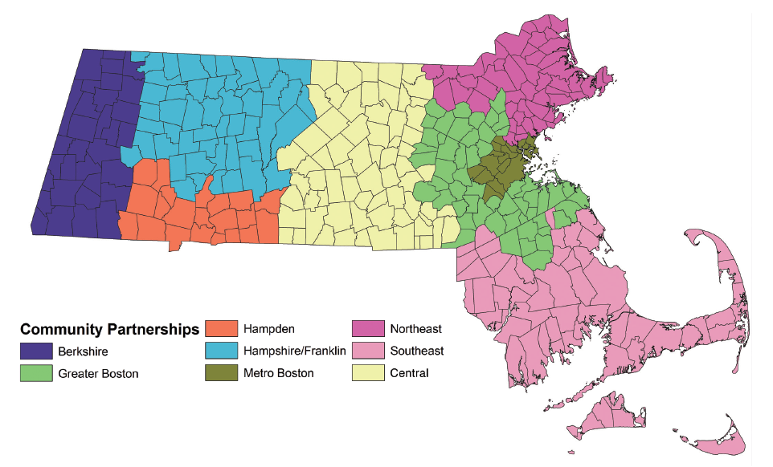
Tobacco-Free Community Partnerships
www.MakeSmokingHistory.org/My-Community

Slide 5
Where do we go from here?
Same Tactics – New Products
Best Practices for Prevention
  Communities
  Health Care Providers
  Schools
  Parents
Promote Cessation

Slide 6

Same Tactics – New Products

Slide 7








New and emerging products
https://www.richmond.com/swedish-match-starting-nationwide-rollout-of-tobacco-free-nicotine-pouch/article_ec408cb1-586a-50da-8e26-31caf74bddf1.html
Notes:
Talking Points:
Tobacco and vaping companies appear to be introducing many new types of e-cigarettes that are sleek, concealable, and modern.
Some vendors state that they can’t keep up with the volume of new e-cigarette products.
Major tobacco companies and independent companies are producing these types of e-cigarettes.
Many of the new e-cigarettes closely resemble the design features of JUUL. In addition to the JUUL style that look like a USB stick, new concealable e-cigarettes have been introduced in additional shapes.
Companies are also now introducing pre-charged, completely disposable e-cigarettes. (From Campaign for Tobacco-Free Kids)

Slide 8
Best Practices for E-Cigarette Prevention
Comprehensive town/city tobacco regulations – educate legislators
Flavored tobacco restriction & retail tobacco permit capping
Schools adopt best practice e-cigarette curriculum
Recommendations at www.GetOutraged.org under schools
Parents/Caregivers talk to kids early and often.
Correct misperceptions and provide reputable facts
Peer to peer education
The 84 Movement: www.the84.org
Local media to educate community
Newspaper, social media, blogs, TV, newsletters, radio etc.
Health systems include e-cigarettes
Pediatricians and doctors screen for e-cigarettes use and promote cessation

Slide 9
What can COMMUNITIES do?

Slide 10
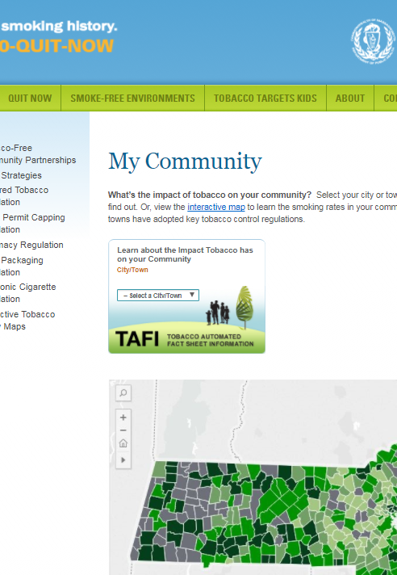
Support strong town/city tobacco regulations
Notes:
Tell your audience that many people think the tobacco problem is solved. It’s not. The youth cigarette smoking rate continues to decrease in Massachusetts, but 2,500 young people still become cigarette smokers every year in our state. Plus, young people’s use of other tobacco products and e-cigarettes has increased dramatically over time.
Strongly encourage your audience to support local strategies and policies:
Restricting sales of flavored tobacco products to adult-only establishments
Minimum cigar pricing
Pharmacy bans
Capping number of tobacco retailers
Include e-cigarettes in the smoke-free workplace law
Frame raising the minimum age of purchase to 21 as an effective part of a comprehensive strategy.
Important: Visit http://makesmokinghistory.org/my-community/ to learn more and support local strategies

Slide 11
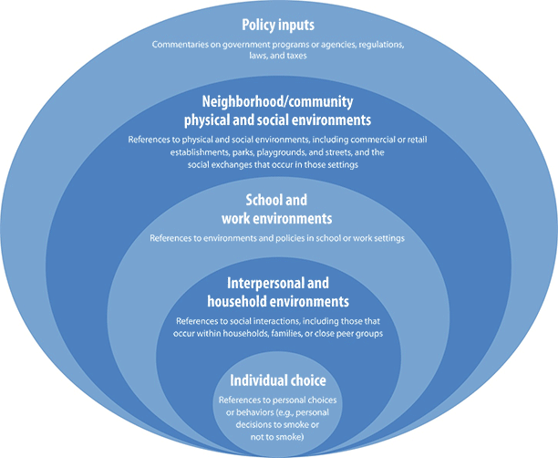
Social Ecological Model
Notes:
https://www.cdc.gov/pcd/issues/2013/12_0204.htm

Slide 12

Use tailored local media to educate community
  Newsletters
  Email blasts
  Social media
  Newspapers
  Radio
  Podcasts
  Community Access TV
  Magazines
  Blogs

Slide 13

The New Look of Nicotine Addiction
DPH Adult Education Campaign for parents and youth-serving adults
Information about products, how to talk to your kids about vaping, and a school/ community based organization toolkit with resources and information
  www.GetOutraged.org
Free materials available at the MA Health Promotion Clearinghouse
  www.mass.gov/maclearinghouse

Slide 14

Vapes and Cigarettes: Different Products. Same Dangers.
DPH Youth Education Campaign: Emphasizes the connection between smoking cigarettes and vaping
Call to action for youth to website
  www.mass.gov/vaping
Posters, handouts, mirror clings for schools and community-based organizations available free of charge via the MA Health Promotion Clearinghouse
  www.mass.gov/maclearinghouse
Notes:
Notes:
Information on how to implement this campaign in your school or organization is found at GetOutraged.org under “For Schools” as well as in the Toolkit that can be downloaded.
Materials can be ordered from the MA Health Promotion Clearinghouse.
The campaign was tested with MS and HS youth in focus groups across the state. The Department of Public Health found that youth wanted the facts about vaping and also didn’t make the connection between cigarette smoking and vaping. Youth know smoking is dangerous but they don’t think the same thing of vaping.

Slide 15
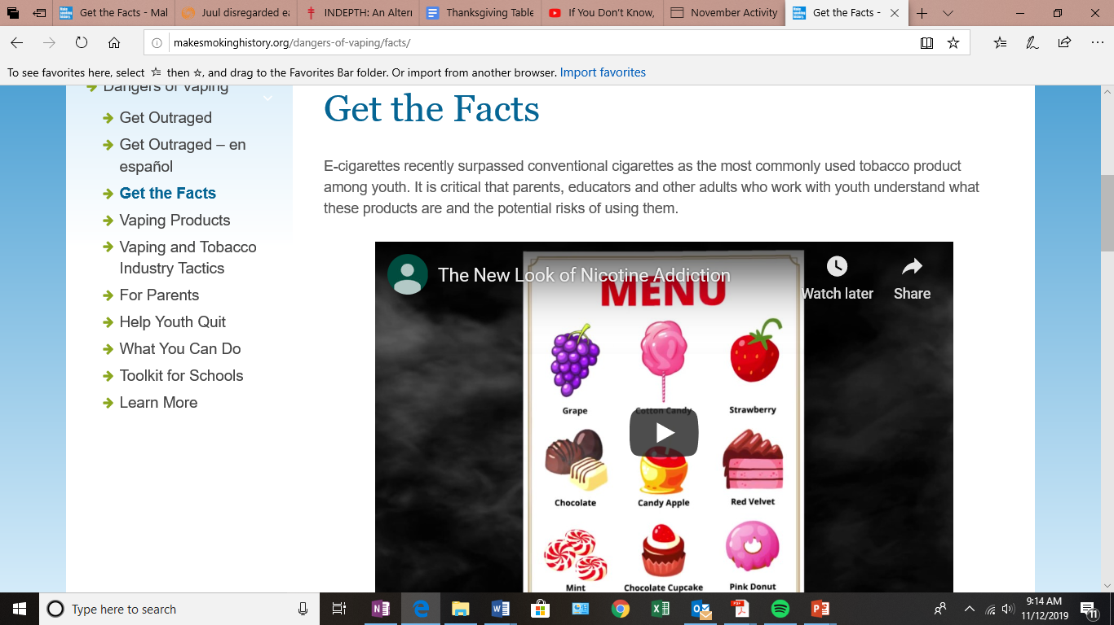

Slide 16
What can health care providers do?

Slide 17
AAP - Supporting Youth who are Addicted to Nicotine: Advice for Pediatricians
Ask the Right Questions
  “Do you use any vaping products, like e-cigarettes or JUUL? Have you used them in the last year?”
Talk with Youth About Quitting
  Provide clear, personalized guidance about the negative health impacts of vaping
Help Youth make a Successful Quit Plan
  Utilize cessation support services
  Consider pharmacotherapy for youth who are moderately or severely addicted
  If the youth is not ready to quit completely, discuss strategies for cutting back and revisit the topic at their next visit
Follow Up
https://downloads.aap.org/RCE/Factsheet_Supporting_Youth_Addicted_to_Nicotine.pdf
Notes:
https://downloads.aap.org/RCE/Factsheet_Supporting_Youth_Addicted_to_Nicotine.pdf

Slide 18
What can schools do?

Slide 19

Know quality programming
If a tobacco or vaping company is involved, don’t use it!
This includes resources, curricula, or cessation programs that are funded by or associated with the tobacco and vaping industries
Best way to know…. ASK!
Notes:
make a clear statement about not using any resources/curriculums/cessation programs funded from the tobacco/vaping industry, associated with the industries, or further the interest of the industries. Also tell them that they should ask organizations they work with or plan to work with (especially if they are private) if they are associated with the industry in any way.
Mention VICE

Slide 20

Schools should update curriculum to address vaping
Best practice curriculum available at www.getoutraged.org in “for schools” tab
E-Cigarette Prevention: CATCH My Breath
  CATCH (Coordinated Approach to Child Health). A youth e-cigarette prevention program targeting ages 11-18.
  Divided into 4 sessions lasting 35-40 minutes each and uses a variety of educational strategies including: cooperative learning groups, group discussions, goal setting, interviews, and analyzing mass media.

Slide 21
Adopt Diversion and Cessation Programs
American Lunch Association - INDEPTH: An Alternative to Teen Nicotine Suspension or Citation
  Session 1 Getting the Facts: Breaks down the program for participants
  Session 2 Addiction: Explains the harmful effects of nicotine and tobacco products
  Session 3 Alternatives: Helps teens understand their urges and identify healthy alternatives to replace tobacco use.
  Session 4 Past, Present, Future: Talks about next steps and how to avoid future tobacco-related problems
https://www.lung.org/stop-smoking/helping-teens-quit/indepth.html

Slide 22

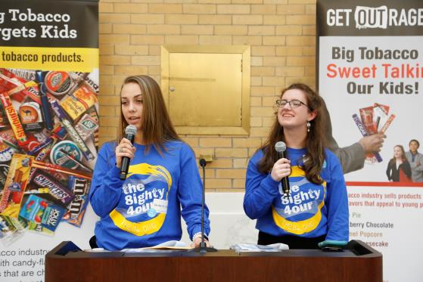
Peer to Peer Education - The 84
The 84 is a statewide movement of youth fighting tobacco in MA
  Formed through local organizations or high schools
  Expanding to middle schools (pilots)
  Youth educate peers and community members about the influence of the tobacco and vaping industries
Notes:
Talking Points:
The 84 is a statewide movement of youth fighting tobacco in Massachusetts.
The 84 represents the 84% of Massachusetts youth who did NOT smoke when the movement began. Now, 92% of youth do NOT smoke.
Youth groups in a high school or community organization who want to fight against Big Tobacco sign up to become an 84 Chapter and be a part of the movement.
What do The 84 Chapters do?
Educate their peers and adults about the tobacco industry’s marketing tactics
Help to create change locally and statewide to reduce the influence of tobacco in their communities
Survey youth and adults about their perception of the prices and availability of other tobacco products
Promote social norms messaging around youth tobacco use
Annually, The 84 Chapters actively engage in important tobacco prevention events.
More information can be found at https://the84.org/ or by talking to your local Tobacco-Free Community Partnership.

Slide 23

Start an 84 Chapter
The 84 Movement
Mini-grants
Statewide Events
Statewide Leadership Team
Trainings
Activities & Local Policy
Register: www.The84.org
Racial Justice
Notes:
Statewide movement
Tobacco prevention program
Empowering youth leaders
Exposing Big Tobacco’s tactics - Sweet, Cheap, Easy to get
Inclusive of anyone in high school who wants to join
Participate in trainings, community activities, and mini-grant projects
Work on local policy and attend statewide events
Who 84 targets (tobacco and vaping industries) and why
●The 84 is a statewide movement of youth fighting back against the tobacco and vaping industries and their sneaky tactics
●This movement is about helping other youth feel empowered to show local decision makers that we do not want to be targets
●We are a movement of inclusion, which means including EVERYONE
●Youth all over the state participate in the movement by getting trainings, doing activities in their school/community, conducting mini-grant projects, working on local policy initiatives, and attending statewide events with other youth in the movement
●We are a movement that works for local policy change via testifying at hearings, talking to local legislators

Slide 24
What can parents do?

Slide 25
Get the Facts
Learn as much as they can about vaping products: what they look like, common brand names, and where they are sold.
Provide youth with facts about vaping
  E-cigarettes contain nicotine
Dispel the myths
  It is not harmless water vapor
Tell them the tobacco and vaping industries are targeting them to make money and hook them on their products
Notes:
Community based organizations can change the word “students” in the title of this slide.
This slide is most relevant for a staff presentation.
Research shows that the more accurate a student’s perception of harm is about a product, the less likely they are to use it (Citation needed)
While the GetOutraged campaign is not directed to youth and it’s materials are not meant for youth, if there is an opportunity to provide youth with the facts about vaping and dispel some of the myths, this certainly can and should be addressed.
Please note that the Massachusetts Tobacco and Cessation and Prevention Program at the Department of Public Health is working on developing materials specifically geared toward youth.

Slide 26
Parents & caregivers talk with their kids early and often
Be patient and ready to listen
No “perfect time” to talk
Ask what they see and what they think
Be open and honest
Be supportive if helping child quit nicotine
Just talking can protect them!
Notes:
This slide is most relevant for a parent presentation
Talking Points:
Talking with your kids about vaping is one of the most important things you can do. Below are tips to help you prepare for and start the conversation.
Be patient and ready to listen. Your goal is to have a conversation, not to deliver a lecture. So avoid criticism and encourage an open dialogue.
There is no “perfect time” to talk. Driving in the car together or waiting at an appointment is often the best time. You can start by mentioning a news story, a TV show, or something that you heard about vaping. Or ask your child what he or she thinks about a situation you witness together such as seeing someone use an e-cigarette, passing a vape shop when you are out, or seeing an e-cigarette advertisement.
There is no “perfect talk.” Consider your talks with your child about vaping as a learning opportunity for both of you, and perhaps just the beginning of an ongoing dialogue. You may have some facts about vaping at hand, but concede that you don’t know all the answers. It will go a long way to keep your kids from going on the defensive.
Ask what your child thinks. Show some genuine curiosity. Ask your child, “What’s your take on vaping?” or “Do you know kids who use e-cigarettes?”
Be open and honest. Be truthful about what you know about the dangers of vaping, and what you don’t. You can honestly say, though, “Vaping isn’t harmless. I hope you can steer clear of it.”
You can’t always control everything your children do when they’re not with you. Talking with your kids about vaping will let them know that you’re concerned about their health.
Are you a tobacco user? Be honest and talk with your child about your choices and how hard it is/was to quit.
If you need help quitting tobacco, it’s never too late to keep trying. Call 1-800-QUIT-NOW or visit makesmokinghistory.org for information and support.

Slide 27
Strategies to educate parents
Use multiple communication strategies to reach parents/caregivers
  School newsletters
  School email blasts
  Social media (parent Facebook groups)
  Parent orientations
  Sports nights
  Coalitions
  TV
  Newspaper
Where does your community get their information?

Slide 28
Promote Cessation

Slide 29
Quit E-Cigarette Resources for Youth
This is Quitting by truth: Text “VapeFreeMass” to 88709
Free and confidential automated texting program for young people who vape. In partnership with MA DPH
www.ThisIsQuitting.com is a free digital quit program that integrates the text program
Talk to pediatrician
Visit teen.smokefree.gov for tools and tips
My Life My Quit: Text "Start My Quit" or Call 855.891.9989
Youth coaching specialists provide free and confidential text and call support for MA youth age 12 to 17
www.MyLifeMyQuit.com has additional resources and provides online real-time coaching
More information at mass.gov/vaping
Notes:
Truth Initiative® quitting resources now include a free, evidence-based text message program that gives teen and young adult e-cigarette users appropriate advice on quitting, as well as information for parents to help their kids quit. Created with input from e-cigarette quitters and Mayo Clinic, the program lets users set a quit date and delivers scheduled messages tailored to a user’s quit progress.
Signs of Addiction
You can't stop smoking. You've made one or more serious, but unsuccessful, attempts to stop.
You experience withdrawal symptoms when you try to stop. Your attempts at stopping have caused physical and mood-related symptoms, such as strong cravings, anxiety, irritability, restlessness, difficulty concentrating, depressed mood, frustration, anger, increased hunger, insomnia, constipation or diarrhea.
You give up social or recreational activities in order to smoke. You may stop going to smoke-free restaurants or stop socializing with certain family members or friends because you can't smoke in these locations or situations.

Slide 30
Upcoming Cessation Resources
Calling It Quit: Vaping was adapted from the smoking cessation program Calling it Quits, a nurse-led intervention developed by UMass Medical School, funded by the National Cancer Institute and used by schools throughout Massachusetts for many years. The program includes an updated 14-page program booklet, a nurse protocol used with the booklet, and scripts to guide nurses through 4 sessions working one-on-one with students. Piloting January 2020
Providers Guide is a 4-panel folder to help school nurses and other personnel use brief interventions to assist students with vaping cessation. Includes assessment of dependence (Hooked on Nicotine Checklist*), talking points on dependence, assessing readiness to quit, assisting with triggers and handling cravings. May be used to complement This is Quitting or used on its own to discuss vaping with youth. Available December 2019
Quitting Vaping – Information for Youth brochure includes a self-assessment of dependence, reasons to quit, tips for handling cravings and how to get started with the MA vaping cessation resources. Available December 2019
MA Resource Card – Includes a quick self-assessment of vaping dependence on one side and a list of vaping cessation resources for youth on the other side. Available December 2019

Slide 31
Quit E-Cigarette Resources for Parents/ Caregivers
Parents and other adults can also text “QUIT” to 202-899-7550 to sign up to receive text messages designed specifically for parents of vapers.
Encourage youth to sign up for My Life My Quit and/or This is Quitting programs.
Encourage young people to ask their school nurse or counselor, athletic coach, doctor, parent or other trusted adult for help.
More information for parents/adults is available at www.GetOutraged.org

Slide 32

Adults: Massachusetts Smokers’ Helpline
Call 1-800-Quit-Now
Tobacco & e-cigarette users can call for free phone counseling & make a quit plan
Up to eight weeks of free Nicotine Replacement Therapy (18 +)
www.makesmokinghistory.org

Slide 33
Contact Information
Mary Cole
Program Coordinator
Greater Boston Tobacco-Free Community Partnership
Bay State Community Services
Email: mcole@baystatecs.org
Phone: 617- 471-8400 x 138
Website: www.MakeSmokingHistory.org

