Slide 1

Vaping – industry marketing strategies and policy options
Cheryl sbarra, j.d., senior staff attorney
Director of policy and law
Massachusetts association of health boards
Regis college – president’s lecture series November 13, 2019

Slide 2

disclaimer
This information is provided for legal education purposes only. It is not intended to constitute legal advice.

Slide 3
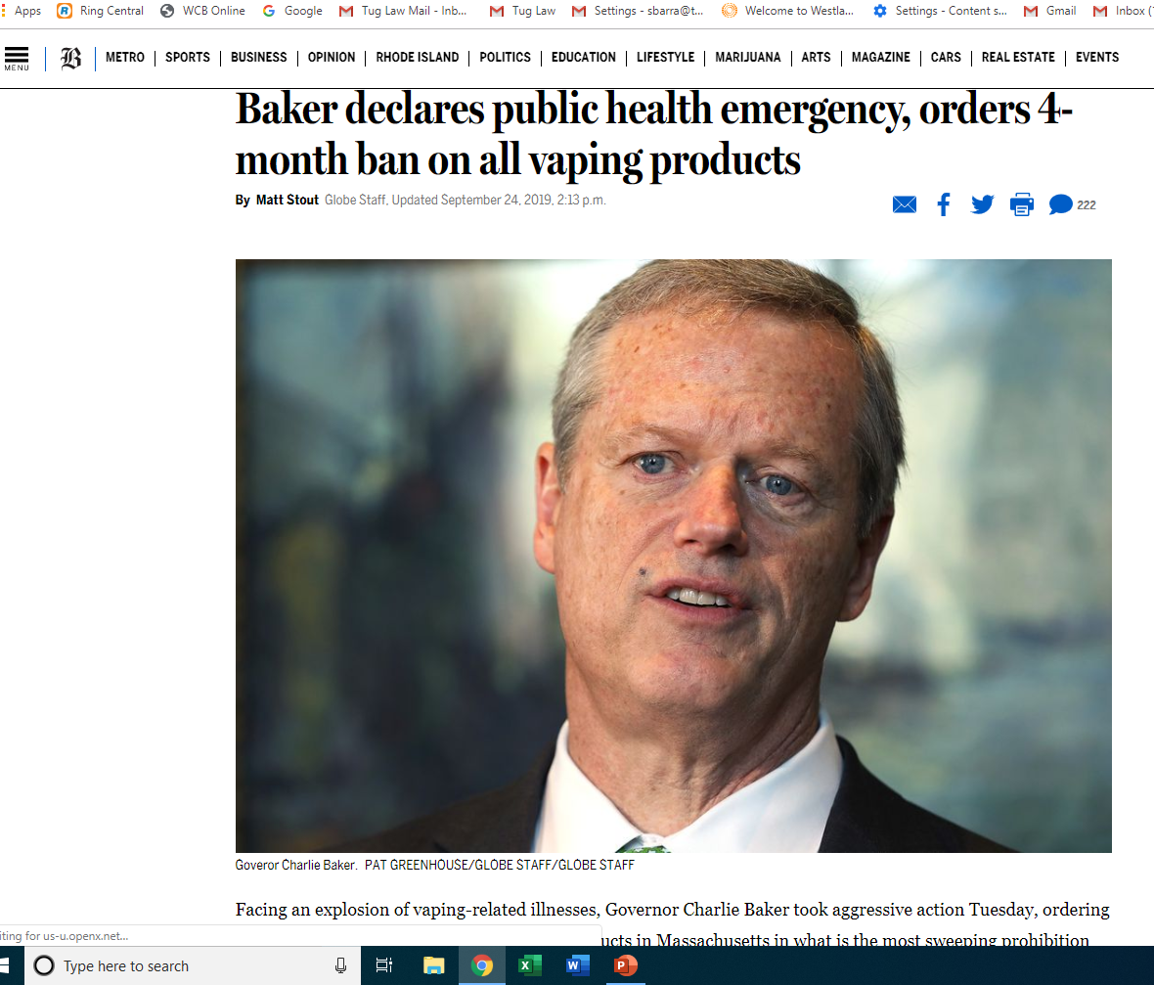

Slide 4

Why?
Met with addiction specialists, pulmonologists and pediatricians who warned the situation will only get worse because the cause is unknown.
“This is not something you should screw around with.” (https://www.bostonglobe.com/metro/2019/09/24)
US public health regulators agree and are diligently investigating.
  CDC admits this should have happened earlier.

Slide 5

Current national status
11.7.19
More than 2051 illnesses across 49 states, DC and 1 U.S. Territory
40 deaths in 18 states.
86% THC (but not exclusively THC)
  34% exclusively THC
64% Nicotine (but not exclusively Nicotine)
  11% exclusively Nicotine
One common link – use of electronic cigarettes and other vaping products.
CDC website has updated information.
CDC reports Vitamin E acetate could be “a culprit”

Slide 6
Current status in Massachusetts 11.06.19
200 reported cases.
61 confirmed and probable cases.
  Three deaths – Northampton, 60-year old female, just nicotine and 40-year old female, just nicotine, male in 50’s nicotine and THC.
82% required hospitalization.
Of the confirmed and probable cases:
  30% nicotine only.
  39% THC only.
  25% both nicotine and THC.
  Other causes negligible.

Slide 7
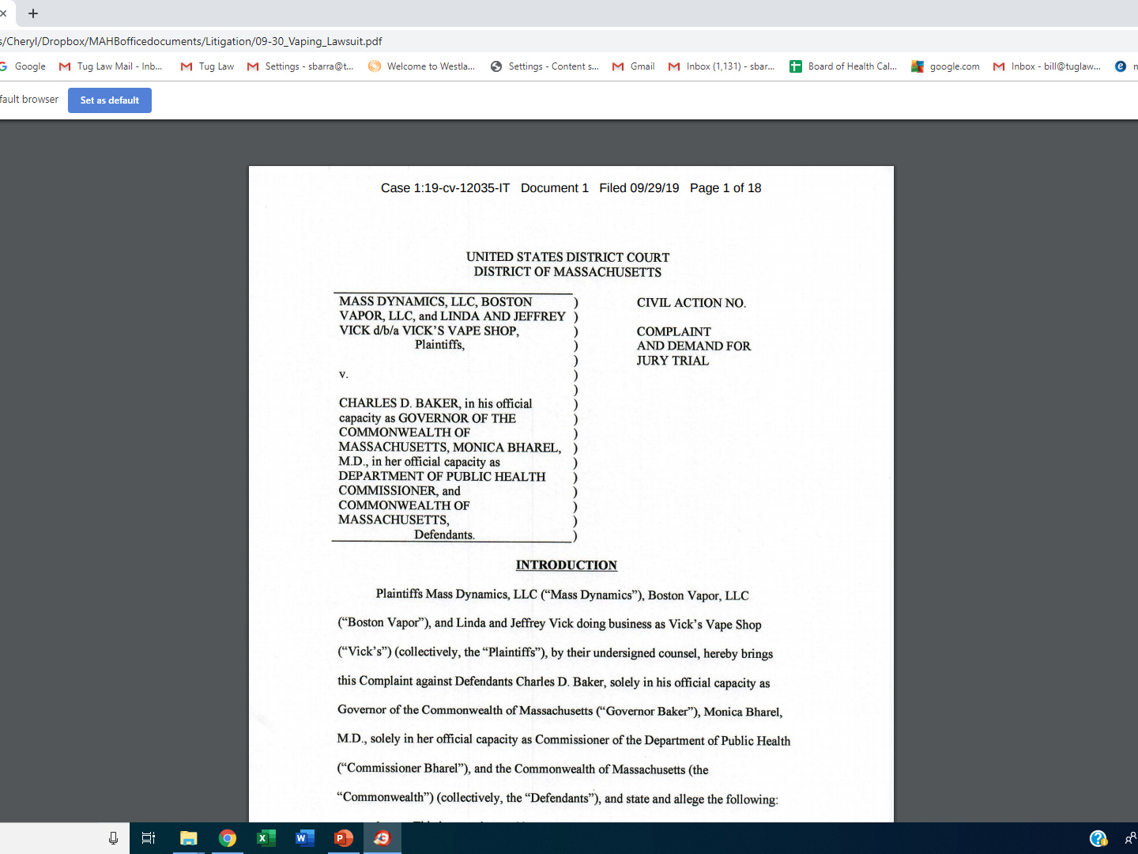

Slide 8

Severe lung disease associated with vaping products 105 cmr 801.000
Emergency Health Regulation adopted by Public Health Council 10.25.19.
  Judge did not uphold Emergency Order.
Hearing scheduled for 11.22.19.
Small business impact statement filed with Secy. of State.
  $7 to $8 million potential business cost.
Effective for 3 months.
Same enforcement mechanism.

Slide 9
Cannabis control commission
11.12.19
Ordered licensed shops and dispensaries to quarantine all marijuana oil vapes.
  Temporary ban.
Removed ban on “flower vaporizers” for medical marijuana patients.
  Separate category of device.
    Battery-powered devices that directly heat up ground-up marijuana flower.

Slide 10
Enforcement
Nicotine products found in convenience stores, gas stations, adult-only retail tobacco stores
  Boards of Health
  Police
CBD products
  Massachusetts Department of Agricultural Resources (MDAR)
Cannabis products
  Cannabis Control Commission
    Looking at regulations

Slide 11
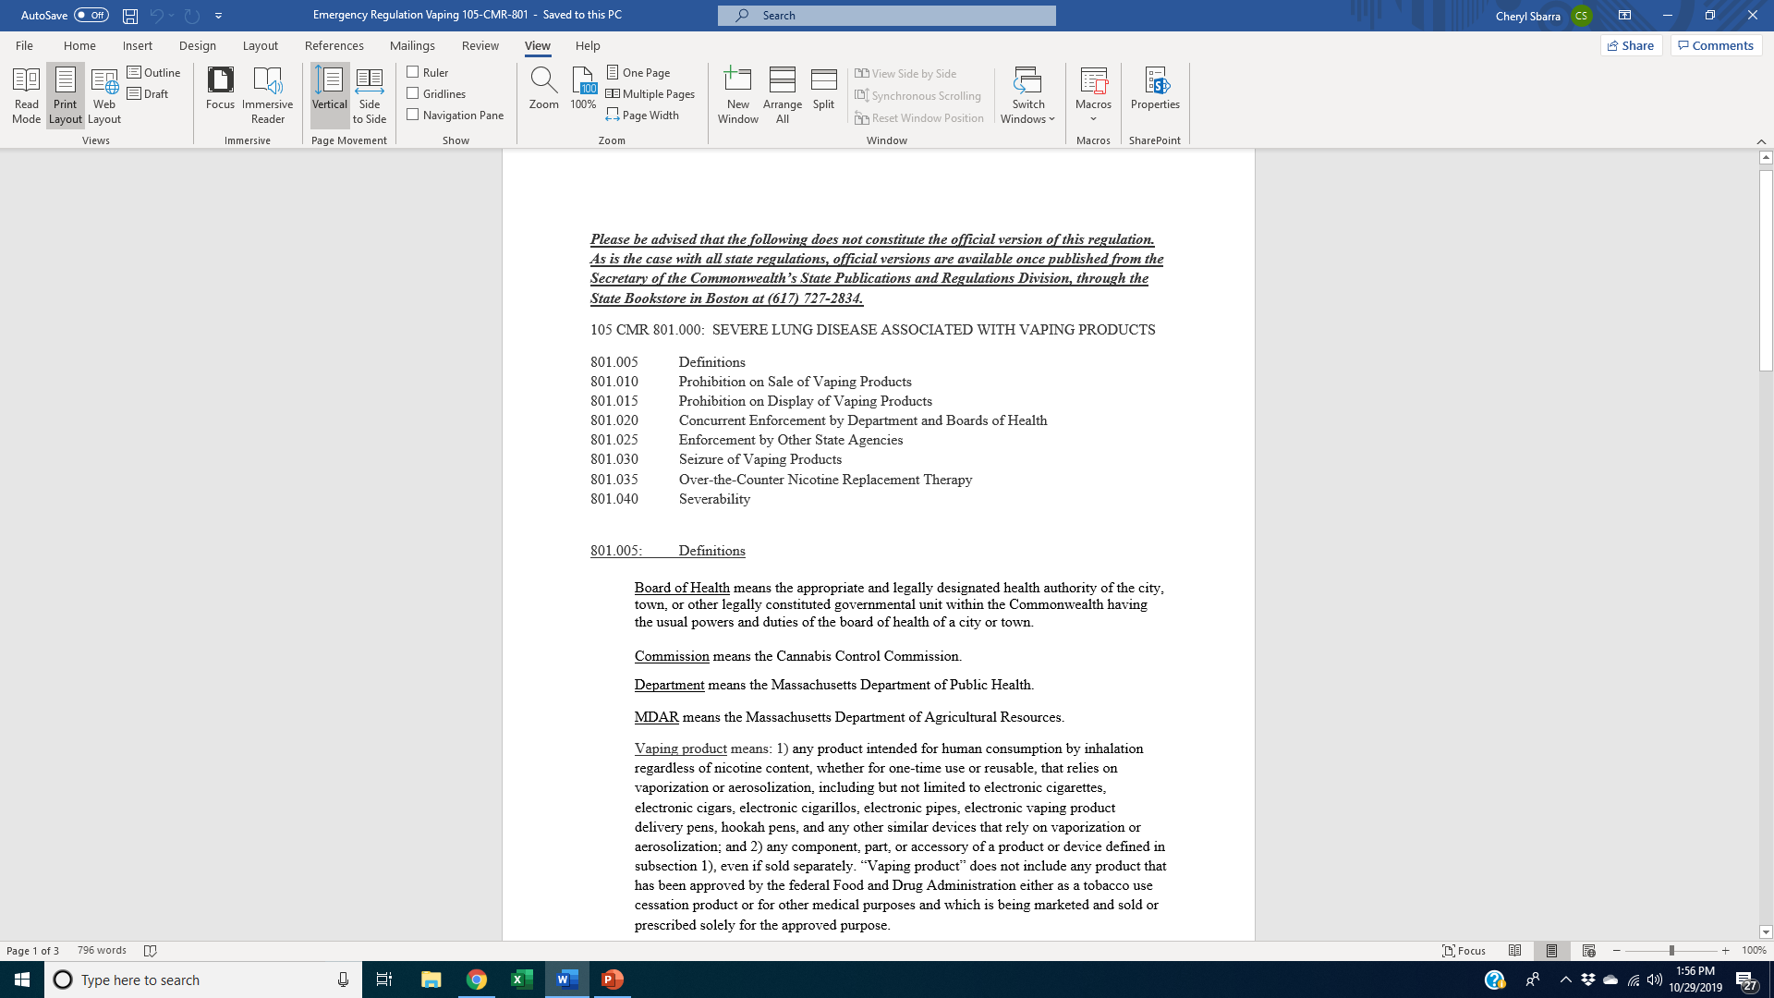

Slide 12
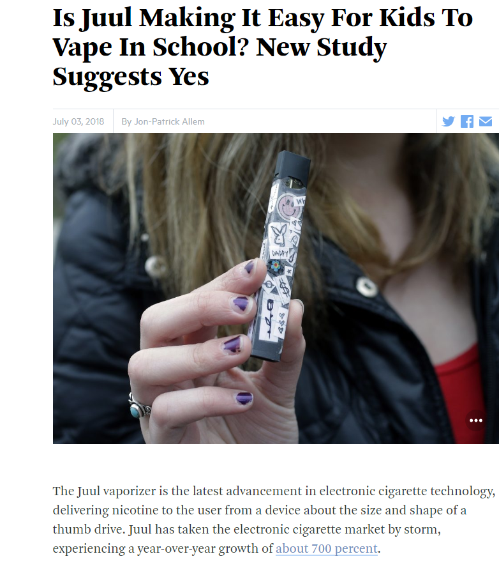
Vaping basics
Current use of cigarettes among high school students has decreased by 82% since 1995 (35.7% to 6.4%). (Youth Tobacco Use in Massachusetts, Department of Public Health, March 2019)
In contrast, current use of e-cigarettes among students is 20.1%. (MA YRBS 2017)
  Increased 78% for high schoolers and 48% for middle schoolers.
Juul’s unique design, high nicotine content and affordable price make it a student favorite (coupons, specials, etc.)

Slide 13
E-Cig use among youth
Juul was valued at $ 38 billion in the summer of 2018.
  Juul owns about 75% of the market.
  Philip Morris bought 35% of Juul for $12.8 billion.
“I took a hit, and another. Each one was a white spike of nothing: a pop, a flavored coolness, as if the idea of a cucumber had just vanished inside my mouth. . . To Juul . . . is to inhale nicotine free from the seductively disgusting accoutrements of a cigarette: the tar, the carbon monoxide, the garbage mouth, the smell.” (New Yorker article)

Slide 14
Current tobacco sales template highlights
New statement of purpose sections to include menthol
New definition of “tobacco products”
New definition of “adult-only retail tobacco store”
New option to cap number of “adult-only retail tobacco stores”

Slide 15
Statement of purpose
Whereas the U.S. Food and Drug Administration and the Tobacco Products Scientific Advisory Committee concluded that menthol flavored tobacco products increased nicotine dependence and decreased success in smoking cessation;
Whereas menthol makes it easier for youth to initiate tobacco use;
  Citations included.

Slide 16
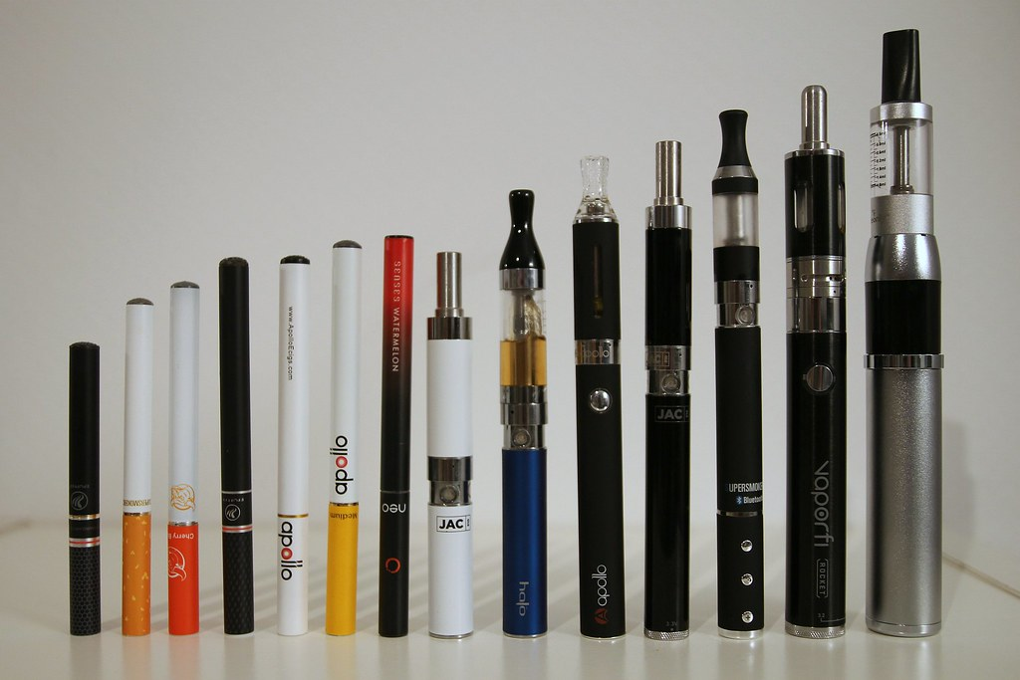
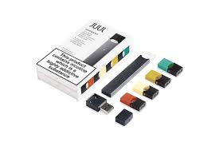
“Tobacco Product” definition
Any products containing, made, or derived from tobacco or nicotine that is intended for human consumption, whether smoked, chewed, absorbed, dissolved, inhaled, snorted, sniffed, or ingested by any other means, including, but not limited to: cigarettes, cigars, little cigars . . . electronic cigarettes . . . liquid nicotine, “e-liquids” or other similar products, regardless of nicotine content, that rely on vaporization or aerosolization.” (Does not include FDA approved cessation devices).

Slide 17
definition of adult-only retail tobacco store
(“specialty store”)
An establishment that does not share space with another business, that has a separate public entrance, that does not sell food or alcohol, that does not have a restaurant license or lottery license, whose only purpose is to sell or offer for retail sale tobacco products and/or tobacco paraphernalia, in which the entry of persons under the age of 21 is prohibited at all times, and which maintains a valid permit for the retail sale of tobacco products from the Board of Health and applicable state licenses. Entrance to the establishment must be secure so that access . . . is restricted to employees and to those 21 years old or older.

Slide 18
Main purpose of new tobacco sales regulation
Restrict the sale of ALL flavored tobacco products to adult-only retail tobacco stores.
OR
Restrict the sale of ALL TOBACCO PRODUCTS to adult-only retail tobacco stores.
Some cities/towns banning ALL VAPING PRODUCTS or restricting all vaping products to adult-only retail tobacco stores.

Slide 19
why restrict the sale of flavored tobacco products?
Same rationale the FDA used in 2009 when they banned flavored cigarettes.
59% of high school smokers in Massachusetts have tried flavored tobacco products and 96.1% of youth who smoked cigars reported smoking cigars that were flavored. (MA Dept. of Public Health 2015 Massachusetts Youth Health Survey; Delneve CD et al., Tob Control, March 2014: Preference for flavored cigar brands among youth, young adults and adults in the USA.)
FDA and U.S. Surgeon General both stated that flavored tobacco products are considered to be “starter” products that help establish smoking habits that can lead to long-term addiction. (FDA 2011. Fact Sheet: Flavored Tobacco Products, Preventing Tobacco Use Among Youth and Young Adults: A report of the Surgeon General.)

Slide 20
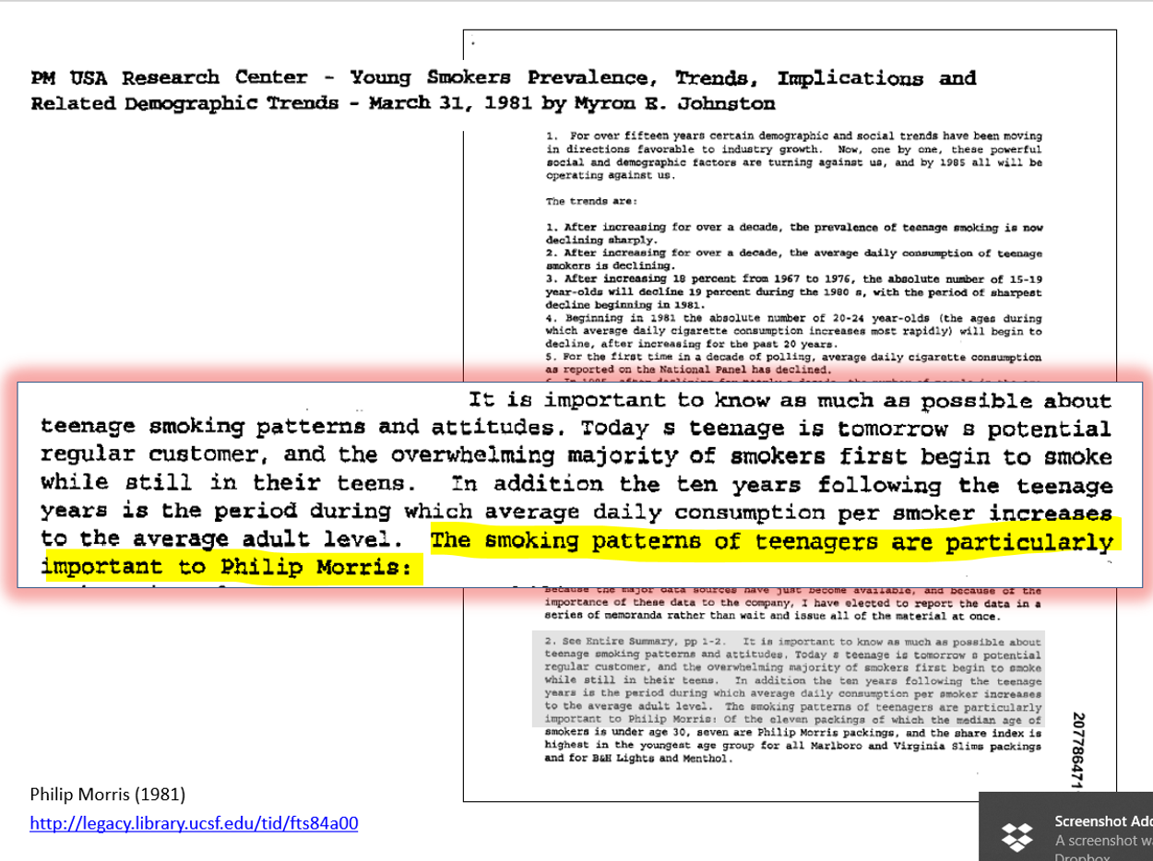

Slide 21
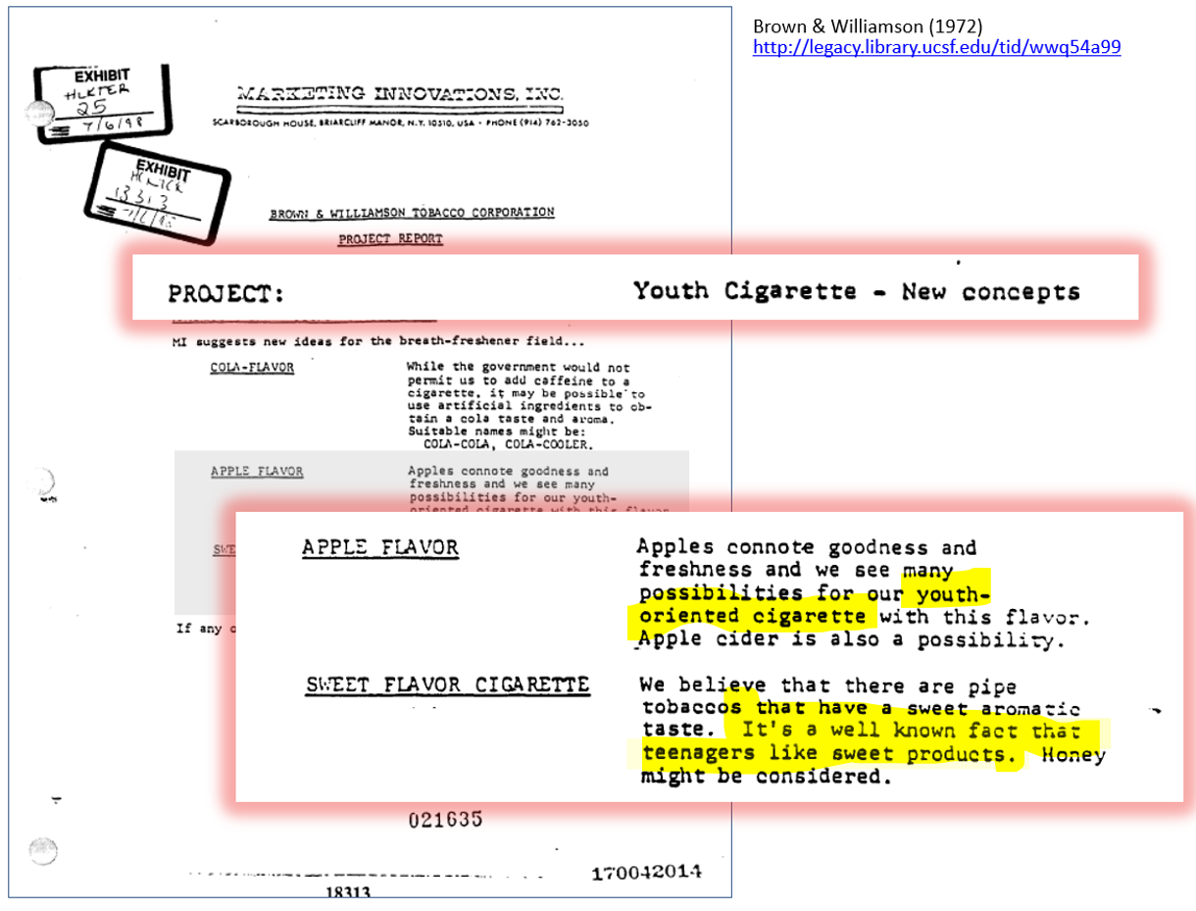

Slide 22
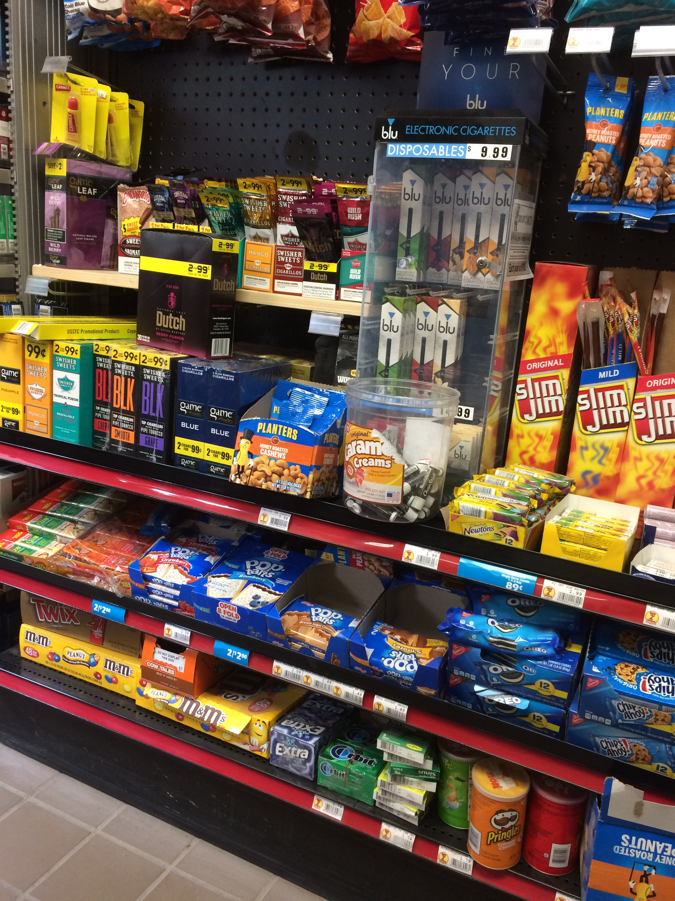
Aggressive Marketing of Flavored Tobacco Products in Retail Environment
The tobacco industry spends more than 96% ($9 billion) of its total marketing budget in convenience stores, gas stations and other non-age restricted retail outlets. (Federal Trade Commission (FTC), Cigarette Report for 2017, 2019 ).
2/3 of teenagers visit a convenience store or other neighborhood retailer at least once a week. (Hendrickson, L. et al., Association of retail tobacco marketing with adolescent smoking, (American Journal of Public Health 94 (12)2081-3, 2004).
Exposure to tobacco marketing in stores and price discounting increase youth smoking. (HHS, Preventing Tobacco Use Among Youth and Young Adults, A report of the Surgeon General, 2012).
Smart, intentional marketing to youth demonstrated by the following body of evidence.

Slide 23
Body of Evidence reviewed by the Surgeon General
Cross-sectional studies on exposure to advertising and use of tobacco;
Longitudinal studies with non-susceptible, never-users of tobacco and subsequent initiation;
Examination of industry marketing efforts and use of specific brands;
Evidence from tobacco industry documents on their marketing practices. (U.S. Surgeon General’s Report, 2012).

Slide 24
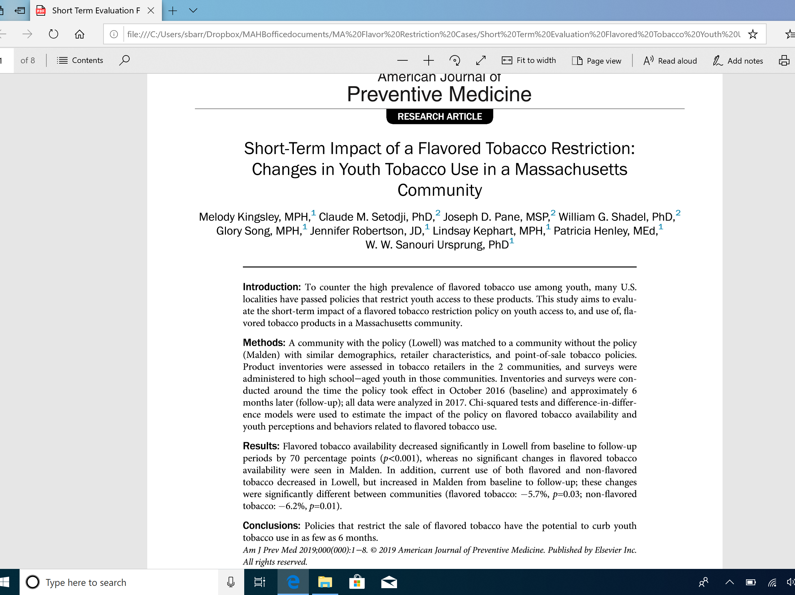

Slide 25


results
“Flavored tobacco availability decreased significantly in Lowell . . . by 70 percentage points . . .,whereas no significant changes in flavored tobacco availability were seen in Malden. In addition, current use of both flavored and non-flavored tobacco decreased in Lowell, but increased in Malden from baseline to follow-up . . .”
“Conclusions: Policies that restrict the sale of flavored tobacco have the potential to curb youth tobacco use in as few as 6 months.” (emphasis added).

Slide 26
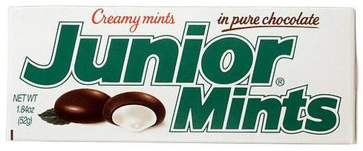
Re-define “characterizing flavor” to include menthol
“A distinguishable taste or aroma, other than the taste or aroma of tobacco . . . Including, but not limited to tastes or aromas relating to any fruit, chocolate, vanilla, honey, candy . . . menthol, mint and wintergreen. . .”
  “menthol, mint and wintergreen” language in FDA exemption.
  Includes ALL mint flavors.
Endorsed by the NAACP and the Urban League.

Slide 27
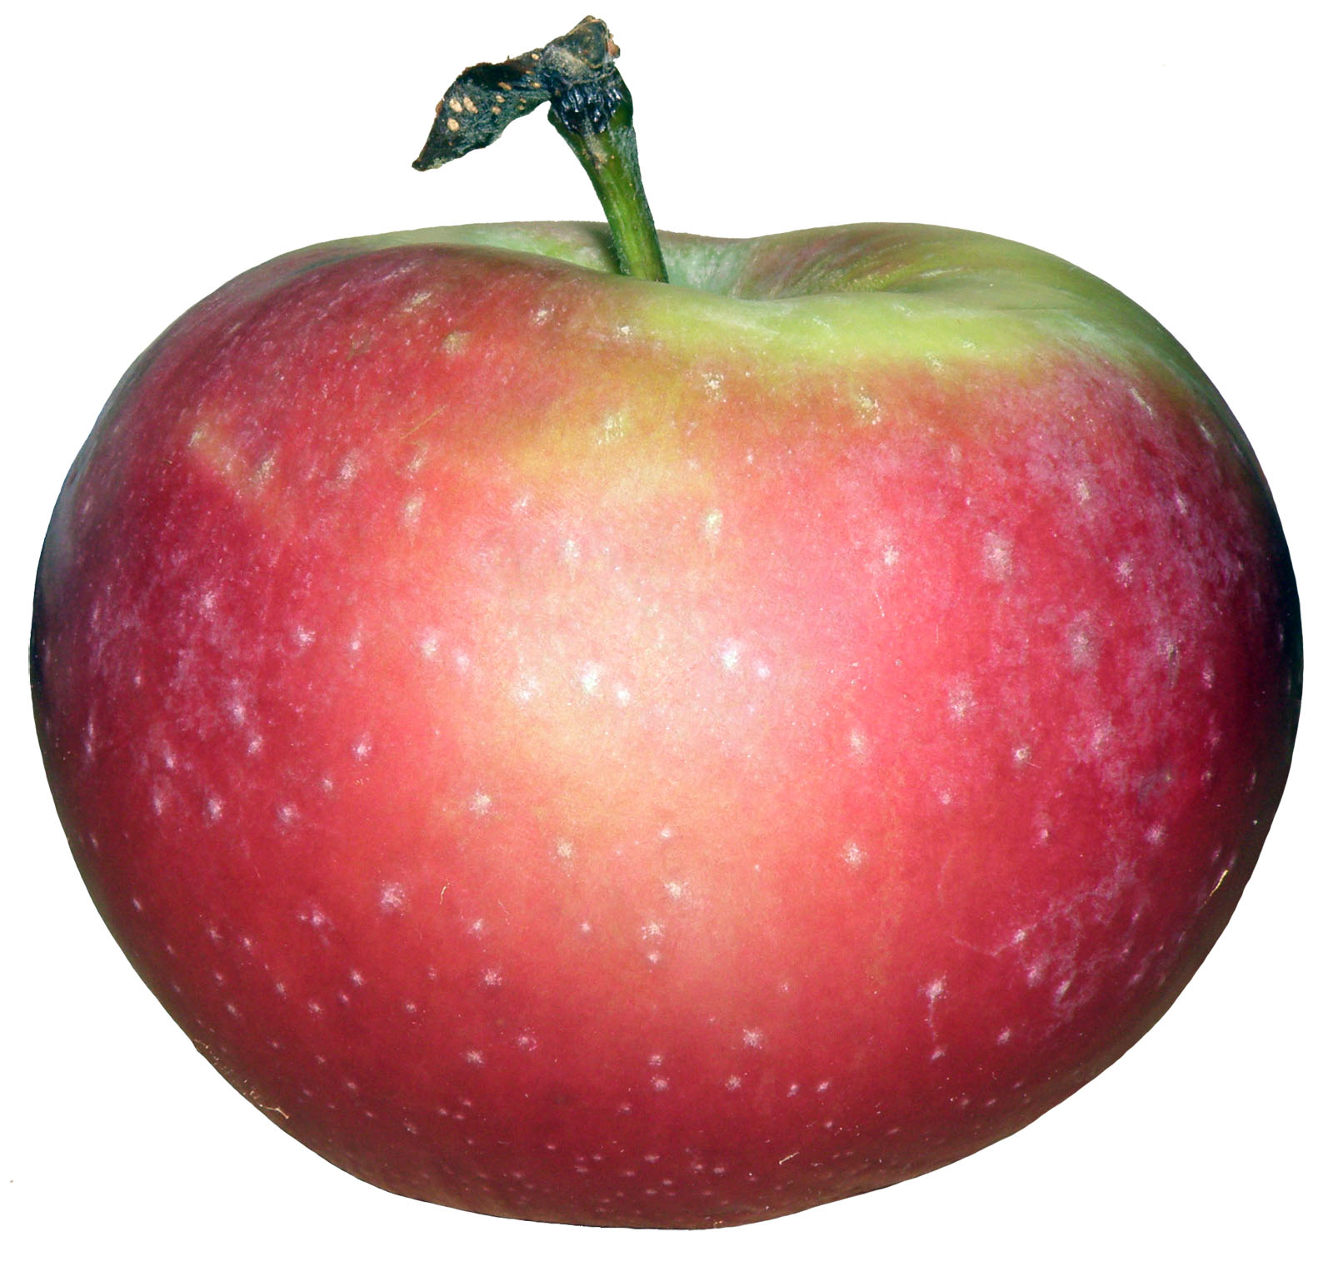
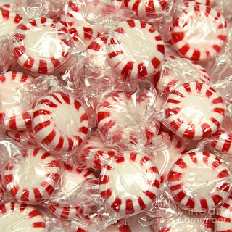
Why?
Same reason FDA banned flavored cigarettes in 2009.
Mint is a flavor – the only flavor left on the market.
  Should have been banned in 2009.
  Only reason FDA didn’t include it was because of lobbying efforts and ultimate “compromise”.
  Even though FDA’s Tobacco Products Scientific Advisory Committee (TPSAC) concluded that “Removal of menthol cigarettes from the marketplace would benefit public health . . .”
Industry has effectively been able to sell a flavored product (mint) for 10 years, even though the same arguments apply to apple that apply to mint.
In fact, more compelling arguments apply to mint, than to apple.

Slide 28

And then we have juuls (and other e-cigarettes)

Slide 29
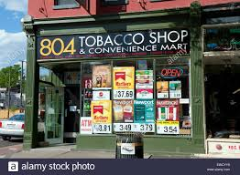
“We are throwing adult smokers under the bus by restricting e-cigs to adult-only stores.”
Adults can still get e-cigarettes from adult-only retail tobacco stores, and
70% of (US) adult flavor users get their products online or from a vape shop.
  Where do Vapers Buy Their Vaping Supplies? Findings from the International Tobacco Control (ITC) 4 Country Smoking and Vaping Survey, Int. J. Environ. Res. Public Health. 2019 Feb; 16(3) 338.
Unfettered adult access vs. youth use epidemic

Slide 30
Youth addiction concerns
The FDA “ . . . won’t tolerate a whole generation of young people becoming addicted to nicotine as a trade-off for enabling adults to have unfettered access to these same products.” (Gottlieb).
Jason Jeong, Junior at Cornell University in a column entitled “Juul Season is Over.”
  “No analysis or criticism of our collective fervor for the Juul will ever be as compelling as the fact that we have all become addicted to nicotine.”
  “It is time to address the Juul as what it is: the public health crisis of our generation.”
“Woo!! Juul!! I hit it from the moment I wake up to the moment I can’t go to sleep and keep Juuling.”

Slide 31
Youth aren’t getting the products in stores
Yes, they are.
  See truth initiative survey results from 1000 12-17-year-olds.
    74% said they got them in brick and mortar stores.
  Internet retailers that aren’t checking drivers’ licenses and public records for exact matches are being shut down.
  Parents’ testimony.
“E-cigarettes are marketed by promoting flavors and using a wide variety of media channels and approaches that have been used in the past for marketing conventional tobacco products to youth and young adults.” (E-cigarette use among youth and Young Adults”)

Slide 32
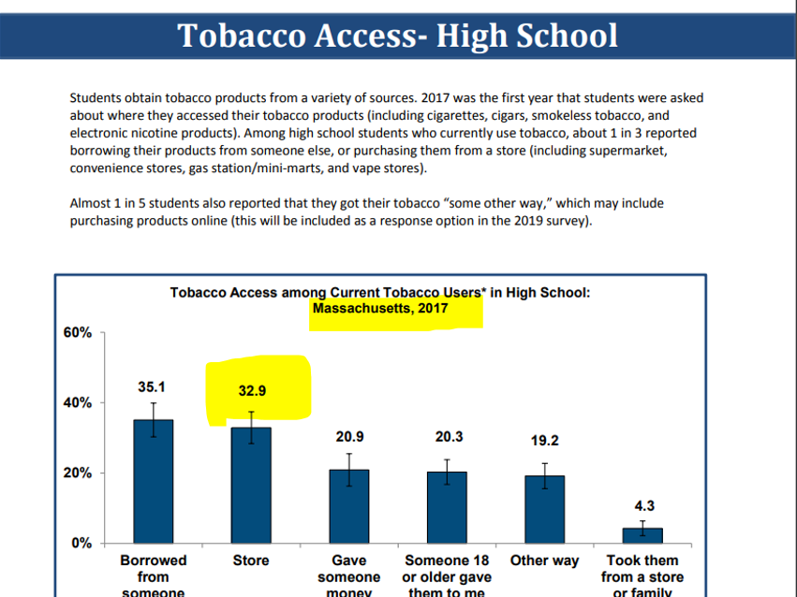

Slide 33

Ticket the kid
Not according to police.
  Ticketing in ineffective, especially since enactment of Criminal Justice Reform Act
    Purpose to support youngest and most vulnerable.
    Expunges criminal records.
    Decriminalizes first offense.
    Immunity from prosecution now for minor in possession of alcohol.
Virtually impossible to enforce.
  Can target individuals.
AND – MA has been able to reduce youth cigarette use significantly during the past 20+ without PUP laws.

Slide 34
“The majority of youth smokers prefer non-menthol cigarettes.”
Actual quote from the report: “Analysis of 2012-2016 National Youth Tobacco Survey data found that Marlboro, Newport and Camel were the most commonly reported usual brands smoked by middle and high school current (past 30 day) cigarette smokers.”
“As was the case with middle school students, Newport was the most prevalent brand among black high school students (47.5% in 2016), and Marlboro was the most prevalent brand among white students (59.5% in 2016).”
Do we only care about white middle and high school students?
I don’t think so . . .

Slide 35
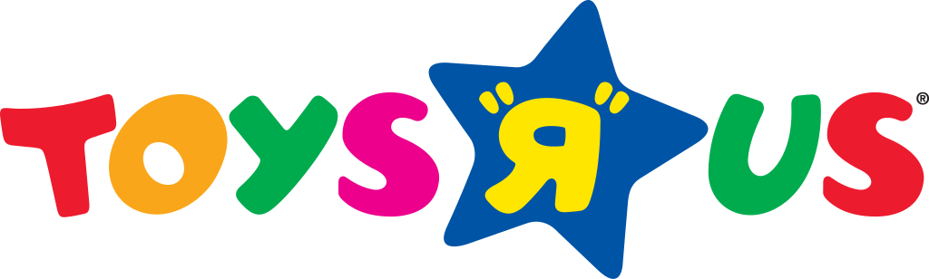
“Litigation is us” tobacco industry strategy
Current regulatory status in Massachusetts
165 cities and town restrict flavored tobacco, except menthol, mint and wintergreen to adult-only retail tobacco stores.
  18 remove the menthol, mint and wintergreen exemption and restrict ALL flavored tobacco products to AORTS.
  Somerville, Ashland, Needham, Barnstable, Charlton, Sharon, Norwood, Brookline, Swampscott, Walpole, Harvard, Chatham, Harwich, Stoughton, Framingham, Norfolk, North Andover, Canton.
  At least 2 towns are considering restricting ALL TOBACCO PRODUCTS to AORTS.

Slide 36
Basis for lawsuit
The regulations are arbitrary because they leave combustible products (Marlboro) in convenience stores and these are the most dangerous products.
  Regulation not arbitrary where it is rationally related to a legitimate, health-related purpose, i.e., protection of youth from harmful effects of tobacco. (RYO Cigar Association, Inc. & another vs. Boston Public Health Commission, 79 Mass. App. Ct. 822). Specifically permits a BOH to act incrementally and “is not saddled with a choice between comprehensive regulation and no regulation at all.”

Slide 37
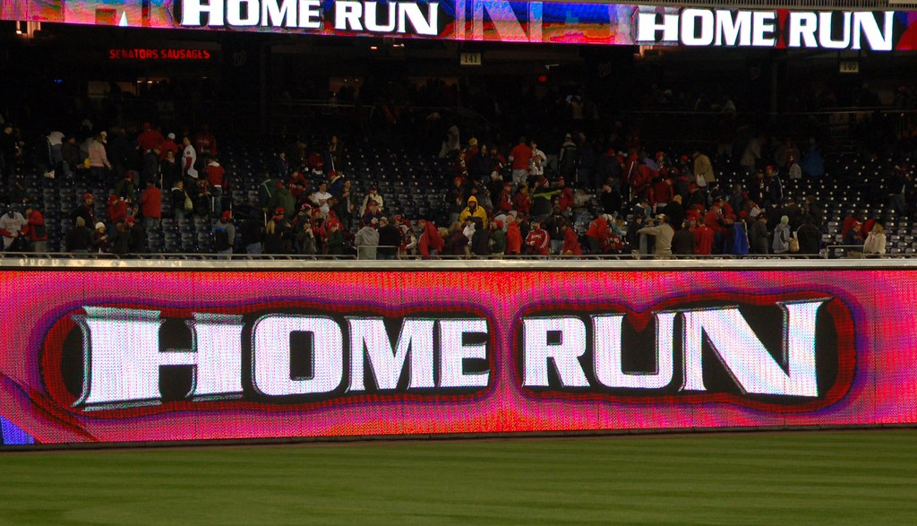
Boards of health are batting 1000
Motions for Preliminary Injunctions filed by retailers in all cases.
  Attempt to stop enforcing of the regulations until the case is brought to trial.
Every Judge who heard arguments denied these Motions.
  The plaintiffs (retailers) have not demonstrated any likelihood of success on the merits.
  Suffolk, Essex, Barnstable, Norfolk and Middlesex Counties.
Motions to Dismiss filed by municipalities.
  Arguments in November.

