Slide 1
What are Health Inequities and What are the Root Causes
Jennifer Valenzuela, LICSW, MPH
Chief People & Equity Officer, Health Leads
October 16, 2019

Slide 2
What do you think is the #1 predictor of your lifespan?
Notes:
\

Slide 3
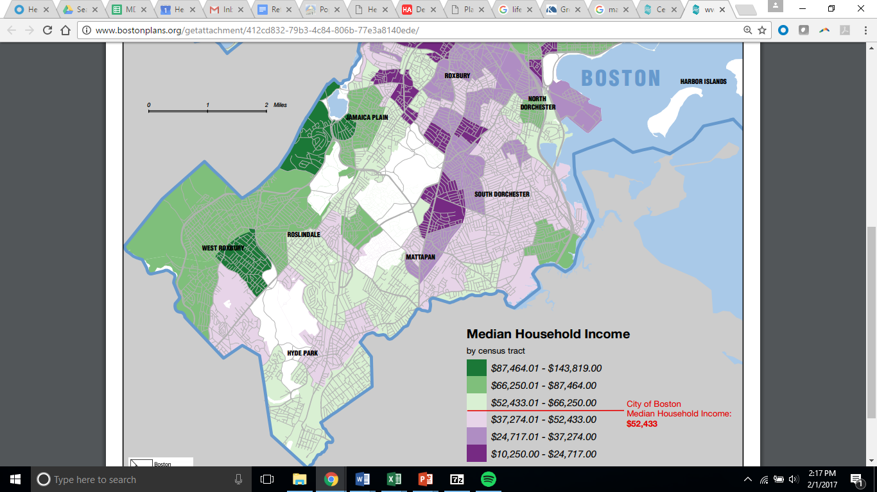
Your Zip Code
Jamaica Plain Life Expectancy
82.8
Roxbury Life Expectancy
77.60
Weston Life Expectancy
83.7 years
Map produced by the Office of Digital Cartography & GIS, BRA. November 2011.
https://www.rwjf.org/en/library/interactives/whereyouliveaffectshowlongyoulive.html
Notes:
http://www.hsph.harvard.edu/news/features/zip-code-better-predictor-of-health-than-genetic-code/
http://www.bostonplans.org/getattachment/412cd832-79b3-4c84-806b-77e3a8140ede/
http://www.bphc.org/whatwedo/health-equity-social-justice/tools-and-resources/Documents/PlaceMatters-Update-04-13.pdf
Springfield College- 75.60

Slide 4
This story plays out in communities across the country…
Approximately 245,000 deaths in the U.S. in 2000 were attributable to low education, and
176,000 to racial segregation
162,000 to low social support
133,000 to individual-level poverty
119,000 to income inequality
39,000 to area-level poverty.
The gap in life expectancy between the richest 1% and poorest 1% of individuals is 14.6 years for men and 10.1 years for women.
Even after controlling for other traditional measures of socioeconomic status, children are more likely to have asthma, migraines/severe headaches, or ear infections the closer their family is to the federal poverty line.

Slide 5
Life expectancy is declining

Slide 6
With an imbalance of health care and social spending…

Slide 7
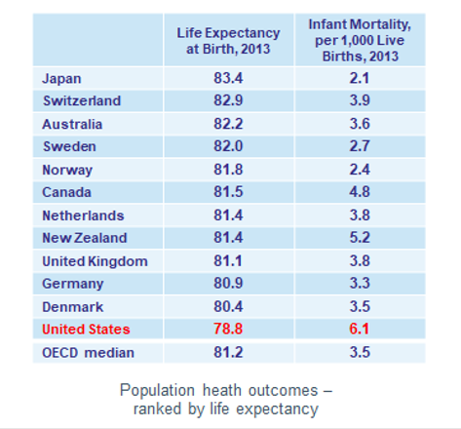
…while we continue to see subpar life expectancy and infant mortality rate in the US

Slide 8
What’s happening?

Slide 9
Social Determinants of Health
the “conditions in which people are born, grow, live, work, and age” and “the fundamental drivers of these conditions.”
World Health Organization’s Commission on the Social Determinants of Health
Relative Influence on Health*
100%
90%
20%
Clinical Care
Access to Care
Quality of Care
80%
10% Environment
Air & Water Quality
Housing & Transit
70%
30%
Health Behaviors
Tobacco Use
Diet & Exercise
Alcohol & Drug Use
Sexual Activity
60%
50%
40%
80% of the modifiable factors are shaped by life outside the clinic
Education
Employment
Income
Family & Social Support
Community Safety
30%
40%
Social and Economic Factors
20%
10%
*https://www.ncbi.nlm.nih.gov/pmc/articles/PMC3134519/

Slide 10
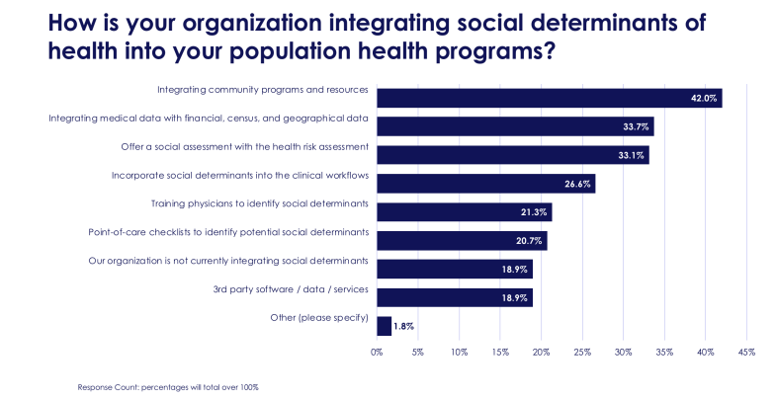
Over 80% have SDOH as part of patient care
Notes:
Community programs- CHWs
Integrating Medical Data- MA Homelessness higher pm/pm
Social Assessment: ACOs, HMOs doing the assessment around housing, food, etc
SD Into workflow: screening
Training physicians: asking questions. Similar to PHQ-9 Point-of-care checklists-

Slide 11
Learning from our partners
Looking for ways to streamline all screens and make use of z-codes
Considering using food insecurity questions as the ‘gateway’ for more conversation with patients
Z-codes documenting homelessness (for example) could support higher payments from payers as evidence of a more complex population
Z-codes trigger pop-ups in EHRs for care teams and enable a view of the prevalence of needs across a patient population more easily
Increasingly focused on Community Health Workers (CHWs)
Technology looked to as the ‘magic wand.’ Much lower success if technology is in absence of navigation support and partnership
Patient advisory is desired, but few are doing this
Community partnerships are key

Slide 12
Health Related Social Needs or Social Determinants of Health
While targeted, small-scale social interventions provide invaluable assistance for individual patients, we must also remain focused on the social determinants that perpetuate poor health at the community level.
Brian Castrucci & John Auerbach
“Meeting Individual Social Needs Falls Short Of Addressing Social Determinants Of Health, " Health Affairs Blog, January 16, 2019.DOI: 10.1377/hblog20190115.234942

Slide 14
We’ve made great progress, but we’re not getting at the root of the inequities that drive disease
Traditional healthcare
Notes:
MA CAN- potentially gets to the social inequities if working to make policy changes that impact preconception health for black women in Boston
MA- work happening at MassHealth level is at the institutional inequities and living conditions
NY- Women, infants and Children (WIC) example of how Health Leads is addressing institutional inequities and living conditions
CA- example of both case management, individual risk behaviors (desk work), to living conditions (training of caregivers) to institutional (food is medicine and Medicaid changes)

Slide 15
Why is this happening?

Slide 16
Disparity “implies a difference of some kind; it can be said that disparity is not undesirable in itself unless it results in some consequence that can be understood as unfair or unjust.” Differences in the presence of disease, health outcomes, or access to health care between population groups.
Inequity “implies unfairness and injustice; inequities are always undesirable and should be subject to serious moral criticism.”
Differences in health that are unnecessary and avoidable.
Pain Medicine, Volume 9, Issue 5, July 2008, Pages 613 –623, https://academic.oup.com/painmedicine/article/9/5/613/1852051

Slide 17
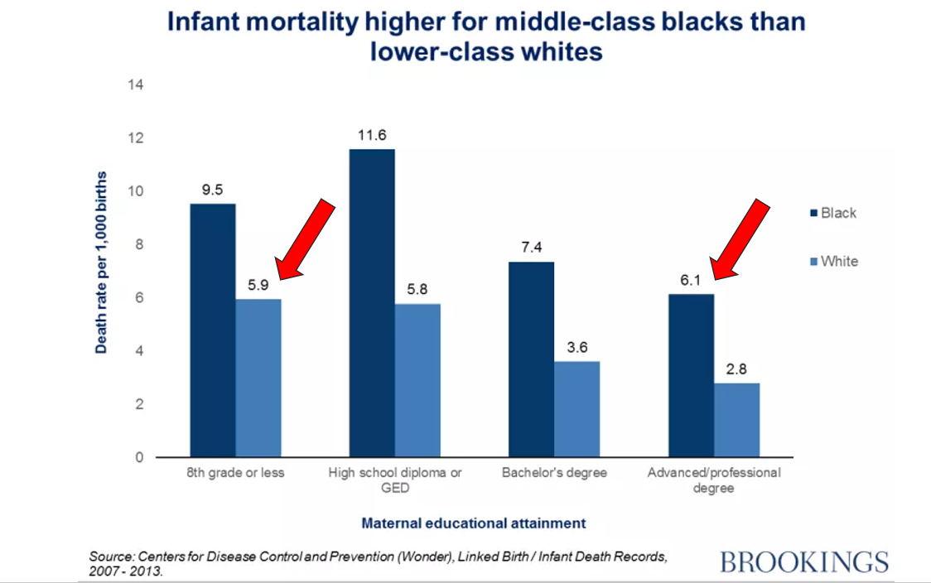
Inequity
Disparity
Weight at birth
Notes:
https://www.bphc.org/whatwedo/health-equity-social-justice/what-is-health-equity/Pages/Health-Disparities-vs.-Health-Inequities.aspx

Slide 18
www.groundwaterapproach.net
Notes:
www.groundwaterapproach.net

Slide 19
The simple story
Addressing basic resource needs as part of care
Reduced needs
Better health
Notes:
\

Slide 20
Trace the pathway from social inequities to community conditions to disparate outcomes

Slide 21
OUR VISION: | OUR MISSION:
Health, well-being and dignity for every person in every community. | We partner with communities and health systems to address systemic causes of inequity and disease. We do this by removing barriers that keep people from identifying, accessing and choosing the resources everyone needs to be healthy.

Slide 22
Thank You!
jvalenzuela@healthleadsusa.org

