Slide 1
An Institution’s Approach to a Significant Health Disparity: Boston Children’s Hospital Community Asthma Initiative
Susan Sommer, NP,AE-C
Clinical Director

Slide 2
Hospital Community Mission
Office of Community Health identified need for asthma home visiting program thru Community Needs Assessment
Reducing/eliminating pediatric asthma health disparities
Addressing Social Determinants of Health
Housing conditions
Health literacy
Access to home visiting services

Slide 3
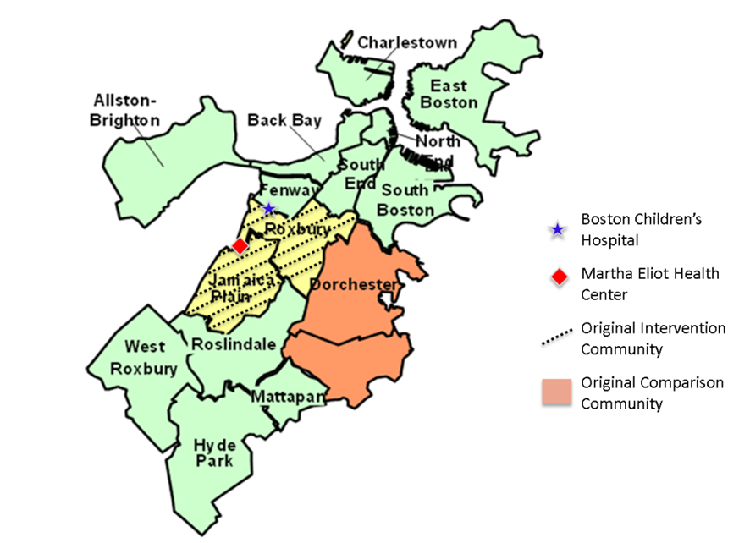
Assessing the Need
Community needs assessment by Office of Community Health (2003-2005): asthma, obesity, mental health, injuries as top priorities
Asthma leading single diagnosis for hospital admissions
70% of children hospitalized for asthma at
BCH from 5 low-income, predominantly
African-American and Latino Boston
neighborhoods
Boston asthma hospitalization rates for
African-American and Latino children in 2003
4-5 times higher than rate for white children
Health of Boston, Boston Public Health Commission:
http://www.bphc.org/healthdata/archive/Documents/Health%20of%20Boston%202005.pdf
Notes:
From 2003 to 2005 when the planning for this program was taking place, asthma was the leading cause of hospital admissions at Boston Children’s Hospital.
70% of children hospitalized for asthma at Children’s came from 5 neighboring low-income, predominately African-American and Latino neighborhoods.
The asthma hospitalization rates for African-American and Latino children in 2003 were 4-5 times the rate for white children.
These statistics clearly demonstrate some major health disparities.

Slide 4
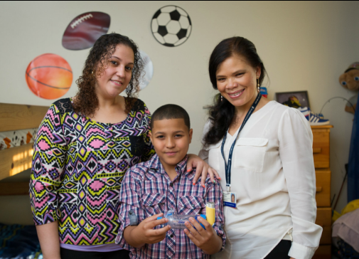
CAI Model: Individual & Family Intervention
Individualized asthma education
Environmental assessment/
Remediation
Care coordination
Case management/ housing
advocacy
Notes:
Care coordination is provided by bilingual and/or bicultural nurses and CHW.
They work with the families to establish their goals for asthma control and identify the barriers to good control. These may include a lack of understanding of asthma and the medications because families often have concerns about their long-term effects. Environmental triggers at home or at school. Lack of or inadequate insurance coverage or high co-pays for patients with private insurance.
The nurses and CHW provide tailored asthma education, work with families to understand their Asthma Action Plans and check medication adherence.
During a home visit, the nurses and CHW conduct an environmental assessment and provide supplies for remediation. This includes a HEPA vacuum, bedding encasements, materials for Integrated Pest Management, and other supplies depending on the families’ needs.
They also work with families to advocate for reasonable accommodations in housing, and make referrals as needed.

Slide 5
Community Health Worker Role (Patient Navigator, Home Visitor)
Trusted member of or deeply understands community served; ability to communicate in primary language of family, understanding of cultural health beliefs
Liaison between provider and community
Builds individual & community capacity through
Outreach
Community education
Informal counseling
Social support
Advocacy

Slide 6
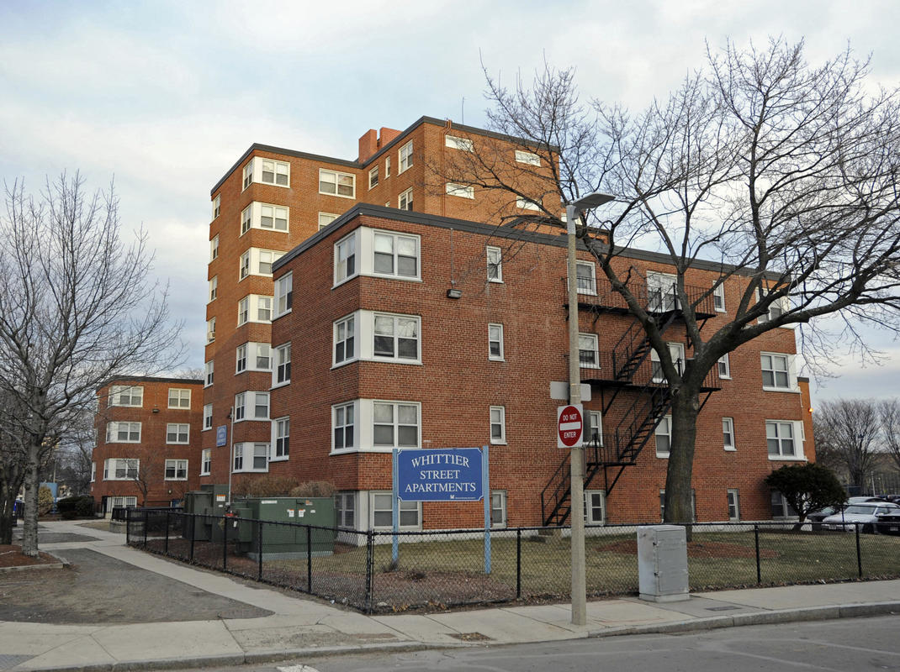
“It’s often not just about the asthma” - CHW quote
Poverty/competing demands
Decreased access to health care and medications (transportation, co-pays, fewer referrals to specialists, lapses in insurance)
Substandard, racially segregated housing
Mental health (parental or child)
Community violence, PTSD,
depression and anxiety, ADHD

Slide 7
CAI Enrollment Criteria
Enroll through Emergency Department (ED) and hospital logs as well as referrals
Asthma diagnosis
2-26 years old
Hospital admission/ED visit(s) for asthma exacerbation in last 12 months
>2 prescription for oral corticosteroids in last 12 months—indicator of more severe exacerbations

Slide 8
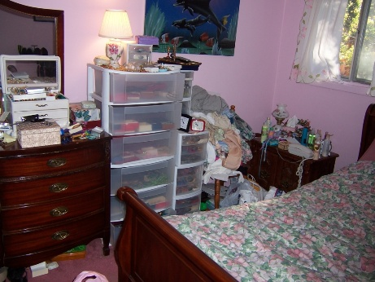
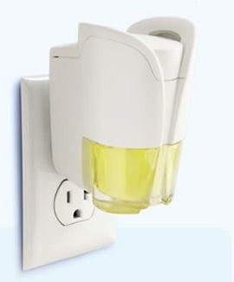
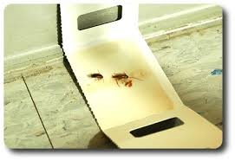
Home Environmental Assessment/ Remediation
Apartment walk-through second half of visit, visual inspection
Suggestions for “asthma-friendly home”
Address common triggers
Notes:
Clutter also provides harborage for pests

Slide 9
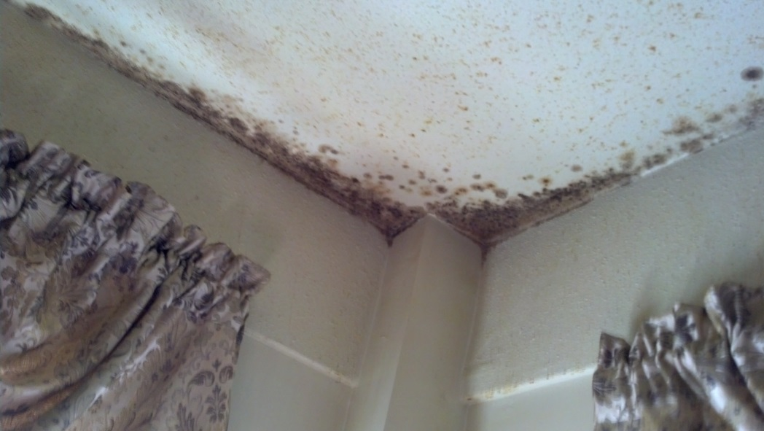
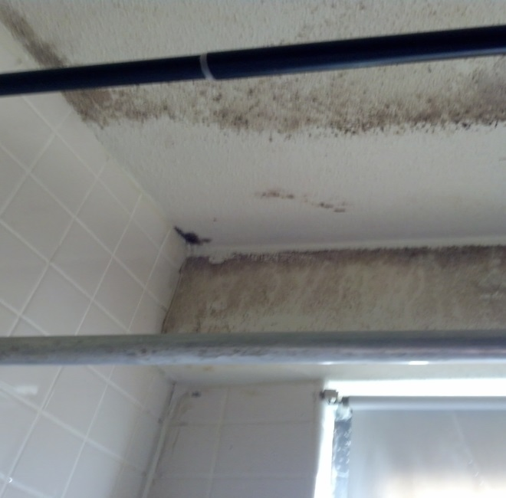

Slide 10
Home Environmental Findings: 84% had one or more triggers
Findings: | Percent Patients:
Significant Clutter | 52.3%
Rodents | 36.1%
Pets | 25.9%
Mold | 17.6%
Cockroaches | 12.2%
Environmental Tobacco Smoke | 18.3%
Notes:
This is a table of some of the major home environmental findings.
51% had significant dust and clutter
38% had a rodents
25% had pets
20% had mold
13% had roaches
And 18% live with a smoker

Slide 11
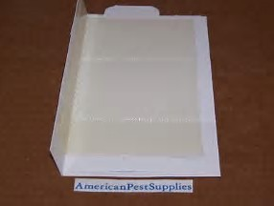
Free Home Supplies

Slide 12
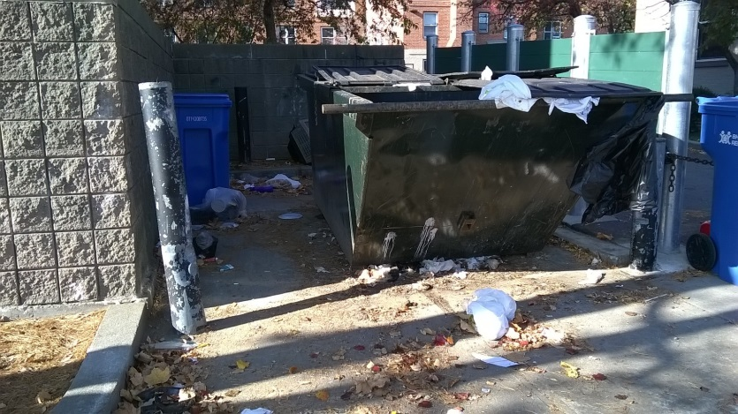
Housing Advocacy
City Inspectional Services on-line referrals
(https://www.boston.gov/civic-engagement/breathe-easy-home)
Medical-Legal Partnership consults, referrals
Reasonable Accommodation letters
Advocacy with landlords, BHA, shelters

Slide 13
Demographic Description (through March 31, 2019)
2,166 patients enrolled
1,506 (69.5%) first home visits for families by nurses and/or Community Health Workers (CHWs)
Demographics:
Mean age 7.2 years + 4.4 SD (range 1.0-23.6 yrs)
50% Latino, 44% African American, 6% other
21.5% Monolingual Spanish-speaking
Income: 65.8% <$25,000
77.8% have Medicaid (MassHealth)
Notes:
From October 1st 2005 to September 30, 2017, 1868 patients received case management.
1367, about 73% of our patients received at least one home visit by a nurse and/or CHW.
The average age of our patients is about 7 years old
About 49% were Latino or Hispanic and about 45% were African American
22% were primarily Spanish-speaking
67% had an annual household income of less than $25,000
And 78% were on Medicaid, which in Massachusetts is called MassHealth

Slide 14
Decrease in the % of patients with any ED visits or Admissions due to Asthma (p<0.001) (as of December 31, 2018)
54% decrease at 6 Months, 56% decrease at 12 Months
77% decrease at 6 Months, 81% decrease at 12 Months
Woods ER, et al. Community Asthma Initiative: Evaluation of a Quality Improvement Program for Comprehensive Asthma Care. Pediatrics, 2012;129:465-472.

Slide 15
Decrease in % patients with any (≥1) Missed School or Parent/Guardian Missed Work Days due to Asthma (p<0.001) (as of December 31, 2018)
46% decrease at 6 Months, 45% decrease at 12 Months
62% decrease at 6 Months, 54% decrease at 12 Months
Woods ER, et al. Community Asthma Initiative: Evaluation of a Quality Improvement Program for Comprehensive Asthma Care. Pediatrics, 2012;129:465-472.
Notes:
Similarly, there was a statistically significant improvement in Quality of Life measures. There was a 45% decrease in the percent of patients with any missed school days and a 53% decrease in the percent of patients with any parent or guardian missed work days due to asthma at 12 months.

Slide 16
Decrease in the percentage of patients with Any Limitation in Physical Activity due to Asthma and Increase in Asthma Action Plans (p<0.001) (as of December 31, 2018)
49% decrease at 6 Months, 43% decrease at 12 Months
37% increase at 6 Months, 38% increase at 12 Months
Woods ER, et al. Community Asthma Initiative: Evaluation of a Quality Improvement Program for Comprehensive Asthma Care. Pediatrics, 2012;129:465-472.

Slide 17
Hospital Administrative Data: CAI, Comparison and High Risk Comparison, Annual Cost Per Patient % Decrease in Cost in 5 years: CAI 74%. Comparison 57%. High Risk Comparison 61%
Bhaumik U, et al. Boston Children’s Hospital Community Asthma Initiative: Five Year Cost Analyses of a Home Visiting Program. J Asthma. 2016; 54(2); 134-142.

Slide 18
Claims Data: Per Patient Total Unadjusted Asthma Utilization Cost (2016 US$) Among CAI (N=45) and a 1:1 Cost Matched Comparison Group (N=45) ROI = 1.37 and p = 0.003 at 3 years
Bhaumik U, et al. Community Asthma Initiative: Cost Analyses Using Claims Data from a Managed Care Organization. J Asthma, January 21, 2019, published online.

Slide 19
Boston Asthma Home Visit Collaborative
Goal of consistent, high quality, cost-effective CHW asthma home visits throughout Boston
Developed standard protocol and data collection tools, now on REDCap
Built capacity to offer visits in multiple languages
Centralized referral system
Pooled data for evaluation
Monthly meetings
Shadowing opportunities

Slide 20
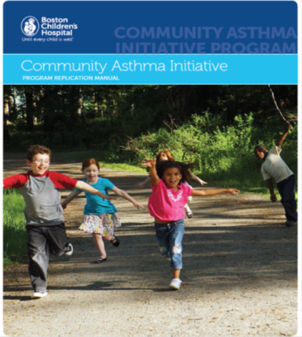
Replication Manual
http://www.childrenshospital.org/centers-and-services/community-asthma-initiative-program

