Slide 1
November 13, 2019 Vaping, Vanity, and Victims:
Benefits and Risks of Vaping
Regis College, President’s Lecture Series
Annegret Klaua, MSc Tobacco Education & Treatment Specialist
Behavioral Health Engagement on Nicotine Addiction (BHENA)

Slide 2
Nicotine in the Brain and Body
Instructs the brain to release adrenaline
Stimulates the central nervous system
Increases heart rate and blood pressure
Causes constriction in blood vessels throughout the body and decreases blood flow to the heart muscle
Releases excess glucose into the bloodstream and inhibits production of insulin
This causes more sugar to stay in the blood than is normal and acts as an appetite suppressant
Notes:
The Health Consequences of Smoking – 50 Years of Progress: A Report of the Surgeon General, 2014
www.drugabuse.gov/infofacts/tobacco

Slide 3
Nicotine in the Brain and Body
Highly addictive – rapid delivery increases its dependence potential
Increases levels of several neurotransmitters, including dopamine
Symptoms of nicotine toxicity
Stomach pain
Dizziness
Headaches
Decreased concentration
Notes:
In all tobacco products, and electronic nicotine delivery systems/e-cigarettes
In the brain in 7-10 seconds when smoked
To send a message, a brain cell (neuron) releases a chemical (neurotransmitter) into the space (synapse) between it and the next cell. The neurotransmitter crosses the synapse and attaches to proteins (receptors) on the receiving brain cell. This causes changes in the receiving cell—the message is delivered.
https://www.drugabuse.gov/publications/drugs-brains-behavior-science-addiction/preface
NIDA: How Does Nicotine Act in the Brain?
Your brain is made up of billions of nerve cells. They communicate by releasing chemical messengers called neurotransmitters. Each neurotransmitter is like a key that fits into a special "lock," called a receptor, located on the surface of nerve cells. When a neurotransmitter finds its receptor, it activates the receptor's nerve cell.
The nicotine molecule is shaped like a neurotransmitter called acetylcholine. Acetylcholine and its receptors are involved in many functions, including muscle movement, breathing, heart rate, learning, and memory. They also cause the release of other neurotransmitters and hormones that affect your mood, appetite, memory, and more. When nicotine gets into the brain, it attaches to acetylcholine receptors and mimics the actions of acetylcholine.
Nicotine also activates areas of the brain that are involved in producing feelings of pleasure and reward. Recently, scientists discovered that nicotine raises the levels of a neurotransmitter called dopamine in the parts of the brain that produce feelings of pleasure and reward.
https://teens.drugabuse.gov/teachers/mind-over-matter/nicotine/how-does-nicotine-act-brain

Slide 4
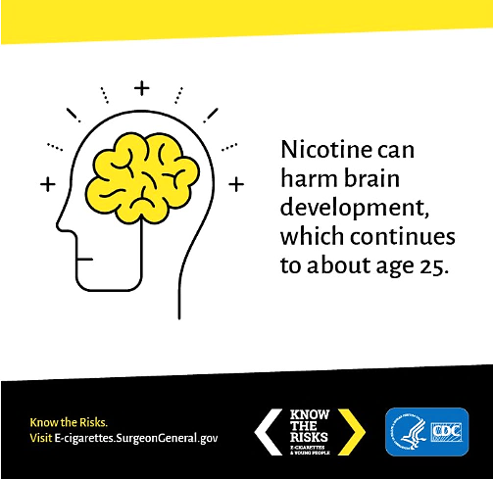
Youth & Nicotine
Attention
Learning
Addiction
Mood disorders
Impulse control
E-cigarettes induce oxidative stress and the developing brain is particularly vulnerable to its harmful effects. (Tobore J Adolesc 2019)
E-cigarettes and dual-product use are significantly associated with greater odds of reporting sleep-related complaints among adolescents. (Riehm et al. J Adolesc 2019)
Notes:
Nicotine can produce structural and chemical changes in the developing brain that make youth and young adults more vulnerable to alcohol and other substance addiction and mental health conditions.
The teen years are critical for brain development, which continues into young adulthood.
During adolescence, the brain goes through numerous developmental changes in structure and function.
The areas of the brain associated with memory, learning, judgment, decision making, risk-taking, reward, emotion and stress are continuing to mature and develop and these areas remain uniquely vulnerable to the damage that addictive substances – such as nicotine – inflict on these critical brain functions. (www.centeronaddiction.org)
Source: www.centeronaddiction.org/e-cigarettes/about-e-cigarettes
Teens and pre-teens who use nicotine products in any form, including e-cigarettes, are uniquely at risk for long-lasting, negative effects. Nicotine exposure during this time can disrupt the growth of brain circuits that control
attention
learning and memory
susceptibility to addiction
Nicotine exposure during this time can also contribute to the development of mood disorders and
permanent lowering of impulse control— a failure to fight an urge or impulse that may harm oneself or others
NIDA: https://www.drugabuse.gov/publications/drugfacts/electronic-cigarettes-e-cigarettes
https://e-cigarettes.surgeongeneral.gov/knowtherisks.html

Slide 5
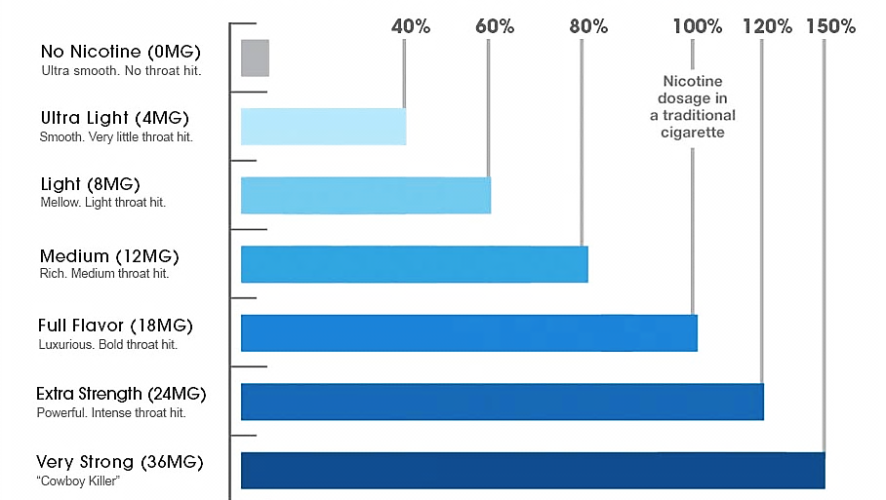
Nicotine Level Chart
EU Limit: 20 mg/mL
Source: http://www.top-electronic-cigarette.com/electronic-cigarette-e-liquid.html
Notes:
From VaporShark Electronic Cigarettes
E-liquids commonly come in 24 mg, 18 mg, 12 mg, or 6 mg strengths among others. But different companies may not have the same standards for strength so it’s important to look at the number of milligrams of nicotine. 18 mg most comparable to a traditional cigarette and will perform best for someone coming off traditional cigarettes.
The amount of nicotine in milligrams, for each milliliter of E-Liquid, expressed as mg/ml.
0mg/mL Nicotine This means that there is supposedly no nicotine in the E-Liquid mixture. Zero nicotine levels are usually ordered by people who have quit smoking but still have an oral fixation and use an electronic cigarette to satisfy it. 6mg/mL Nicotine This level of nicotine is the lightest level offered. For people who wish to enjoy the smallest possible nicotine level while still enjoying a full E-liquid taste. This is commonly the last level in "stepping." 12mg/mL Nicotine On the lower end of the spectrum, 12mg/ml is a comfortable level for people who prefer nicotine, but aren't heavy vapers. This level is also common for people who used to smoke light cigarettes. 18mg/ml Nicotine This is the middle of the road in terms of nicotine. Most vapers who were former smokers enjoy this level because it delivers the perfect amount of nicotine in each vape. 24mg/ml Nicotine This is on the high side of nicotine levels and is commonly preferred by people who were formally heavy smokers (about a pack per day). It has a noticeable nicotine level that many former smokers enjoy. 36mg/ml Nicotine This is the highest concentration of nicotine that we offer our customers. People who prefer this level are usually former smokers with a serious addiction, usually meaning more than two packs per day.

Slide 6
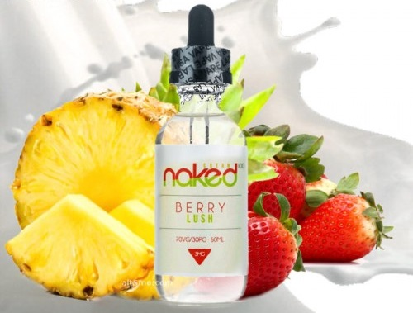
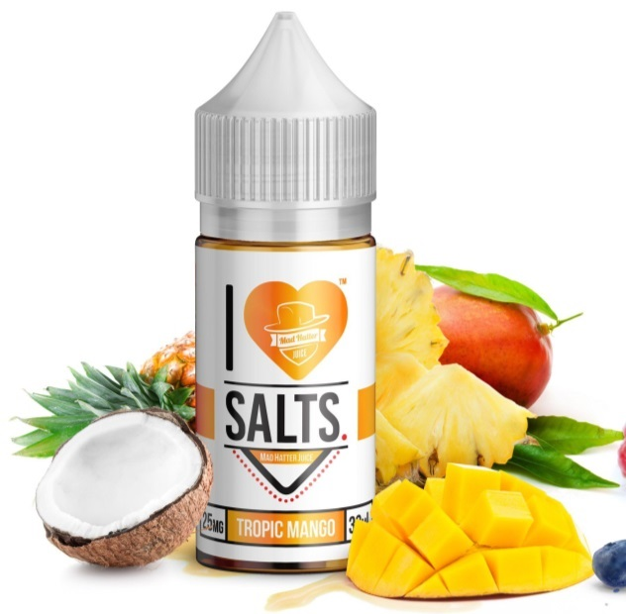
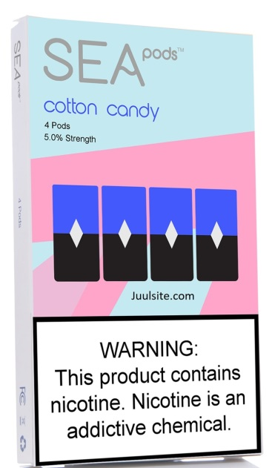
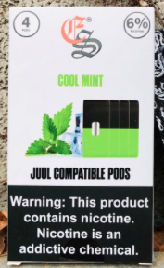
JUUL nicotine content = 59 mg/mL or 35 mg/ml (5% or 3% by weight; lower option released in 2018)
JUUL-compatible pods and other pod systems, as well as nicotine salt liquids, come in up to 6.8% nicotine by weight and many more flavors than JUUL ever had
Salt-based formula vs. freebase nicotine liquids

Slide 7
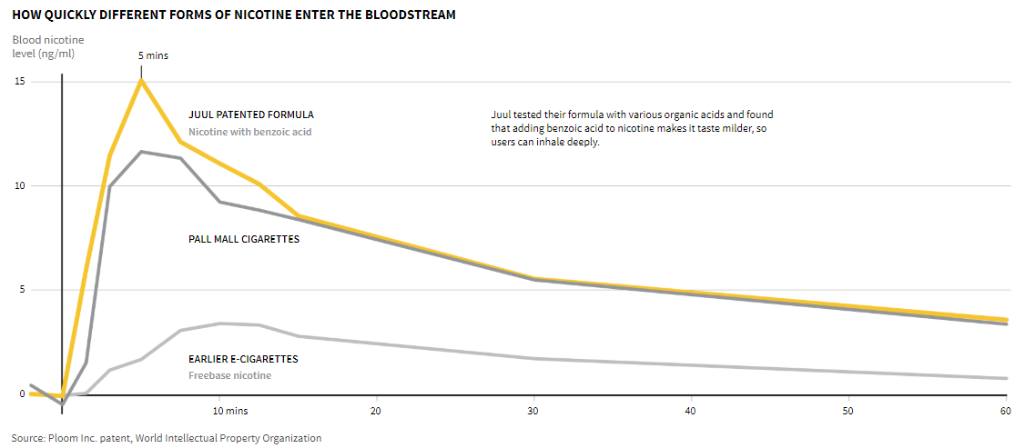
(Kirkham. Nicoteen Inc: JUUL disregarded early evidence it was hooking teens. Reuters 11/5/2019)

Slide 8
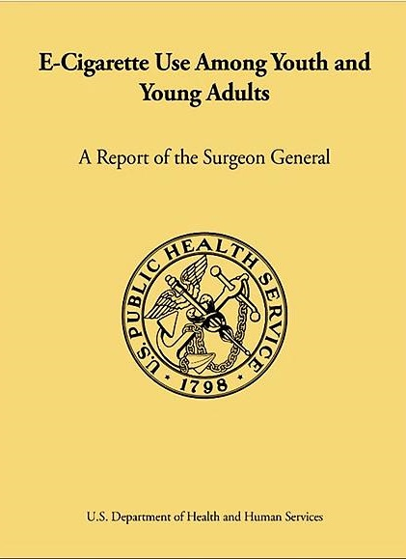
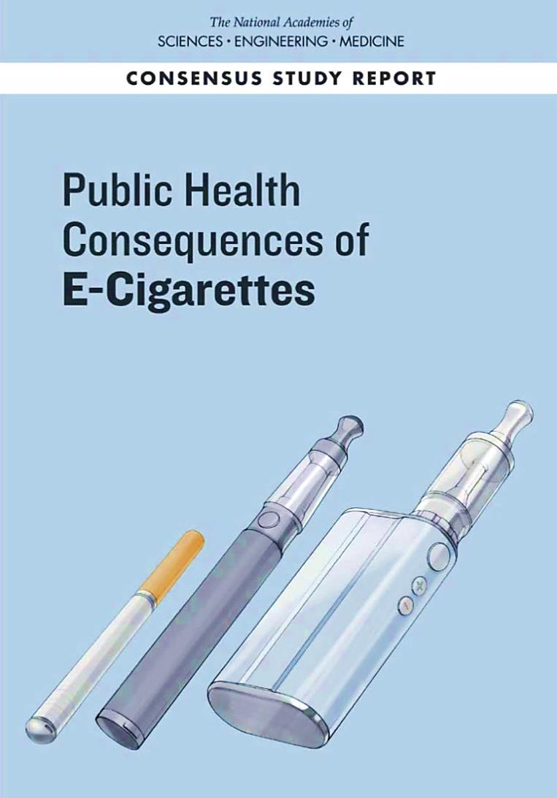
Substantial evidence that e-cigarette use among youth increases risk of cigarette use
2016
2018
Mixed evidence on health consequences
Long-term health consequences unknown
Limited evidence as a cessation device
Notes:
In December 2016, the U.S. Surgeon General issued a groundbreaking report "E-Cigarette Use Among Youth and Young Adults.’ The report focused on e-cigarette use among youth/young adults because research indicates that this is a critical period for influencing tobacco use and related behaviors. Nearly all adult tobacco users began using prior to age 18.
January 2018 – the National Academies of Sciences, Engineering and Medicine released a consensus report on the “Public Health Consequences of E-cigarettes
The Center for Tobacco Products of the FDA requested that the National Academies of Sciences, Engineering, and Medicine convene a committee of experts to conduct a review the available evidence of the health effects related to the use of e-cigarettes and identify future federally funded research needs.
This report is a comprehensive and systematic review of the literature that evaluates the evidence about e-cigarettes and health, highlights gaps that are a priority for future research, and makes recommendations to improve the quality of this research.
There is mixed evidence on the health consequences of e-cigarette use while long-term consequences remain uncertain.
Both reports found that E-cigarette use among youth is also strongly linked to the use of other tobacco products, such as regular tobacco cigarettes, cigars, hookah, and smokeless tobacco.
Nicotine use in youth causes changes in the brain that make life-long addiction much more likely for teens and pre-teens who use e-cigarettes.
Because nicotine affects the development of the brain's reward system, continued use of e-cigarettes or other tobacco products can not only lead to nicotine addiction, but also prime young brains for addiction to other drugs.
Source: www.centeronaddiciton.org/the-buzz-blog/what-today%E2%80%99s-parents-should-know-about-gateway-drug-theory

Slide 9
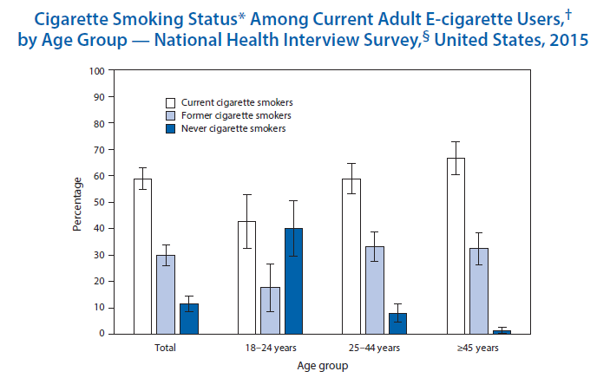
Notes:
CDC MMWR (2016) Cigarette Smoking Status Among Current Adult E-cigarette Users by Age Group, NHIS, US, 2015
From the National Center for Health Statistics
* Adults were asked if they had smoked at least 100 cigarettes in their lifetime and, if yes, whether they currently smoked cigarettes every day, some days, or not at all. Those who smoked every day or some days were classified as current cigarette smokers. Adults who had not smoked 100 cigarettes were classified as never cigarette smokers. Adults who had smoked 100 cigarettes but were not smoking at the time of interview were classified as former cigarette smokers. Percentages are shown with 95% confidence intervals.
† Current e-cigarette use was based on responses of “every day” or “some days” to the question, “Do you currently use electronic cigarettes every day, some days, or not at all?” asked of adults who had ever tried an e-cigarette, even one time.
§ Estimates are based on household interviews of a sample of the noninstitutionalized U.S. civilian population aged ≥18 years and are derived from the National Health Interview Survey sample adult component.
In 2015, 3.5% of U.S. adults were current e-cigarette users. Among adult e-cigarette users overall, 58.8% also were current cigarette smokers, 29.8% were former cigarette smokers, and 11.4% had never been cigarette smokers. Among current e-cigarette users aged ≥45 years, 98.7% were either current or former cigarette smokers, and 1.3% had never been cigarette smokers. In contrast, among current e-cigarette users aged 18–24 years, 40.0% had never been cigarette smokers.
Source: National Health Interview Survey, 2015 data. Available at http://www.cdc.gov/nchs/nhis.htm.

Slide 10
Recent studies to give us pause
E-cigarette aerosol is a lung and potential bladder carcinogen in mice (Tang et al. Proc Natl Acad Sci 2019)
Vaping slows wound healing as much as smoking (Troiano et al. JAMA Facial Plast Surg 2019)
Current knowledge of population effects is insufficient to determine whether the respiratory health effects of e-cigarettes are less than those of combustible tobacco products (Gotts et al. BMJ 2019)

Slide 11
Recent studies to give us pause
Chemicals for flavorings like clove, mint and vanilla can harm blood vessel cells that help keep the heart healthy (Fetterman et al. Arterioscler Thromb Vasc Bio 2018)
Chemicals cause harm separate from the known harms caused by tobacco
A sample of electronic cigarette and smokeless tobacco products had high levels of the mint oil constituent pulegone, banned as a food additive in the U.S. in 2018 (Jabba & Jordt JAMA Intern Med 2019)

Slide 12
But I have heard…
… that vaping is 95% safer than smoking (Nutt et al. Eur Addict Res 2014)
Not a scientifically proven number
Controversial in the public health community
… people using e-cigarettes are more successful in quitting cigarettes compared to people using NRT (Hajek et al. NEJM 2019)
RCT in the UK; 18 mg/mL nicotine for e-cigarettes
1-year abstinence rates: e-cig = 18%, NRT = 9.9%
Use after 1 year: e-cig = 80%, NRT = 9%

Slide 13
To summarize:
Fewer chemicals in e-cigarette liquids compared to cigarettes ➔ POTENTIAL BENEFIT: Non-pregnant adult smokers if used as a complete substitute
Complicated by uncertainty of EVALI
Long-term health effects not yet clear either
Not proven as a cessation device, continued addiction to nicotine, potential to be more addictive than cigarettes
Effects of nicotine/chemicals ➔ SHOULD NOT USE: Youth, YA, pregnant women, adults not currently using tobacco
Risk of addiction, damage to lungs and cardiovascular system
Increases risk of smoking combustible cigarettes in youth

Slide 14
Annegret Klaua annegretklaua@healthrecovery.org 617.661.3991 x120

