Slide 1
OVERCOMING THE BARRIERS: INDIVIDUALS AND COMMUNITIES AT WORK
Marylyn Creer,MPH
Community Liason
Boston University Activist Lab

Slide 2
Important Social Determinants of health within communities
Inadequate income, low socioeconomic status (SES)
The Built Environment
-Grocery stores, Fast Food Restaurants
-Overexposure to Marketing/Advertising
Unemployment
Affordable/Available Housing

Slide 3
WORKING WITH COMMUNITIES TO EMPOWER THEM FOR CHANGE

Slide 4
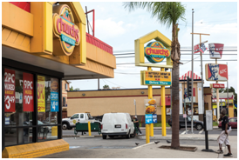
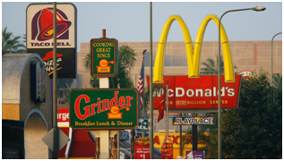
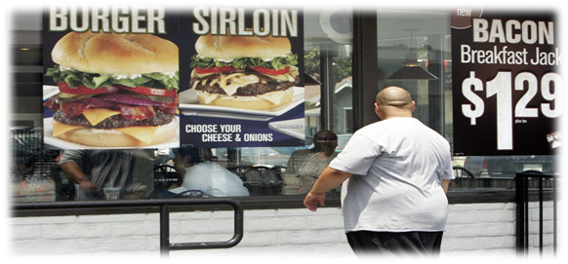
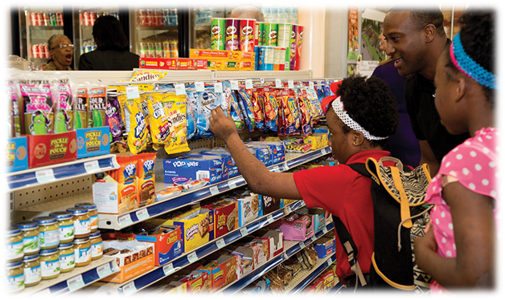
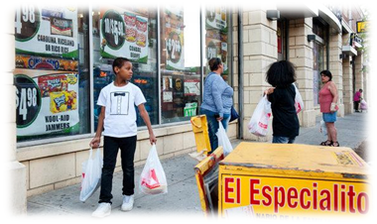
CONSUMPTION OF FOODS AND BEVERAGES FROM FAST FOOD RESTAURANTS AND CONVENIENCE STORES TRANSLATES INTO UNHEALTHY EATING

Slide 5
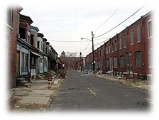
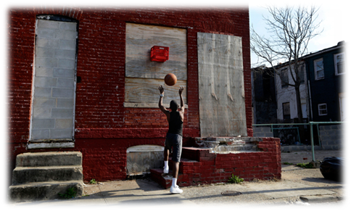
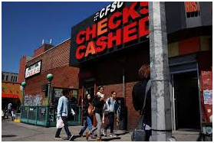
The Built Environment “WHAT IS AROUND YOU DOES MATTER”

Slide 6
Traditional Built Environment of Marginalized Communities
Overexposure to Marketing Advertising
Fast Food Restaurants
Convenience Stores vs. Grocery Stores

Slide 7
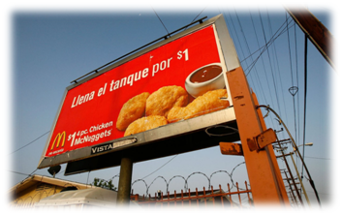
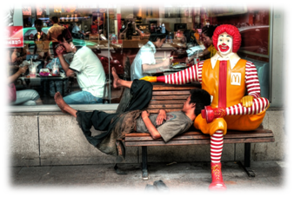
Overexposure of marketing/advertising

Slide 8
Many marginalized communities are targeted with a saturation of ads promoting unhealthy fast food options

Slide 9
Abundance of fast food restaurants/Promotes unhealthy eating

Slide 10
The Built Environment/Why Is This So Important??
A neighborhood‘s physical built environment may also not be conducive for residents to participate in healthy physical activities.
Walk-ability, lack of sidewalks, uneven terrain, and poor lighting can impact opportunities and desires for residents to be physically active (Booth et al., 2005).
Lack of safe parks and walking trails can be barriers as well, thus negatively impacting engaging in much-needed physical activity, which in itself can negatively impact one’s health status

Slide 11
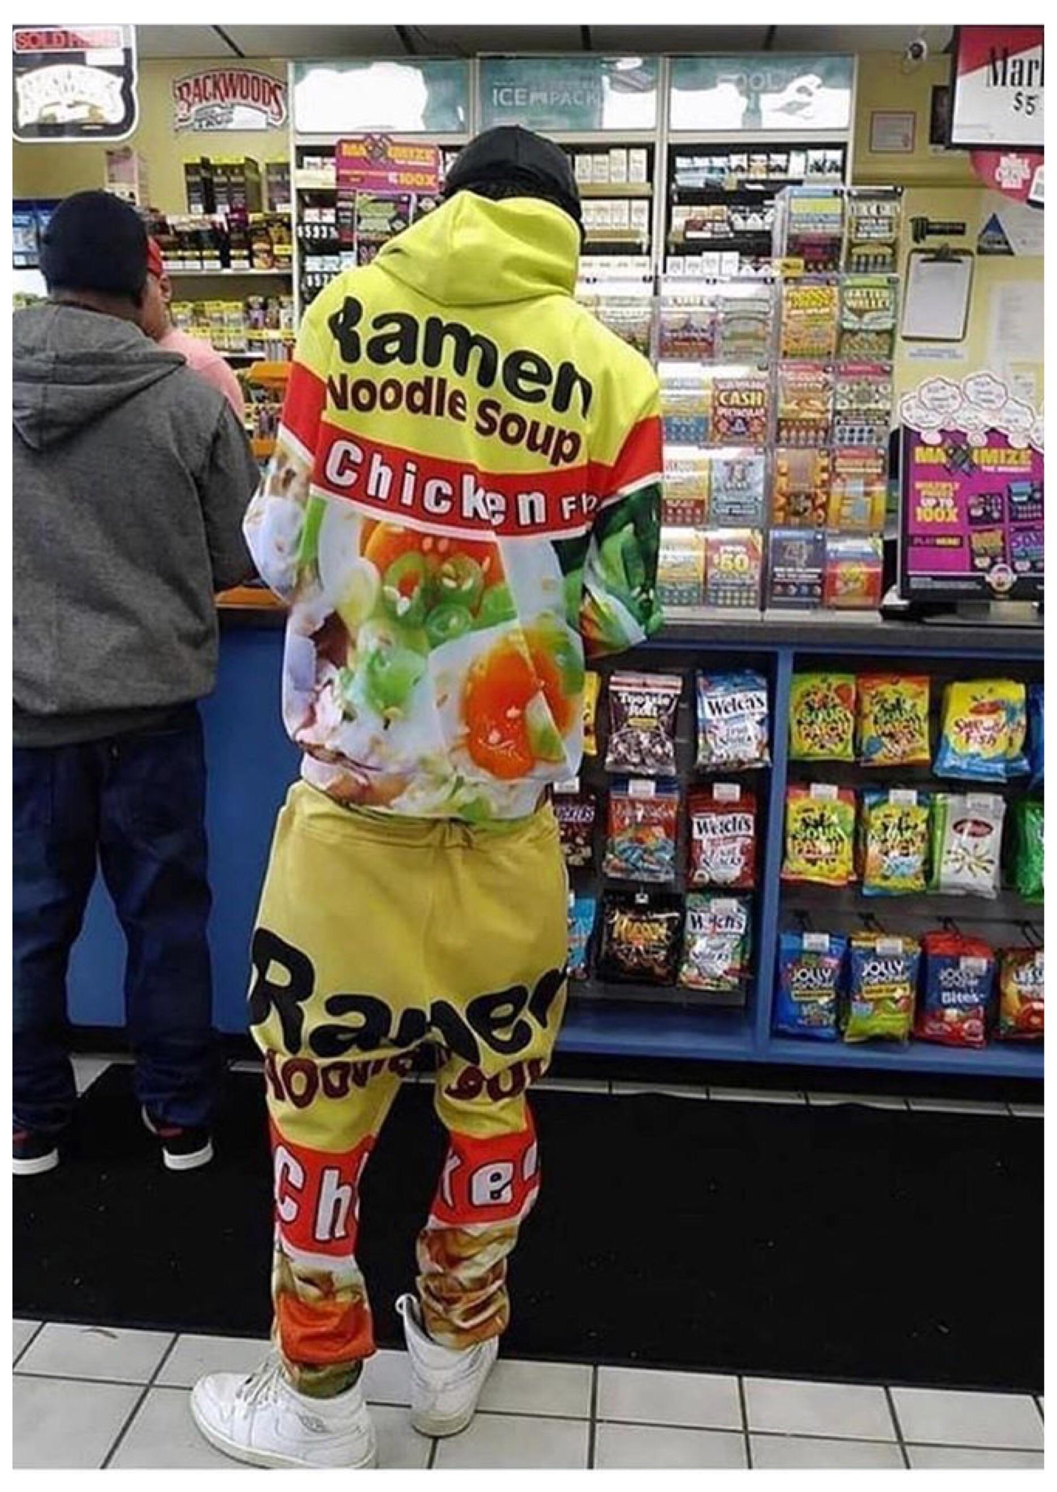
PROLIFERATION OF CONVENIENCE STORES VS. GROCERY STORES
In many marginalized communities many blocks are proliferated with convenience stores

Slide 12
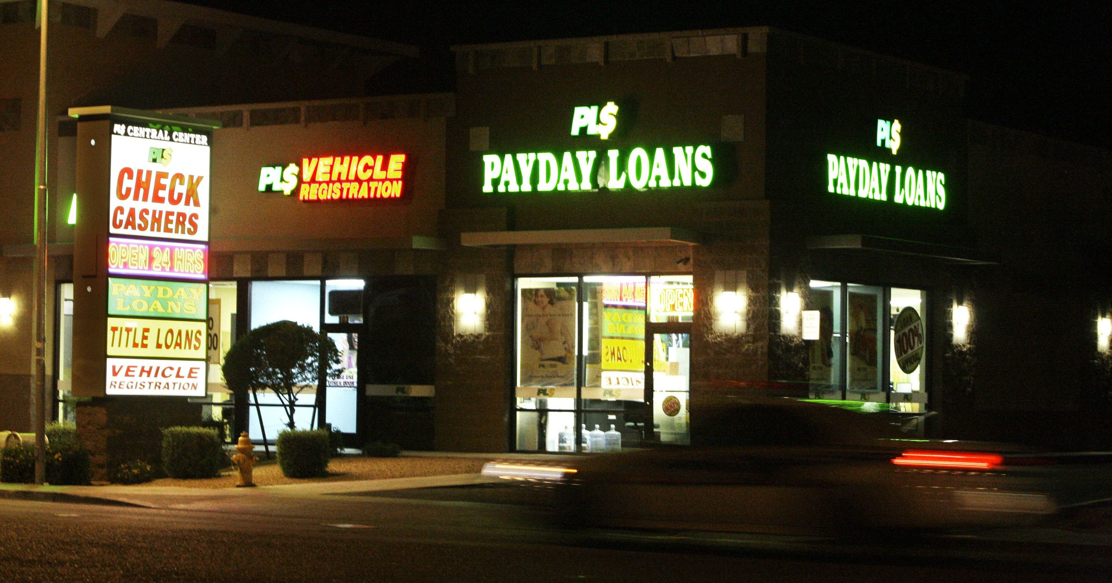
THE BUILT ENVIRONMENT/LACK NEEDED BUSINESSES
Many Neighborhoods lack grocery stores, which could provide much needed services, such as purchase of money orders, check cashing services and bill payments.
Instead, they are proliferated with check cashing, payday and car title loans and convenience stores that have higher pricing designs.

Slide 13
WITHOUT A FULL-SERVICE GROCERY STORE FOR MORE THAN 900 DAYS Published 2 months ago on August 26, 2019 By Wendy Wes
This article discusses a -block area of St. Petersburg that has been without a full-service grocery store for more than 900 days..
Consider all this activity with nary a word from those in office or running regarding the lack of affordable and nutritious foods available in the area, and the negative impact on health this creates.
I am a clinical dietitian at a local acute care hospital and, every day, I educate and treat patients with diabetes, heart disease and kidney failure who live in the 42-block area. They cannot properly manage their diseases on a gas station and convenience store diet that offers low fiber, low nutrient, high sodium and high sugar foods with an even higher price tag.
Many local social service agencies are in the game and aware of the problem,However, gardens and food pantries are not the answer to food insecurity. Nor are city-sponsored shuttle services to Walmart or pop-up produce carts.
At a farm organizing event, I met a man who learned I was a dietitian; he asked me a slew of questions about food and diabetes. I learned he is a middle-aged man with a past medical history of Type II diabetes, congestive heart failure and chronic kidney disease at the fourth stage, which is pre-dialysis. With several hospitalizations under his belt over the past two years, he pointed to the closing of the Walmart grocery store as the fast catalyst for his worsening health.
“I used to walk there,” he said. “Every other day I walked there and got fresh vegetables and fruits, nuts and other stuff that I would store in my room.”
“So, how do you get groceries now?” I asked.
“I don’t,” he answered. “Since that store closed I’ve been eating junk from a gas station. Chips and crackers and stuff. And that’s when things got bad for me.” He suspected his current convenience store and gas station diet was exacerbating his heart failure and kidney failure. I confirmed that managing diabetes on highly processed diet was difficult because of added sugars and lack of fiber. He seemed despondent and hopeless – and I was, too.
Not only is this diet exacerbating his diseases, his food costs have tripled. Consider a gallon of milk at a gas station or convenience store can cost $5, and a dozen eggs $3.75. This compared to $2.59 and 75 cents, respectively, at Aldi across town.
What is the solution? More hand wringing? More shuttles to the mega Walmart?
One promising solution in the works is the One Community Grocery Co-Op, which pledges to follow a road-tested national model of forming grocery co-ops designed by the Food Co-Op Initiative. One Community must recruit 300 members to finish Phase 1 and is seeking financial support for marketing to recruit more members. Co-ops work in cities like Tallahassee and Minneapolis, and will thrive here, too.

Slide 14
WORKING WITH COMMUNITIES TO EMPOWER THEM FOR SUSTAINABLE CHANGE
There are numerous neighborhood associations, organizations, and other governmental agencies and entities that already exist WITHIN COMMUNITIES to help residents to become change agents themselves, as they become empowered to shape and change their community and influence their health status.
Many organizations have been spear-headed and founded by residents themselves and serve as clearinghouses to direct and connect residents to needed services.
Residents can visit them to attain information of where and how to access available services relative to healthcare, education, food scarcity; and of how to attain other services needed.
With such organizations promoting lowering unemployment rates, organizing and engaging their youth in activities, increasing levels of and access to quality education, low socioeconomic status can indeed be influenced.

Slide 15
COMMUNITIES, INDIVIDUALS, ORGANIZATIONS AT WORK
THE CHELSEA STORY
Healthy Chelsea
DUDLEY NEIGHBORHOOD
INITIATIVE

Slide 16
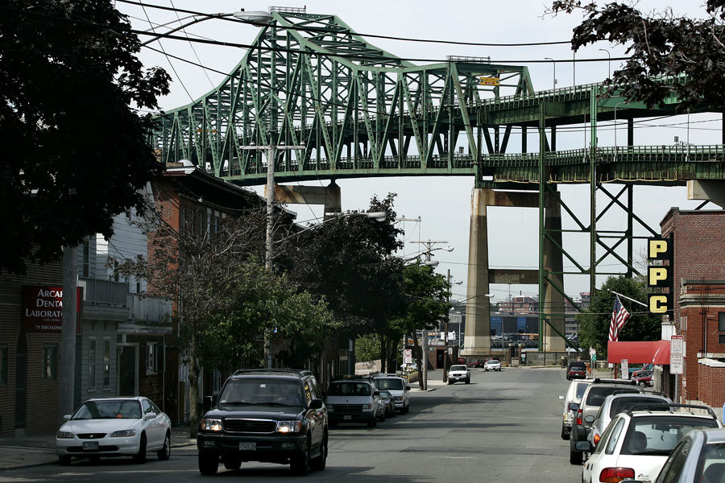
THE CHELSEA STORY: FROM ADDRESSING OBESITY TO MAKING HISTORY
How addressing obesity paid off

Slide 17
Healthy Chelsea, A Neigborhood Initiative
In 2009, a coalition of 75 persons composed of community individuals, persons serving state and local government, along with businesses and community healthcare providers dedicated themselves collectively to addressing the high obesity rate in Chelsea after identifying the need for obesity prevention and the promotion of a healthy lifestyle in Chelsea. This coalition also worked very closely with the Chelsea Public Schools to advocate for dedicated physical activity time for students and for the implementation of healthier eating habits among students.
Working collaboratively with the Chelsea's Planning and Development Department they also were instrumental in improving their infrastructure through park renovations, through focusing on measures to calm traffic and through redesigning roads and sidewalks. In addition Healthy Chelsea worked with the Board of Health to integrate the regulation for artificial trans-fat free for prepared foods that are served in the businesses that are located with Chelsea.
GreenRoots, Inc. , an independent community-based organization, is also located in Chelsea and focuses on public health and environmental justice within the city of Chelsea and surrounding communities. Before becoming an independent organization in 2016, it was a grassroots community committee under the Chelsea Collaborative, Inc. (also known as the Collaborative), which was founded in 1994.[ GreenRoots' accomplishments include enacting the Youth Pass which allocates $26 monthly passes and $7 weekly passes for youth aged 12 to 21 years old.

Slide 18
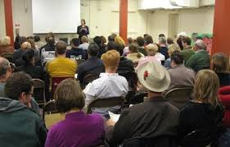
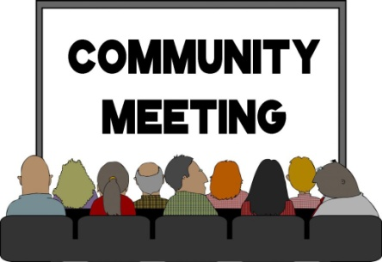
COMMUNITY MEETINGS/COMMUNITY ORGANIZATIONS
Many community, grassroot and
faith-based organizations
and groups exist that engage
the community and
residents in addressing
concerns revolving around
The social determinants of health.
By engaging with such entities
it more likely that voices will
be heard and issues resolved that
Impact the residents.

Slide 19
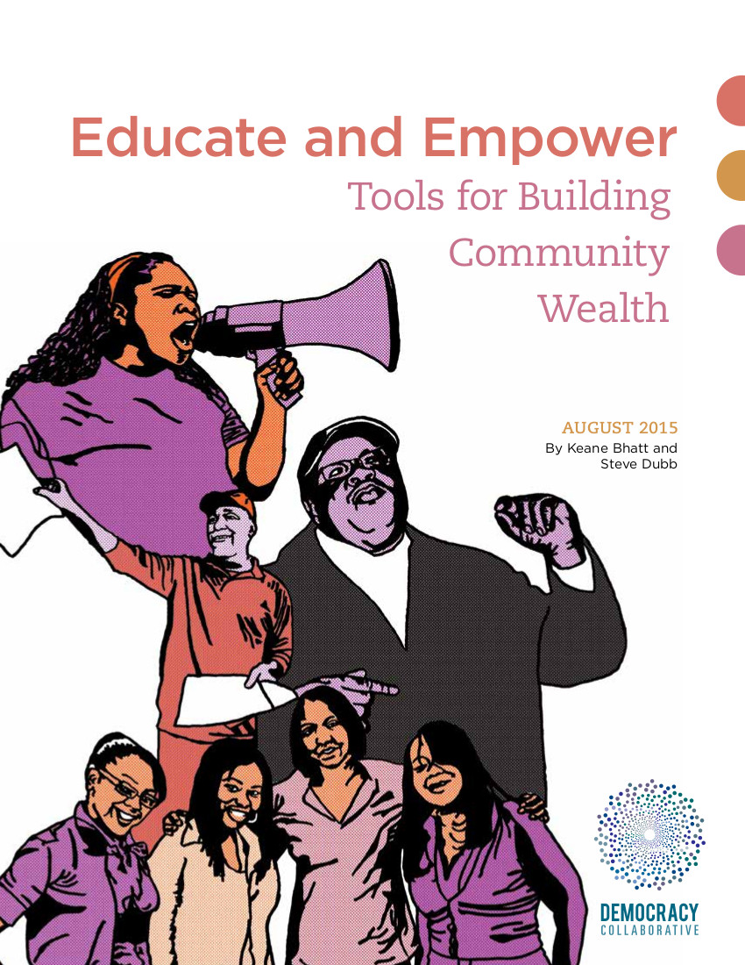
EDUCATE AND EMPOWER
DUDLEY STREET
NEIGHBORHOOD
INITIATIVE

Slide 20
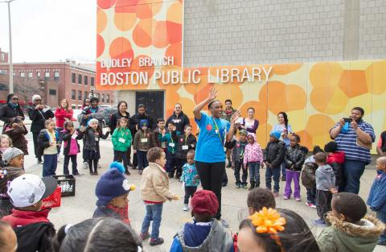
DUDLEY STREET NEIGHBORHOOD INITIATIVE

Slide 21
DUDLY STREET NEIGHBORHOOD INITIATIVE (DSNI) NARRATIVE
“Dudley Street Neighborhood Initiative is a nonprofit community-based planning and organizing entity birthed in 1984 out of the passion, ingenuity and determination of Dudley residents seeking to reclaim a neighborhood that had been ravaged by disinvestment, arson fires and dumping. DSNI’s mission is to empower Dudley residents to organize, plan for, create and control a vibrant, diverse and high quality neighborhood in collaboration with community partners”.
“When many had given up, DSNI dared to gather neighbors to create a comprehensive plan and a shared vision for a new, vibrant urban village. To fulfill the community mandate for development without displacement, DSNI gained eminent domain authority, purchased vacant land, and protected affordability and family stability through a community land trust. The once garbage-strewn vacant lots have been rebuilt with quality affordable houses, parks and playgrounds, gardens, community facilities, and new businesses”.
“Through our Board structure, residents lead an effort that includes all neighborhood stakeholders in a democratically-elected, community accountable process. Together, we have created greater civic participation, economic opportunity, community connections, and opportunities for youth. We have built community across our diversity –of language, race & ethnicity, age. We have invested in our young people and the youth in turn have invested in the community”.

Slide 22
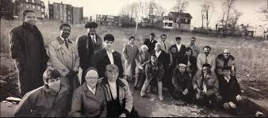
DUDLEY STREET NEIGHBORHOOD INITIATIVE (DSNI)
Dudley Street Neighborhood Initiative created a resident-led process for an innovative governance structure. It’s board is composed of a majority of Roxbury residents who are elected every two years, via open voting.
Different ethnic groups are purposefully elected to the board, with slots also being reserved for area nonprofits and local businesses.

Slide 23
SOME NOTABLE RESOURCES Help with Homelessness Prevention, Shelter, Housing Stabilization, Employment Services and Other Resources
FAMILY AID BOSTON: For homeless families who are ready to return to permanent housing immediately FamilyAid Boston offers two affordable housing programs.
Each family’s has a different situation.
While some only need brief assistance in getting on their feet,
others may need long –term help and stability.
Family Aid Boston provides two permanent housing programs,
serving families with varied needs:
1) Rapid Re-Housing helps homeless families
with sufficient resources transition
quickly back into permanent housing.
2) HOMES provides formerly homeless families with
permanent affordable housing and support services.

Slide 24
FAMILYAID BOSTON: EMPLOYMENT SERVICES
EMPLOYMENT SERVICES
FamilyAid Boston’s employment services
provide clients with the job search, education and
training referrals, and career development
resources they need for success by providing a wide range
of support for not only individuals seeking jobs but also for
those persons seeking to advance their careers.
Using a combined approach with housing, clinical, and case
management services, families are given the utmost opportunity
to achieve success for self sufficiency.
Once enrolled in the program, the families receive a variety of services
that includes employment counseling, needs assessment, job search support and
access to professionals who are trained to work with families of low-socioeconomic status
and homeless families in providing career development services.

Slide 25
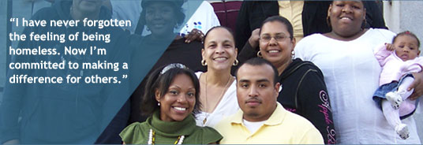
HOMES FOR FAMILIES
Homes for Families
Homes for Families, a state-wide policy
advocacy organization, values the importance of
meaningful engagement of families experiencing
homelessness, shelter providers, along with
communities and elected officials as being central in
Impacting the fight against homelessness.
“We understand that the best way forward is
collaboratively, through family and provider driven,
ground up organizing, advocacy and policy making.
We have a holistic approach of cross educating,
Grassroots organizing and lobbying to address the
devastating impacts of housing instability on families.”

Slide 26
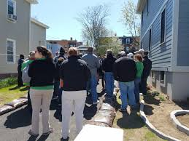
IMPORTANCE OF COMMUNITY ENGAGEMENT: THE VOICE OF THE PEOPLE
Community engagement and involvement are key
to solving simple and complex problems
for residents. It is very important to hear
and listen to the voice of the community before
taking action on addressing issues that
are of concern to the residents. It is
their voice, support and willingness to sustain
proposed programs and interventions
that can spell “success or failure’” in moving
toward implementation.

Slide 27
HELPFUL RESOURCES
Boston Area Resources
Homes for Families
Massachusetts Coalition for the Homeless
Project Hope
Casa Myrna
Rosie's Place
Metropolitan Boston Housing Partnership
Pine Street Inn City Life Vida Urbana
Horizons for Homeless Children St. Francis House
Government Resources
U.S. Department of Housing and Urban Development
Massachusetts’ Department of Transitional Assistance
Department of Housing and Community Development
MassHousing City of Boston Emergency Shelter Commission
City of Boston 311
Advocacy Resources
Massachusetts Housing and Shelter Alliance
MassachusettsLaw Reform Institute HealthCare for All
Children's HealthWatch Center

Slide 28
TOGETHER, I, YOU, AND WE CAN MAKE A DIFFERENCE!!!

Slide 29
THE END
(THE BEGINNING IS LEFT UP TO US!!)

Slide 30
REFERENCES
Booth, K. M., Pinkston, M. M., & Poston, W. S. (2005). Obesity and the built environment. J Am Diet Assoc, 105(5 Suppl 1), S110-117. doi:10.1016/j.jada.2005.02.045
Carlson, S., & Neuberger, Z. (2017). WIC Works: Addressing the Nutrition and Health Needs of Low-Income Families for Years. Policy Futures. Retrieved from https://www.cbpp.org/research/food-assistance/wic-works-addressing-the-nutrition-and-health-needs-of-low-income-families
Centers for Disease Control and Prevention. (2014). NCHHSTP Social Determinants of Health. Retrieved from https://www.cdc.gov/nchhstp/socialdeterminants/definitions.html
Flood, S. (2010). Dudley Street Neighborhood Initiative | Participedia. Retrieved October 3, 2019, from https://participedia.net/en/organizations/dudley-street-neighborhood-initiative
Staff — DSNI. (n.d.). Retrieved October 03, 2019, from https://www.dsni.org/staff
NIP. (2014). Boston Promise Initiative at Dudley Street Neighorhood Initiative, Boston, Massachusetts. Promise Neighborhood Institute at PollcyLink. Retrieved from
www.promiseneighborhoodsinstitute.org
www.umb.edu/news/detail/anything_is_possible_motto_guides_dudley_street_neighborhood_initiatives_af

