Slide 1
Vaping: Background
Sara Kalkhoran, MD MAS
Assistant Professor of Medicine
Massachusetts General Hospital
Harvard Medical School

Slide 2
Disclosures
I receive royalties from UpToDate for a chapter on electronic cigarettes

Slide 3
Overview
Background on e-cigarette devices/vaping
Components of e-cigarettes
Prevalence of e-cigarette use
Update on e-cigarette associated lung injury

Slide 4
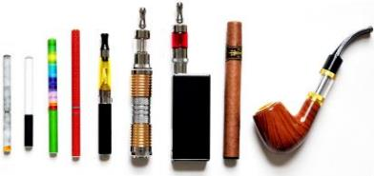
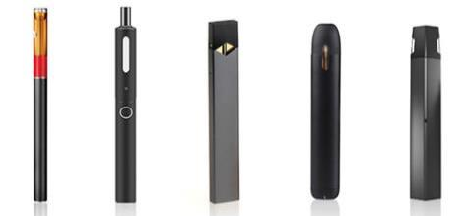
Electronic cigarettes
Type of electronic nicotine delivery system
Battery-powered devices that heat a solution of humectants, nicotine, flavorings
Hundreds of brands, thousands of flavors
Images from Fda.gov
Notes:
Heat a solution of humectants such as propylene glycol or glycerol
100s of different brands, thousands of different flavors available on the Internet, vape shops
466 brands, 7764 flavors in 2014

Slide 5
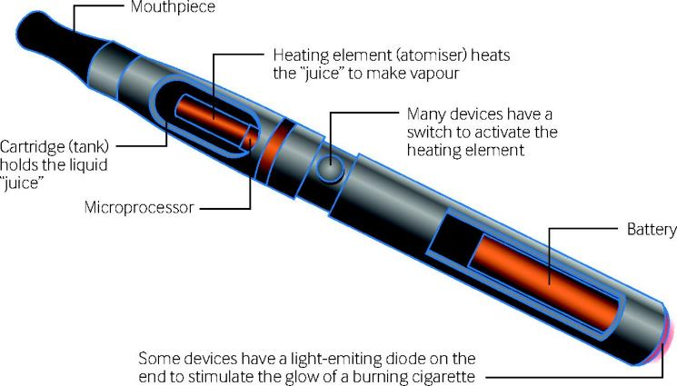
E-cigarette components
Jamie Hartmann-Boyce et al. BMJ 2018;360:bmj.j5543
©2018 by British Medical Journal Publishing Group
Notes:
Components of an electronic cigarette

Slide 6
Types of e-cigarettes
Image from CDC.gov
Notes:
1st generation: cigalikes – not refillable or rechargeable; disposable
2nd generation: pen or tank; have rechargeable batteries, refillable cartridges and may allows users to regulate puff frequency and duration
3rd generation: often contain manual switches and battery casing to customize battery capacity
4th generation: Pod-mods – replaceable cartridges

Slide 7
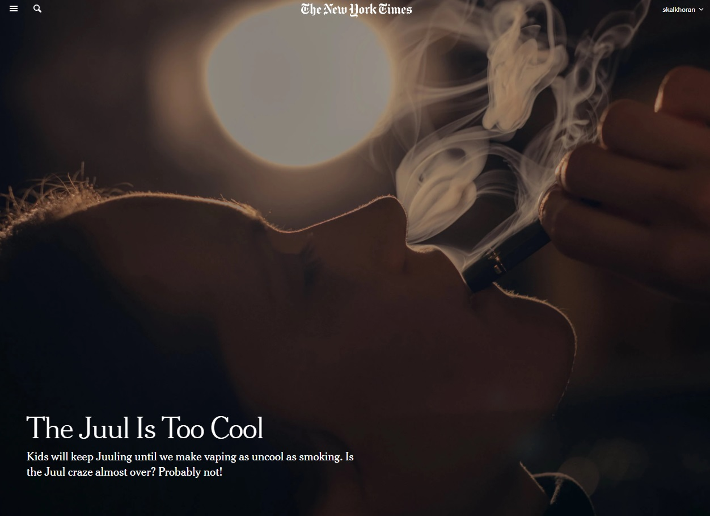
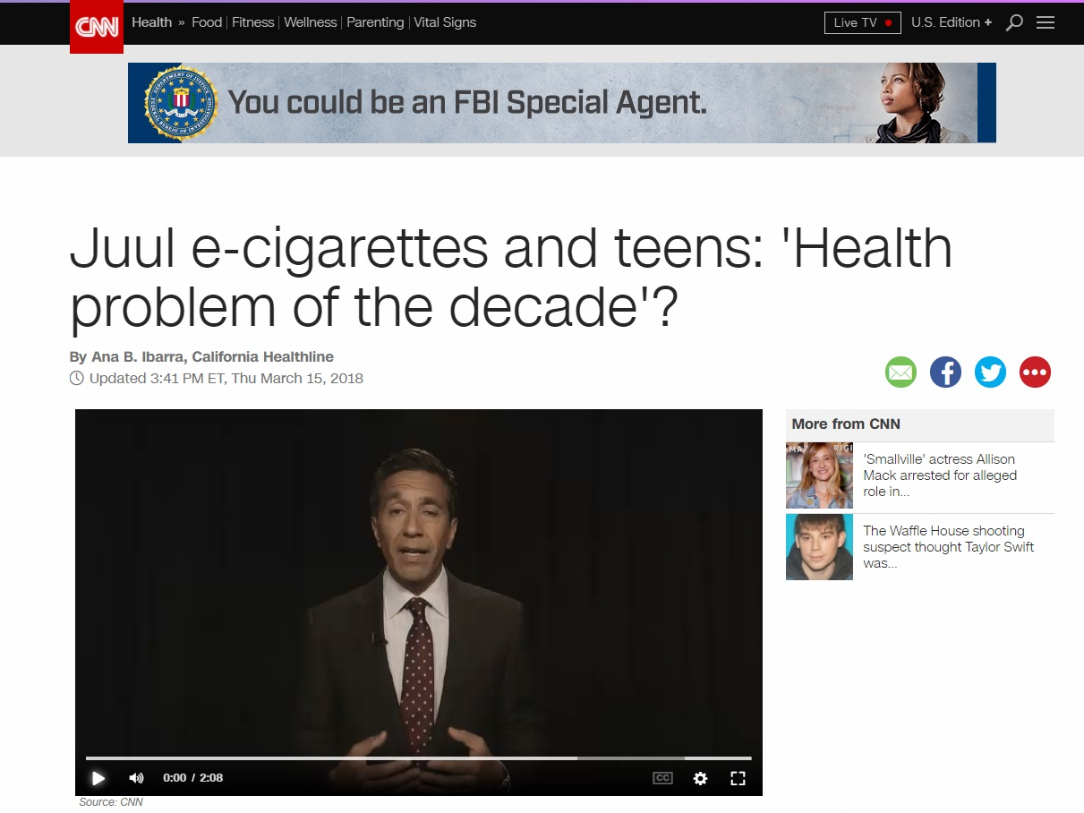
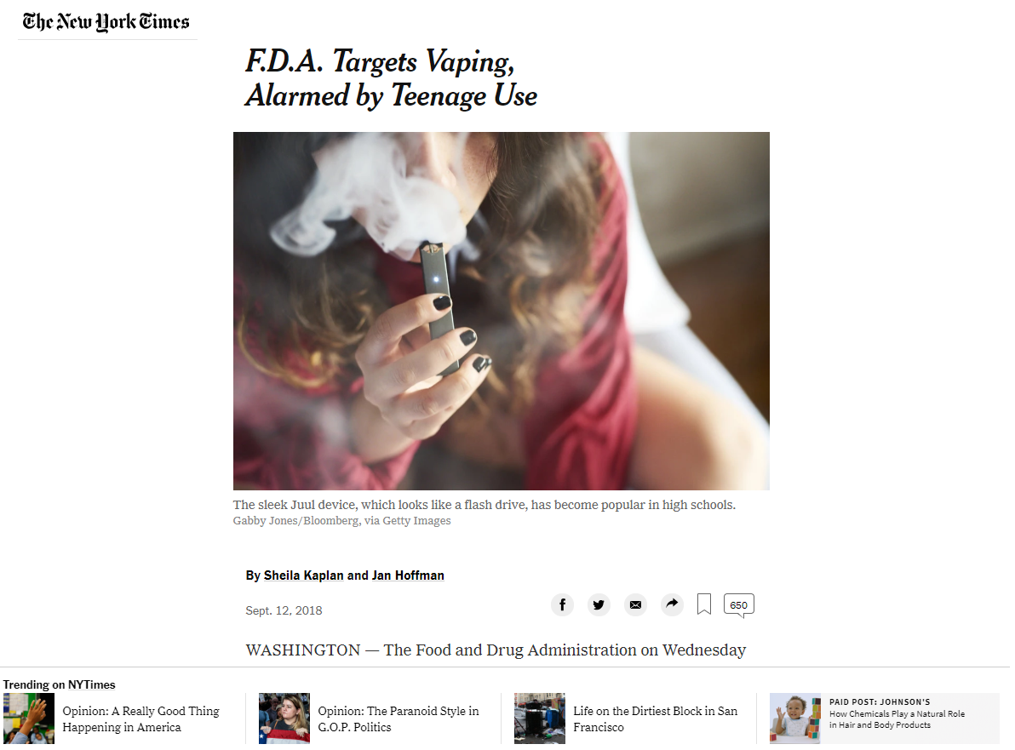


Slide 8

JUUL
Nicotine salt-based
Less irritating when inhaled
High nicotine exposure
Come in variety of flavors
Goniewicz ML, et al. Tobacco Control. 2019

Slide 9
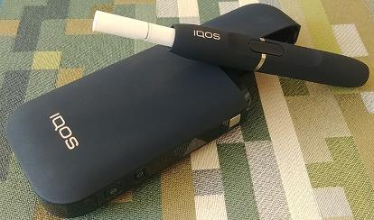
Heat not Burn Tobacco Cigarettes
Heat tobacco instead of burning it like combustible cigarettes
Different from e-cigarettes in that they heat tobacco, not nicotine

Slide 10
What’s in an e-cigarette?
Propylene glycol or glycerol
Nicotine
Flavorings
Metals, volatile organic compounds
Notes:
Some people also use marijuana, THC, or CBD in e-cigarettes

Slide 11
Nicotine concentration of e-cigarettes
Some are nicotine-free
Nicotine delivery variable (based on device, individual use patterns)
Experienced users may receive comparable nicotine to combustible cigarettes
Talih S et al. Nicotine Tob Res 2015; Farsalinos KE et al. Sci Rep 2015

Slide 12
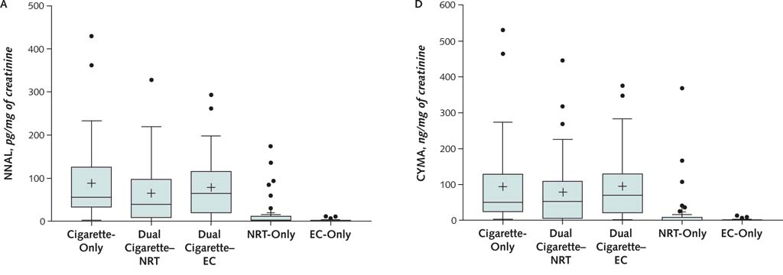
Toxin and carcinogen content of e-cigarettes
Shahab L et al. Ann Intern Med. 2017
Notes:
NNAL – lung carcinogen
CYMA = acrylonitrile - carcinogen

Slide 13
Toxin and carcinogen content of e-cigarettes
Toxins | E-cigarette (15 puffs) | Conventional cigarette | Nicotine inhaler
Formaldehyde (µg) | 0.20 - 5.61 | 1.6 – 52.0 | 0.20
Acetaldehyde (µg) | 0.11 - 1.36 | 52.0 – 140.0 | 0.11
Acrolein (µg) | 0.07 - 4.19 | 2.4 – 62.0 | ND
o-methylbenzaldehyde (µg) | 0.13 - 0.71 | -- | 0.07
Toluene (µg) | ND - 0.63 | 8.3 – 70.0 | ND
p,m-xylene (µg) | ND - 0.2 | -- | ND
NNN (ng) | ND - 0.00043 | 0.0005 - 0.19 | ND
NNK (ng) | ND - 0.00283 | 0.012 - 0.11 | ND
Cadmium (µg) | ND - 0.022 | -- | 0.003
Nickel (µg) | 0.01 - 0.03 | -- | 0.019
Lead (µg) | 0.003 - 0.057 | -- | 0.004
ND = Not Detected; -- = not reported Data from Goniewicz et al. 2013, Tobacco Control, using lowest and highest values reported
Notes:
Long-term effects of inhaled propylene glycol and/or glycerol unknown
Variability in devices, liquids, and patterns of use

Slide 14
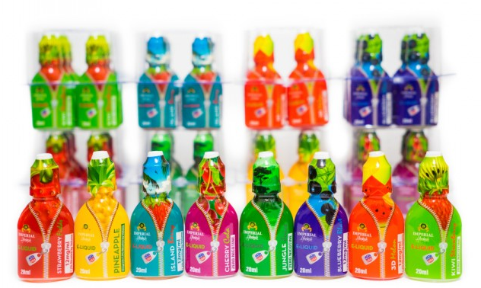
E-cigarette flavors
Diacetyl, found in sweet-flavored e-cigarettes, associated with respiratory disease
Benzaldehyde, found in cherry-flavored e-cigarettes, associated with respiratory irritation
Farsalinos KE et al. Nicotine and Tobacco Research 2015; Kosmider L et al. Thorax 2016

Slide 15
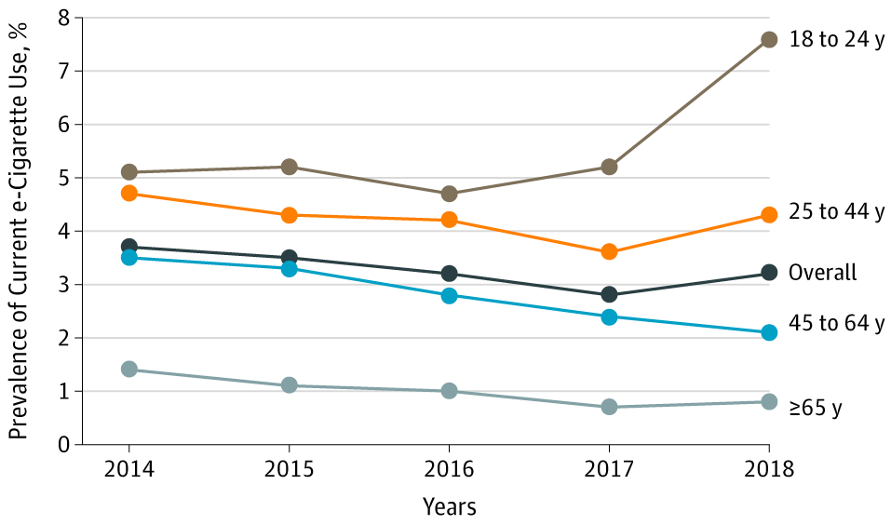
E-cigarette use among adults, 2014-2018
Bao W et al. JAMA Intern Med. 2019.

Slide 16
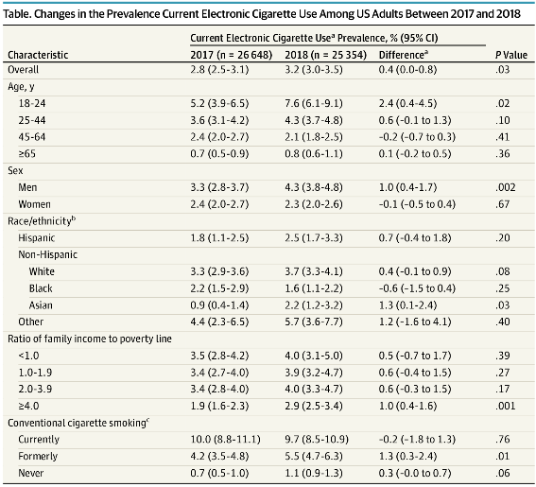
Who is using E-cigarettes?
Bao W et al. JAMA Intern Med. 2019.

Slide 17
Current cigarette and e-cigarette use among HS Students, 2011-2019
Adapted from National Youth Tobacco Survey, 2011-2019
Cullen KA et al. JAMA 2019

Slide 18
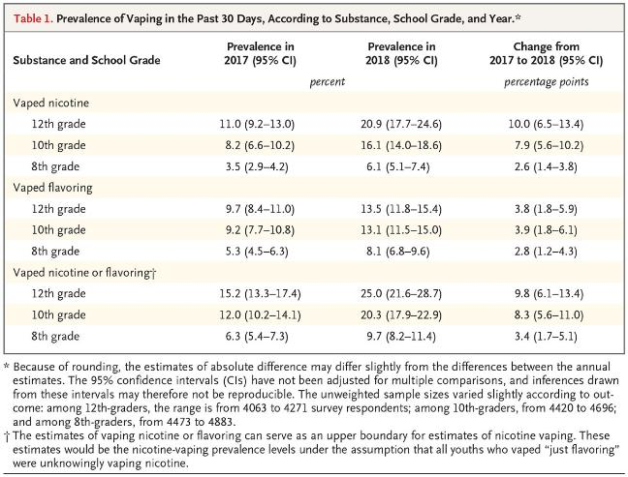
Nicotine vaping among Adolescents
Miech R et al. NEJM 2019

Slide 19
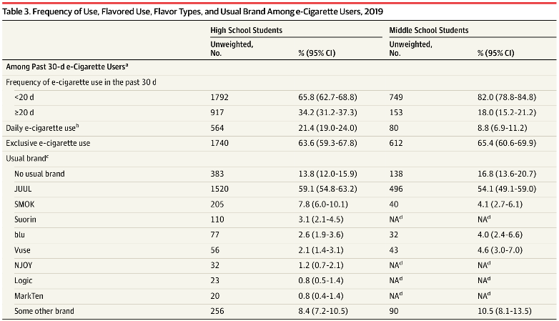
Youth e-cigarette use patterns
Cullen KA et al. JAMA 2019
Notes:
2019 NYTS data

Slide 20
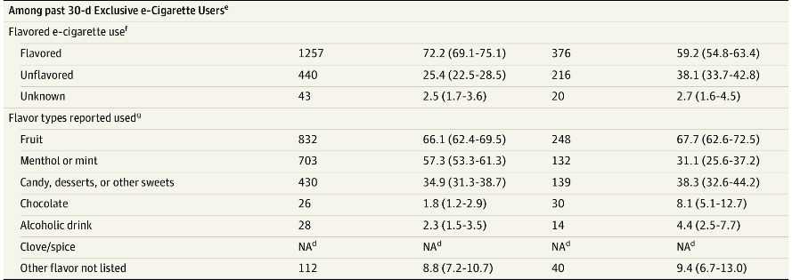
Youth e-cigarette use patterns
Cullen KA et al. JAMA 2019

Slide 21
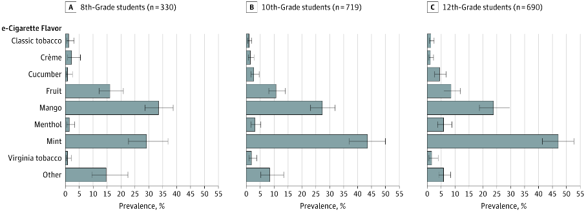
Flavors used by Past 30-Day JUUL users
Leventhal AM et al. JAMA 2019
Notes:
What flavor did you use most often?

Slide 22

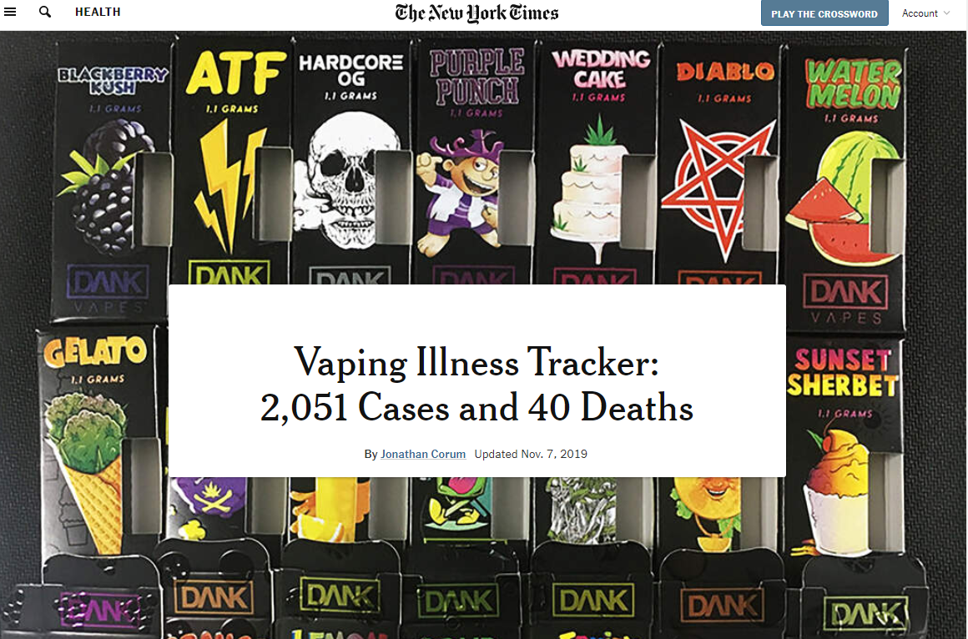
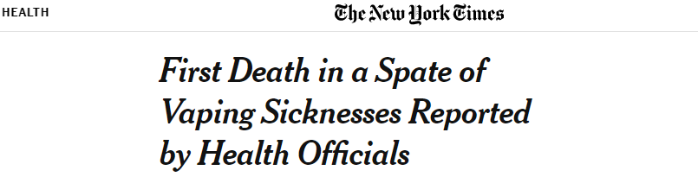
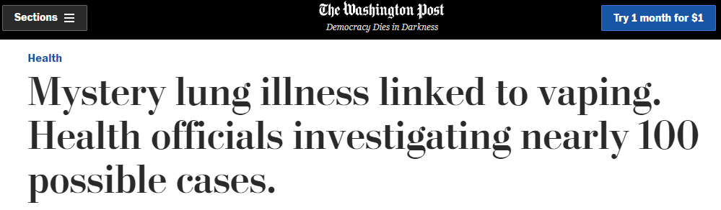

Slide 23
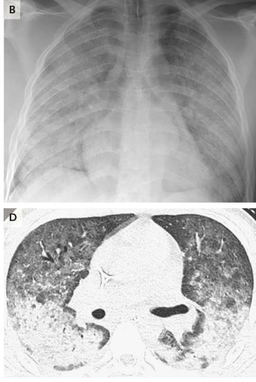
E-cigarette or Vaping product use-associated lung injuries
As of November 5: 2,051 cases of EVALI
From 49 states, District of Columbia, and 1 U.S. Territory
39 deaths in 24 states
Ages 17-75 (median 53)
Symptoms:
Cough, shortness of breath, chest pain
Nausea, vomiting, abdominal pain, diarrhea
Fevers, chills, weight loss
Layden JE et al. NEJM 2019; CDC

Slide 24
EVALI Cases
70% are male
Median age 24 years old (range: 13-75)
79% under 35 years old
86% reported using THC-containing products
34% exclusive THC use
64% reported nicotine-containing products
11% exclusive nicotine use
November 8: CDC reported Vitamin E acetate was found in all 29 test samples of bronchoalveolar lavage fluid

