Slide 1
LGBTQA+ Wellness Care: Illusion, Delusion or Reality
Notes:
Change the the title

Slide 2
Learning Outcome
An increase in participants’ knowledge of the challenges the LGBTQA+ population faces in health care and society as well as knowledge of how to successfully move forward.
This increase in knowledge will allow participants to better advocate for change at the individual, societal, and population levels and serve in providing quality care for those who identify as LGBTQA+.
Notes:
Redo these

Slide 3
Social Construction Anyone?

Slide 4
Social Construction
Social constructionism is the theory that people develop knowledge of the world in a social context, and that much of what we perceive as reality depends on shared assumptions.
Notes:
From a social constructionist perspective, many things we take for granted and believe are objective reality are actually socially constructed, and thus, can change as society changes.
Source: https://www.thoughtco.com/social-constructionism-4586374

Slide 5
Intersections

Slide 6
Intersections
The reference to “social implications” in this definition takes into account the sociohistorical (including personal history) and sociopolitical context of these identities and recognizes the unique experiences of the individual based on the intersection of all relevant group memberships.
Notes:
Marsiglia and Kulis (2015) offer a definition of intersectionality in the context of social work practice. They state that this concept refers to
The multidimensionality and complexity of the human cultural experience and describes the place where multiple identities come together or intersect. Individuals hold positions within multiple systems of inequality based on race, ethnicity, gender, social class, sexual orientation, age and ability status; particular set of identities carry important social implications. (p. 52)
Cited in Sue et al. (2016). Multicultural social work practice: A competency-based approach to diversity and social justice, (2nd ed.). Wiley.

Slide 7
ADDRESSING
A – age
D – developmental disabilities
D – acquired disabilities
R – religion/spirituality
E – ethnicity/race
S – sexual orientation
S – socio-economic status
I – indigenous group membership
N – nationality
G – gender
Notes:
Developed by Pamela Hays (1996, 2008), the "ADDRESSING" model is a framework that facilitates recognition and understanding of the complexities of individual identity. According to Hays, consideration of age, developmental disabilities, acquired disabilities, religion, ethnicity, sexual orientation, socioeconomic status, indigenous group membership, nationality, and gender contributes to a complete understanding of cultural identity.

Slide 8
What’s in a Name?
Terminology

Slide 9
Sexual Orientation
Sexual orientation – Attraction for sexual partners either of the opposite, same, or both sexes.
Heterosexual – “straight”
Homosexual: Gay, Lesbian, Bisexual, Queer, Questioning, etc.
Notes:
LESBIAN
A woman whose enduring physical, romantic, and/or emotional attraction is to other women. Some lesbians may prefer to identify as gay or as gay women.
GAY
The adjective used to describe people whose enduring physical, romantic, and/or emotional attractions are to people of the same sex. Sometimes lesbian is the preferred term for women.
BISEXUAL
A person who has the capacity to form enduring physical, romantic, and/or emotional attractions to those of the same gender or to those of another gender. People may experience this attraction in differing ways and degrees over their lifetime. Bisexual people need not have had specific sexual experiences to be bisexual; in fact, they need not have had any sexual experience at all to identify as bisexual.
QUEER
An adjective used by some people whose sexual orientation is not exclusively heterosexual. Typically, for those who identify as queer, the terms lesbian, gay, and bisexual are perceived to be too limiting and/or fraught with cultural connotations they feel don’t apply to them. Some people may use queer, or genderqueer, to describe their gender identity and/or gender expression. Once considered a pejorative term, queer has been reclaimed by some LGBTQ people to describe themselves; however, it is not a universally accepted term even within the LGBTQ community.
QUESTIONING
Sometimes, when the Q is seen at the end of LGBT, it can also mean questioning. This term describes someone who is questioning their sexual orientation or gender identity.
Terms defined by gaycenter.org

Slide 10
Gender Identity
Terminology

Slide 11
Transgender
TRANSGENDER
  An umbrella term for people whose gender identity and/or gender expression differs from what is typically associated with the sex they were assigned at birth.
Cisgender – seeing one’s sex and gender as the same
Notes:
People under the transgender umbrella may describe themselves using one or more of a wide variety of terms— including transgender. Many transgender people are prescribed hormones by their doctors to bring their bodies into alignment with their gender identity. Some undergo surgery as well. But not all transgender people can or will take those steps, and a transgender identity is not dependent upon physical appearance or medical procedures.

Slide 12
Gender
Gender binary
Gender-expansive
Gender expression
Gender-fluid
Gender identity
Gender non-conforming
Genderqueer
Notes:
Gender binary | A system in which gender is constructed into two strict categories of male or female. Gender identity is expected to align with the sex assigned at birth and gender expressions and roles fit traditional expectations.
Gender-expansive | A person with a wider, more flexible range of gender identity and/or expression than typically associated with the binary gender system. Often used as an umbrella term when referring to young people still exploring the possibilities of their gender expression and/or gender identity.
Gender expression | External appearance of one's gender identity, usually expressed through behavior, clothing, body characteristics or voice, and which may or may not conform to socially defined behaviors and characteristics typically associated with being either masculine or feminine.
Gender-fluid | A person who does not identify with a single fixed gender or has a fluid or unfixed gender identity.
Gender identity | One’s innermost concept of self as male, female, a blend of both or neither – how individuals perceive themselves and what they call themselves. One's gender identity can be the same or different from their sex assigned at birth.
Gender non-conforming | A broad term referring to people who do not behave in a way that conforms to the traditional expectations of their gender, or whose gender expression does not fit neatly into a category. While many also identify as transgender, not all gender non-conforming people do.
Genderqueer | Genderqueer people typically reject notions of static categories of gender and embrace a fluidity of gender identity and often, though not always, sexual orientation. People who identify as "genderqueer" may see themselves as being both male and female, neither male nor female or as falling completely outside these categories.
Terms defined from: https://www.hrc.org/resources/glossary-of-terms

Slide 13
Impact of Social Construction
How does this impact our clients?

Slide 14
Personal Impact
Impact of suppression of self
Exclusion from the dominant culture
Social network and support
Internalization of dominant expectations
Can you think of other ways a person can be impacted?
Notes:
Dominate to Dominant

Slide 15
Transgender
Identity vs. Dysphoria

Slide 16
Gender Dysphoria: DSM-5
Strong and persistent identification with being the other gender (demonstrated by four of the following:)
  Stated desire to be, or insistence that he or she is, the other sex
  Preference for cross-dressing
  Preference for cross-sex roles in play and fantasy
  Desire to participate in stereotypic games of other sex
  Preference for playmates of the other sex
Persistent discomfort with his or her sex and sense of inappropriateness in the gender role of that sex.
Causes significant distress or problems in functioning.

Slide 17
Gender Dysphoria
Diagnostic criteria differ for children vs. adolescents and adults
  Preferences in play and behavior
  Desire to be the other gender

Slide 18
Transitioning
MTF: someone transitioning from male to female
FTM: Someone transitioning from female to male

Slide 19
The Nature of Gender Dysphoria
Clinical Overview
  Person feels trapped in the body of the wrong gender
  Assume identity of the desired gender
  The goal is not sexual
Causes are Unclear
  Gender identity develops early – 18 to 36 months of age

Slide 20
Daily Living
Challenges

Slide 21
Challenges of Daily Living
Dress
Restroom
Wanting to look like the gender they feel they are
  Binding
  Facial hair
  Voice
Social judgment and oppression

Slide 22
Barriers and Buffers
Assessment Time

Slide 23
Barriers and Buffers
  Barriers
  Heterocentrism
  Political & Social Climate
  Work/Life Pressures to Pass
  Cultural/Racial Variables
  Fear of
    Physical/Emotional/Spiritual Harm
  Rural vs. City Status
  Minority Status
  Fear of loss of F.O.O.
  Fear of loss of community
(friends, religious, family, community)
  Buffers
  Cohort
  LGBQ Community Access
  Political & Social Climate
  Cultural/Racial Variables
  Access to Affirmative Clinicians
  Rural vs. City Status
  Sexual Diversity Awareness
  “Minority” Status
  Access to GSAs
  Access to Role Models
  Access to Positive Media Portrayals Resilience

Slide 24
Challenges of Coming Out

Slide 25

Coming Out Challenges
  Isolation
  Depression
  Fear of being “found out”
  Fear of physical harm
  Sexual loneliness and risk taking
  Loneliness from larger LGBTQ community
  Family problems
  Lack of trust with others

Slide 26
Remember
  There is no rubric, guideline, or one-size-fits-all process
  Everyone is an individual, and everyone has different reasons for the choices one makes
  An individual may come out to different people or groups at different periods of time

Slide 27
Adolescent Issues

Slide 28
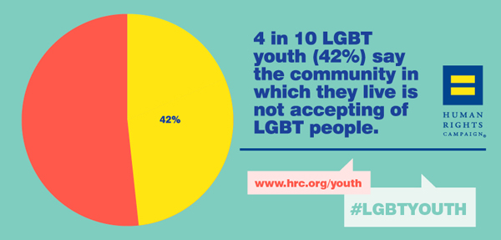

Slide 29
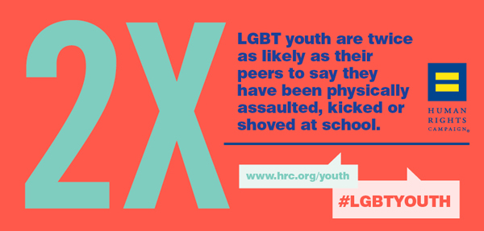

Slide 30
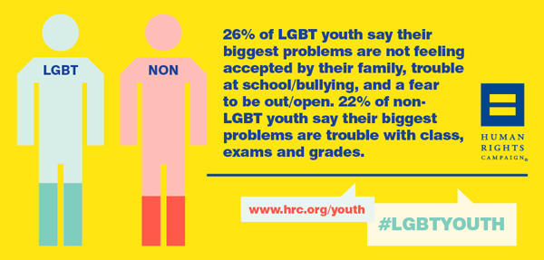

Slide 31
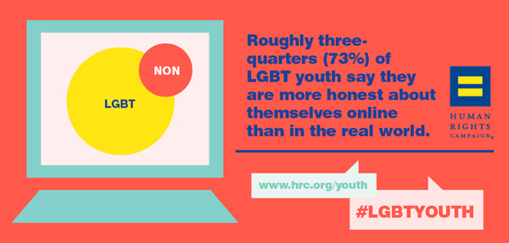

Slide 32
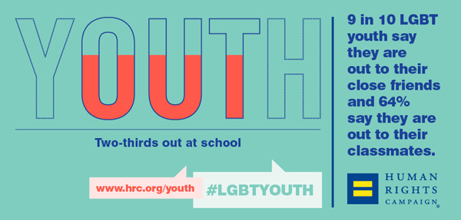

Slide 33
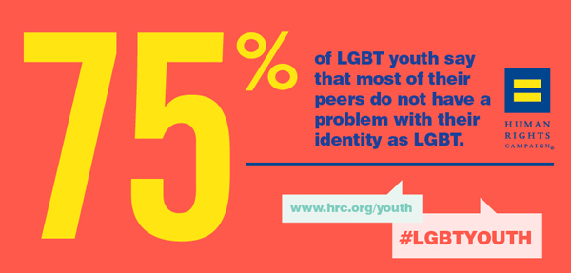

Slide 34


Slide 35
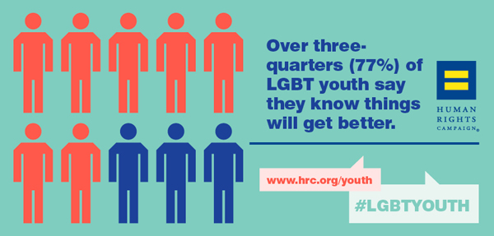

Slide 36
Mental Health Issues

Slide 37
Mental Health Issues
Depression
Anxiety/Stress
Trauma
Relationship challenges/attachment
Trust

Slide 38
Supporting others

Slide 39
10 Ways to Support LGBTQ Clients
  Confront your own prejudices and homophobia, even if it is uncomfortable to do so.
  Use all-inclusive language (i.e. “partner” instead of “boyfriend” or “girlfriend”) until you know your client’s preference.
  Understand that you cannot tell if someone is gay by looking at him/her.
  Listen and be open-minded.
  Respect confidentiality. It is imperative that you can be trusted. If someone comes out to you, don’t assume that they have come out to others.

Slide 40
10 Ways to Support LGBTQ Clients
  Be honored if someone comes out to you.
  Let others know that you find homophobic comments and jokes offensive.
  Educate others.
  Advocate for the trainee/volunteer when he or she is mistreated because of their LGBTQ identity.
  Know when and where to seek help to grow in your quest to be an inclusive provider.

Slide 41
What are the traits of an
LGBTQ affirming provider?

Slide 42
LGBTQ Affirming Clinicians:
Ensure that the therapy environment is safe and affirming
Have policies in place that support the needs of the LGBTQ client:
    Intake Forms
    Trained office staff
    Signs and symbols

Slide 43
LGBTQ Affirming Clinicians:
  Informed regarding the impact of societal stigma on
  the well-being of the client
  Educated on the impact of heterocentrism on
  LGBTQ stress levels
  Normalize sexual diversity
  Understand their role in acting as external buffer

Slide 44
LGBTQ Affirming Clinicians:
Gently following shifts in identity with questioning &
newly coming out persons
Are educated on the stressful process of coming out
and identity synthesis
Acknowledging authentic life and relationship rituals
of LGBQT clients
Stay informed regarding issues that impact clients
Notes:
Item number 1 has been put into two bullet points; needs to be one
Take out the period for bullet point #4

