Slide 1


What is it actually like?
An individual and familial perspective.

Slide 2
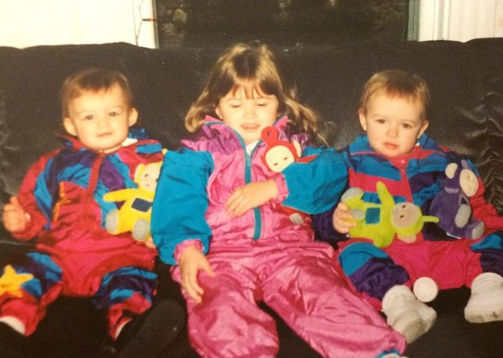
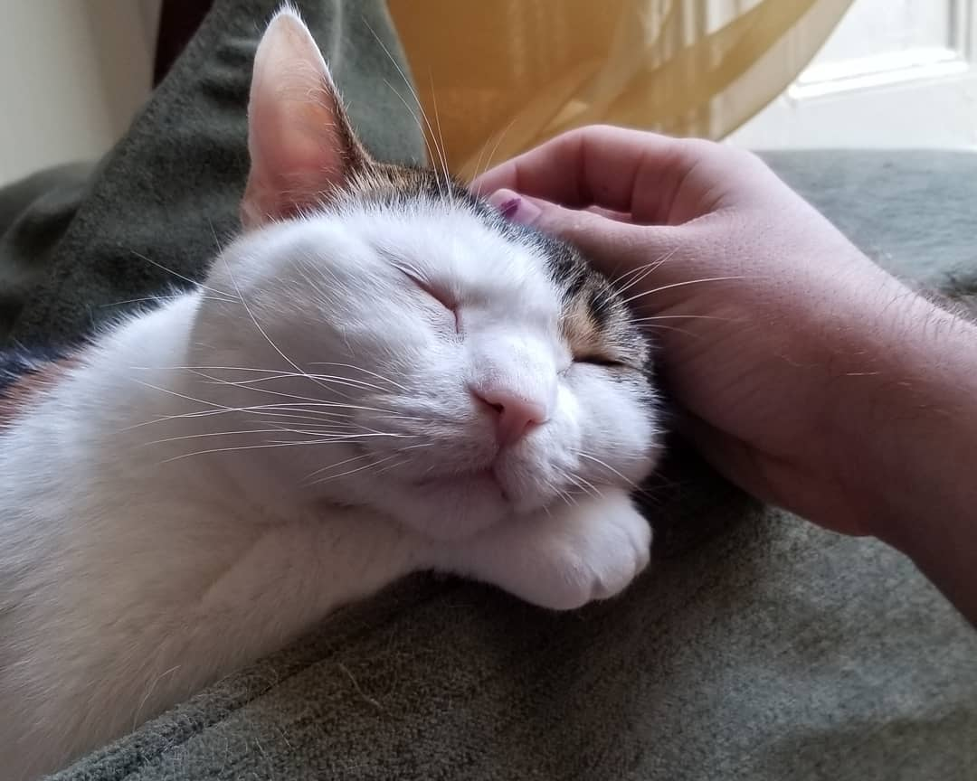
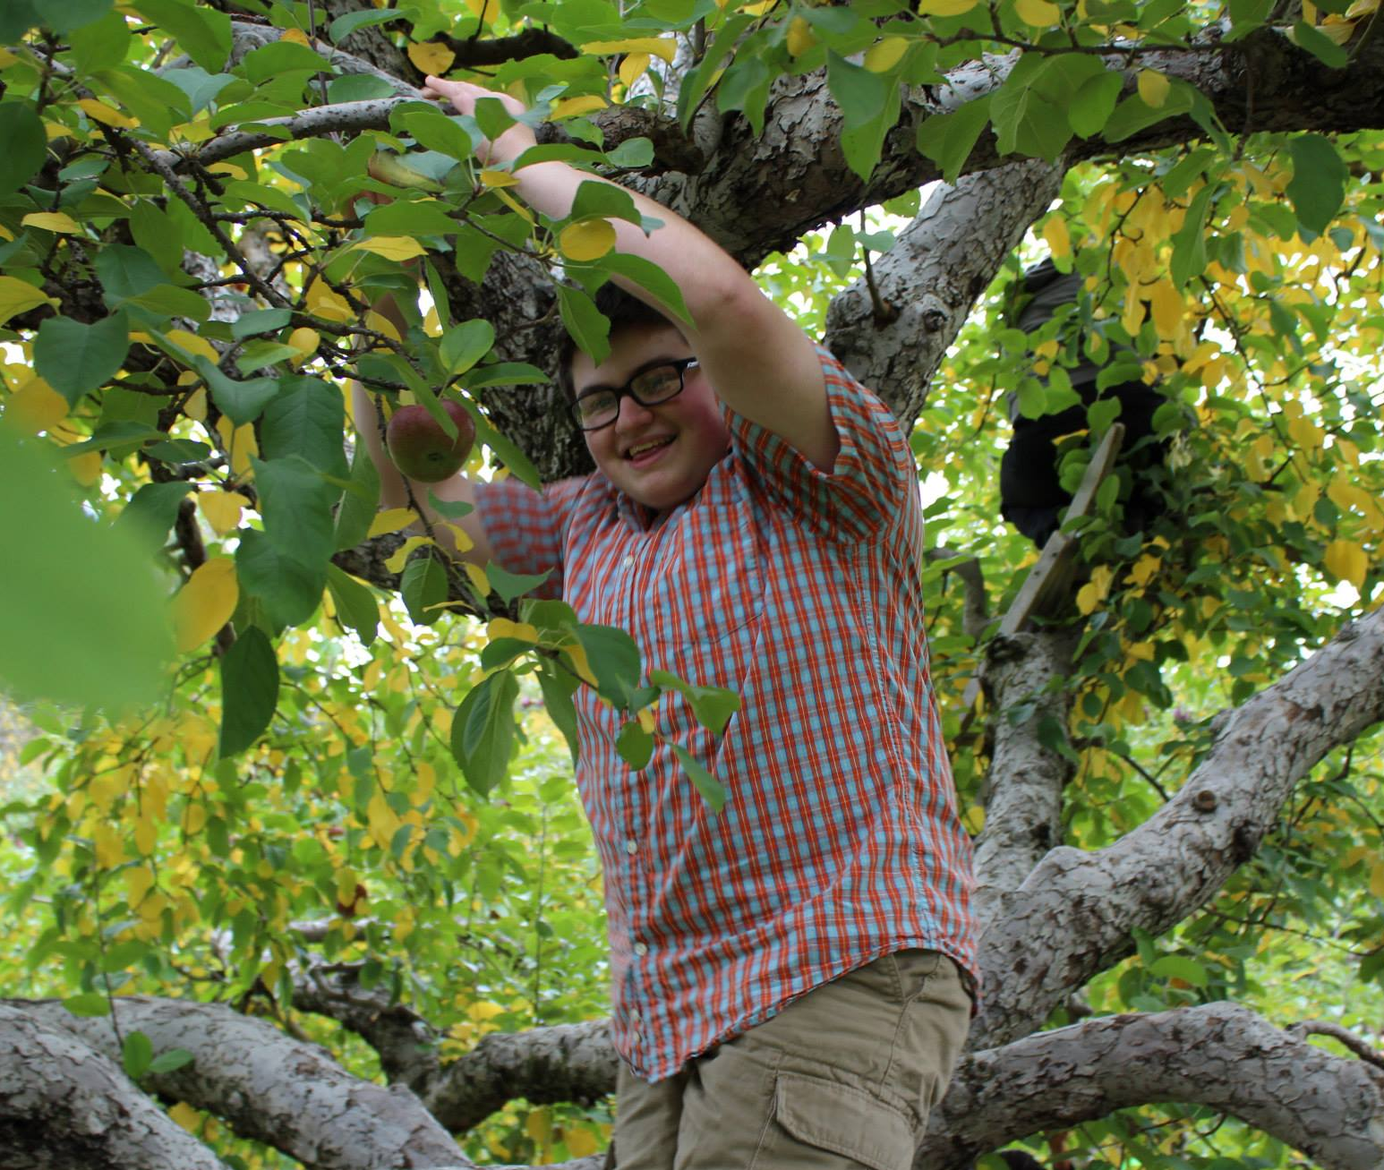
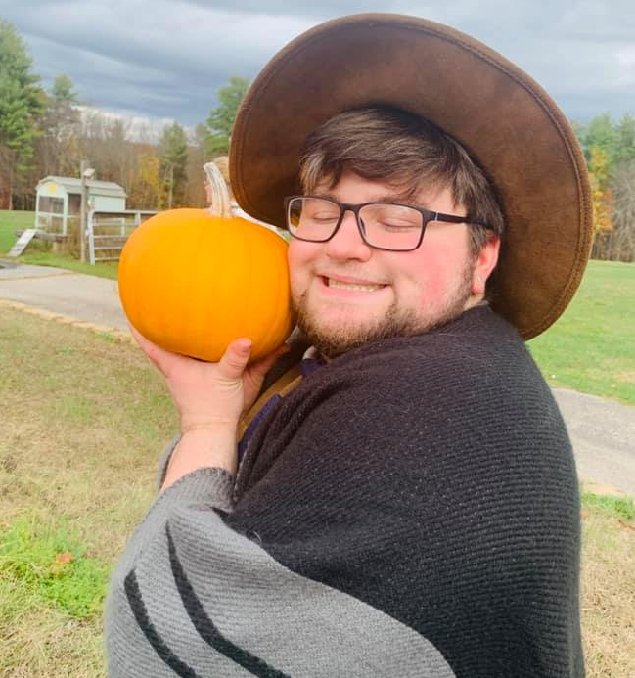
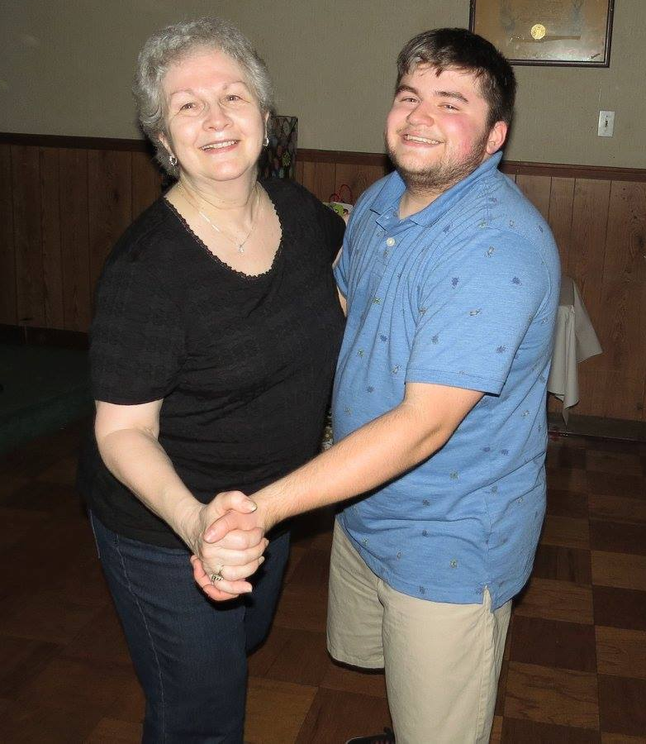

Ashley D’Orlando
Notes:
I’ve been asked to touch on the more personal aspect of transitioning and all that comes with it. First, an introduction. I’m Ashley. I’m 27 and started transitioning when I was 20. My hobbies include camping, petting my cat, and being gay.

Slide 3
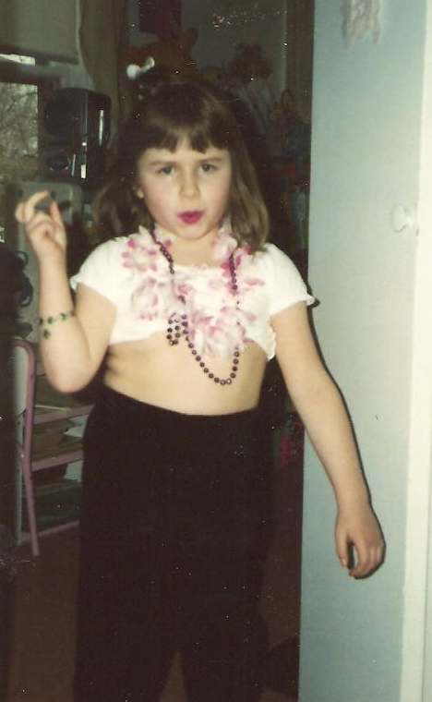
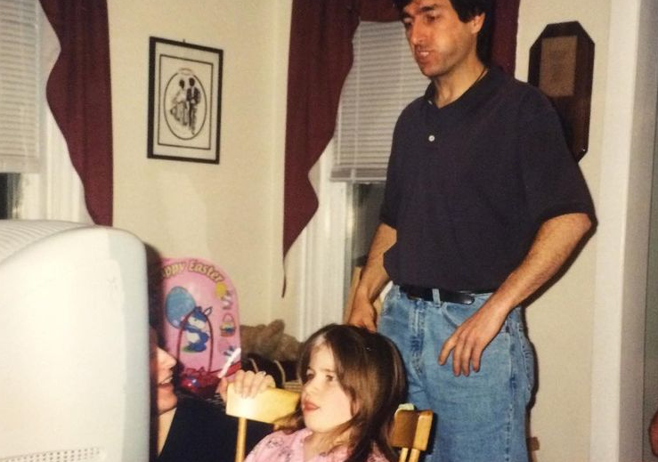
Early Years
No concept of my own gender
Body glitter and video games
Honestly, not much has changed
Notes:
As a child I enjoyed things that children enjoy. And I say that because people like to say “oh I was always into boy stuff” but I was very much not like that. I had diverse interests, and while I gravitated towards some more stereotypically masculine things, I also enjoyed a lot of toys and games considered to be “feminine”. I think I knew I was a girl, or I knew that people told me I was, but I didn’t really have any sort of concrete idea of what that meant. I didn’t feel “wrong” in any way.

Slide 4
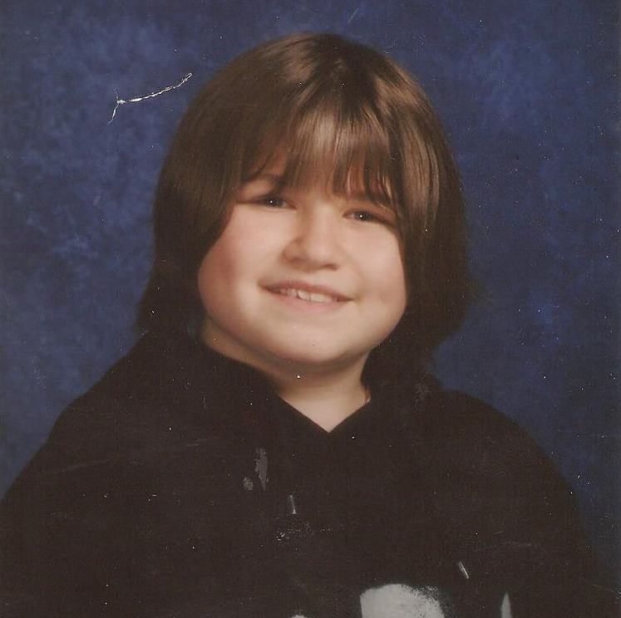
Adolescence -
Notes:
But puberty made things a little more interesting.

Slide 5
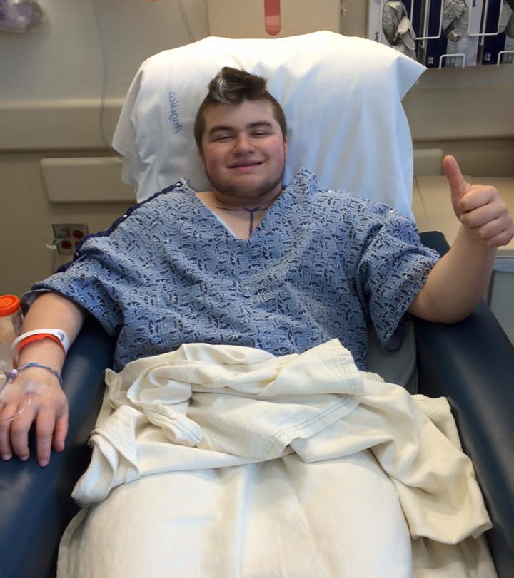
Coming Out & Transitioning
Coming out:
Largely positive experience
Supportive community and family
Transitioning Medically:
Easy access to HRT and surgery
Insurance coverage
Access to informed clinicians
Notes:
My coming out was a largely positive experience, I was fortunate in that I had a very supportive community where I was going to school at the time, and also a very supportive family. Having this network really helped make other aspects of transition easier. Luckily we live very close to one of the leading centers for trans healthcare, and Fenway was also a large part of making my transition simple. A lot of people have to wait years and jump through all sorts of hoops to receive the medical care they need, but I happened to be very lucky in this department. I was able to start HRT and have top surgery less than 1 year after coming out.

Slide 6
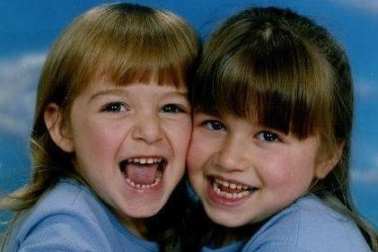
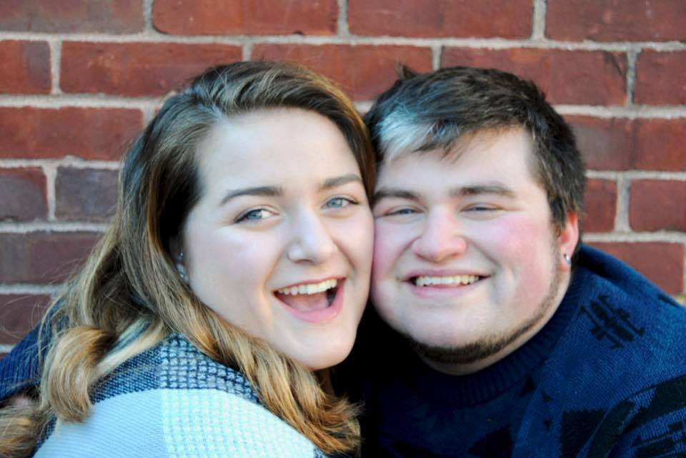
Family & Support Network
Notes:
An integral part of my transition going smoothly was the overwhelming support I received from family and friends. I hardly had any negative reactions that I can recall, and that’s a pretty rare situation. It’s one of the reasons I feel like I can be open about my experiences.

Slide 7
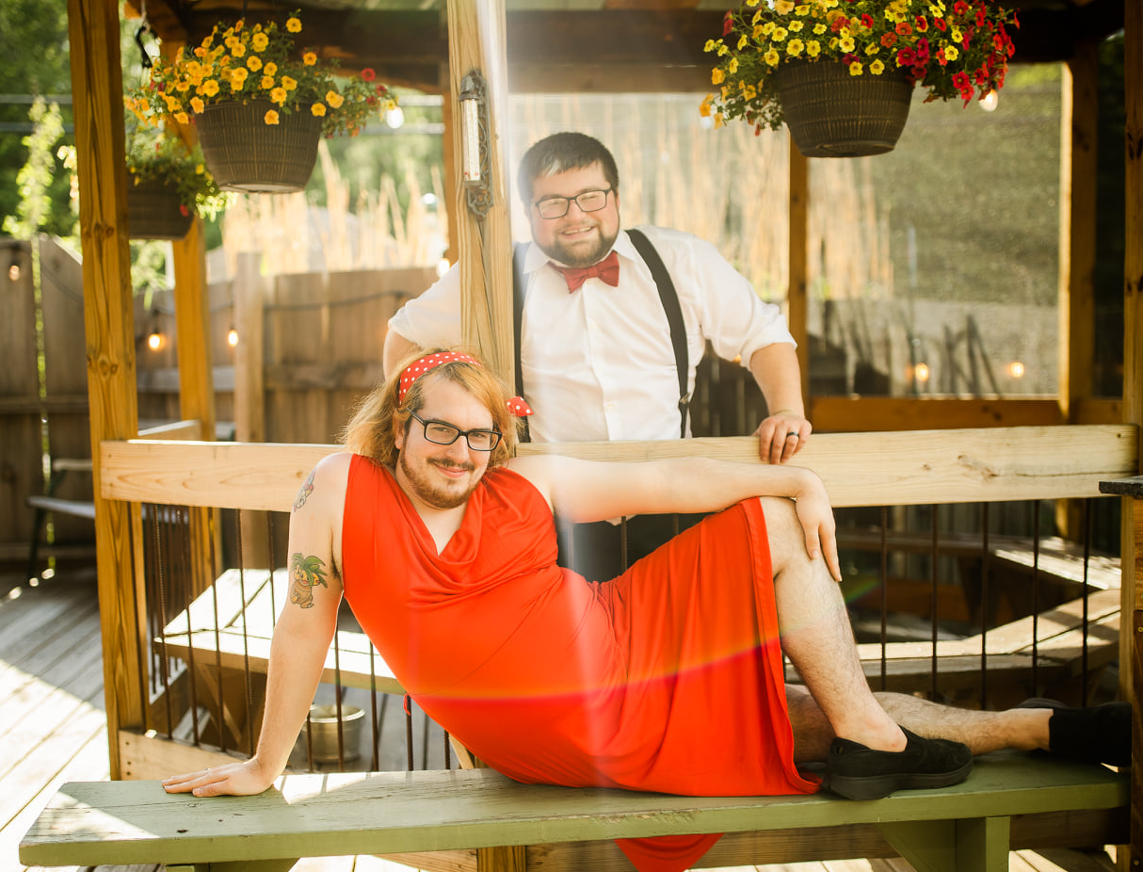
Experiences in Healthcare
Challenges:
Navigating a complex system designed for a Gender-Binary world
Insurance issues
Uninformed providers
Notes:
Even for me, there are some downsides to just existing as a trans person, especially when it comes to healthcare. Insurance companies and many medical offices are behind in terms of how to manage trans patients.
Checking boxes on forms is challenging when the forms were not designed to include you.
If my insurance lists me as male, I’ll get important procedures declined. If my insurance lists me as female, it doesn’t match my other documentation. I’ve even been accused of attempting commit insurance fraud by asking an urgent care clinic to bill my insurance as female. And my experience has been overwhelmingly positive. There are many people who don’t have the same advantages I’ve been afforded and are subject to much more discrimination in healthcare.

Slide 8
Things to Remember...
Suggested Resources
Keep an open-mind.
LISTEN.
Never make assumptions.
All people, regardless of gender identity or sexual orientation, should be treated with dignity and respect.

