Slide 1
Disparities, discrimination, and how you can support LGBTQ+ health equity LGBTQ+ Legal Rights, Human Rights, and Moving Forward
Sean Cahill, PhD
President’s Lecture Series on Health, Regis College
October 13, 2021

Slide 2
PRESENTER
Sean Cahill, PhD
Director of Health Policy Research, Fenway Institute
Affiliate Assoc. Clinical Professor, Bouve College of Health Sciences, Northeastern University
Adjunct Associate Professor, Boston University School of Public Health
Member, Massachusetts Special Legislative Commission on LGBT Aging, 2014-present
Associate Editor, LGBT Health
Nephew of two Sisters of Saint Joseph

Slide 3

FENWAY HEALTH
FQHC in Boston
35,000 patients
About half LGBT, 4,500 transgender and nonbinary
2,200 patients living with HIV; >5000 put on PrEP
Ryan White Part C clinic, HIV research, COVID research
Behavioral health integrated with primary care
Fenway Institute: Research, education & training, policy

Slide 4
OUTLINE
LGBTQ+ health disparities, including BH
Discrimination, impact on health, functions as barrier to accessing care
Recent changes in federal sexual orientation and gender identity (SOGI) nondiscrimination law and policy
What you can do to support LGBTQ+ people, LGBTQ+ health equity

Slide 5
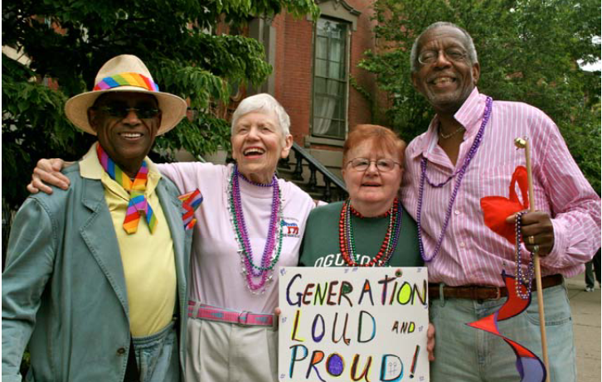
DEMOGRAPHICS OF THE LGBT COMMUNITY

Slide 6
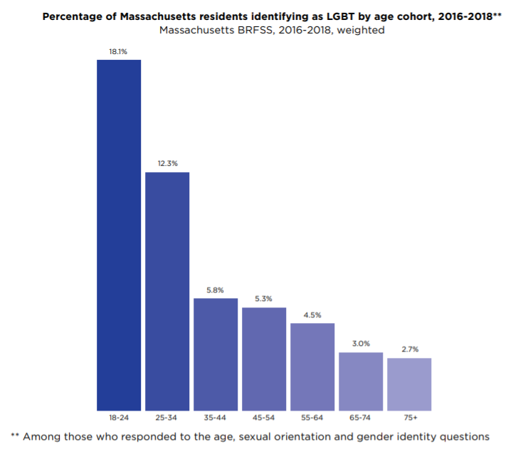

Slide 7
LGBT people experience higher rates of:
Cardiovascular disease risk factors (mental distress, lifetime depression diagnosis, smoking) among LGB people, risk factors and myocardial infarction among transgender people
Caceres, Makarem, Hickey, Hughes. Am J Health Promot. 2019
Alzahrani et al., Circ Cardiovasc Qual Outcomes, 2019.
Diabetes among LGB people
Nurses’ Health Study II data: lesbian, bi women have 27% higher rate than heterosexual women, earlier onset of Type 2 diabetes
Corliss et al., Diabetes Care, 2018.
2014 BRFSS: gay men 50% higher rate, bi men 55% higher rate
Beach et al., LGBT Health, 2018.
Higher rates of obesity among sexual minority women
Azagba, Shan, Latham, Int J Environ Res Pub Health, 2019
Carceras et al., Am J Health Promot, 2019

Slide 8
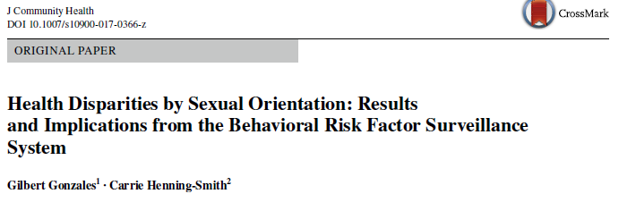
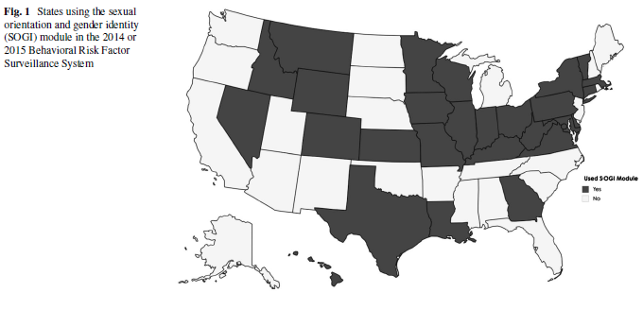

Slide 9
DISPARITIES IN BEHAVIORAL HEALTH BURDEN
Lesbians in these 27 states more likely than heterosexual women to recently binge drink (OR 1.49), currently smoke (1.96)
Bisexual women more likely to be recent binge drinkers (OR 1.84), current smokers (OR 1.73)
Gay, bi men more likely to currently smoke than heterosexual men (OR 1.66, 1.28 respectively)
Bisexual men and women much more likely to report higher rates of mental distress, depression (2-3x for women)
27 state BRFSS, Gonzales & Henning, 2017

Slide 10
Higher rates of substance use
Meghan Schuler et al. analysis of 2015-2017 National Survey of Drug Use and Health data (SAMHSA)
All LGB subgroups had elevated lifetime pain reliever misuse rates relative to same-gender heterosexuals.
Lifetime heroin use was elevated among LGB women and bisexual men; bisexual women had 4 times the odds of injection heroin use.
LGB women and gay men had 1.4-2.4 times the odds of past-year opioid misuse; bisexual women had 2.5 times the odds of OUD.
Schuler, Dick, Stein. Drug Alcohol Depend. 2019.

Slide 11
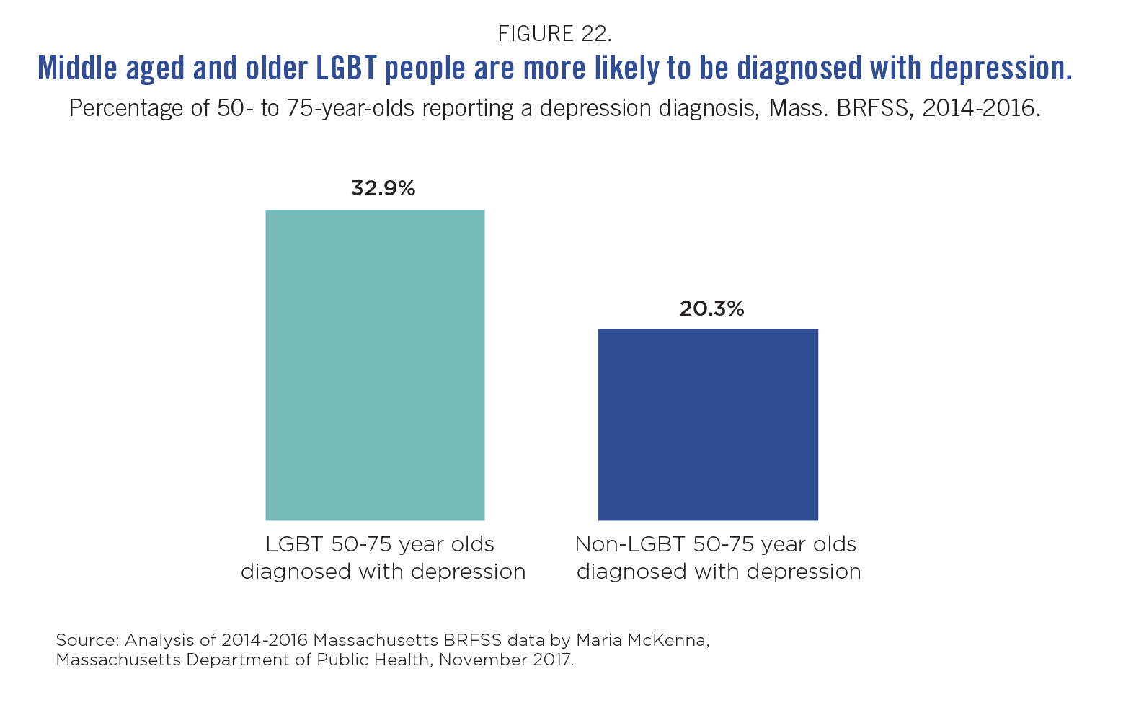

Slide 12
TheSE DISPARITIES intersect with racial/ethnic, other disparities
HIV: Black and Hispanic gay and bisexual men, transgender women bear per capita greatest burden
Bisexual, lesbian women and ovarian, breast, cervical cancer
Rural LGBT people seldom or never disclose their SOGI
Rosenkrantz et al., Stigma and Health, 2017.

Slide 13
discrimination hurts health and well-being, access to care
More than 1 in 3 LGBTQ Americans faced discrimin. in past year (more than 3 in 5 trans people).
15 percent of LGBTQ Americans report postponing or avoiding medical treatment due to discrimination (nearly 3 in 10 transgender individuals).
Center for American Progress, “The State of the LGBTQ Community in 2020: A National Public Opinion Study”
69% of those who reported discrimination said it affected their psychological well-being; 44% said it affected their physical well-being
Singh and Durso, Center for American Progress, 2017

Slide 14
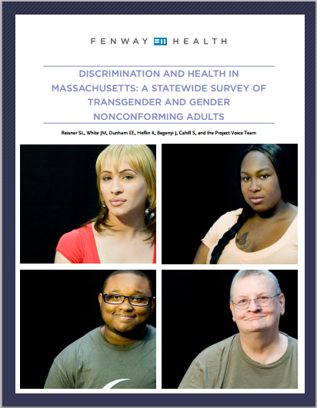

Slide 15
POORER MENTAL AND PHYSICAL HEALTH, LESS ACCESS TO CARE
Public accommodations discrimination associated with two-fold increased risk of adverse physical (RR=1.84), emotional (RR=1.99) symptoms in past 30 days.
Those reporting discrimination in health care 19% less likely to seek emergency care, 25% less likely to seek routine or preventive care
Reisner, White Hughto, Dunham et al. Milbank Quarterly, 2015.

Slide 16
Racial stigma and LGBTQ+ people
Racial stigma a major barrier to care for Black lesbian, bisexual women
Brenick et al., LGBT Health, 2017
Anti-Black stigma is common in White LGBT settings
McConnell et al., Psychol Sex Orientat Gend Divers., 2018
Long history of structural stigma and discrimination against Black people in healthcare settings contributes to medical mistrust that acts as a major barrier to accessing care for Black LGBT people
Quinn et al., Arch Sex Behav. 2020; Fields, STIs, 2019

Slide 17

Intersectional/layered experiences of discrimination, economic marginalization
Women
Members of racial and
ethnic minority groups
Immigrants

Slide 18
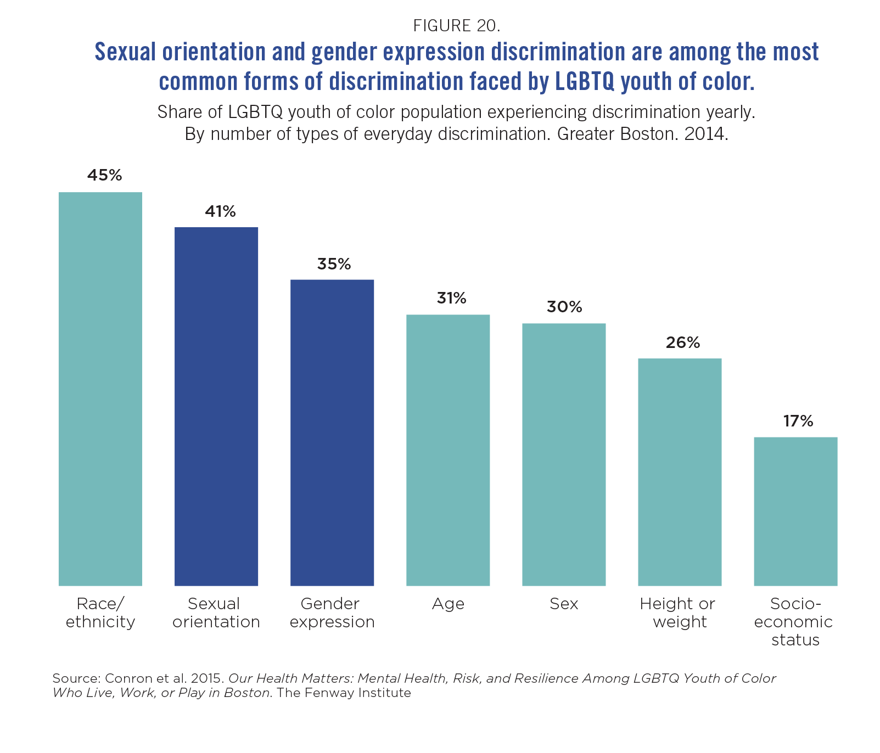

Slide 19
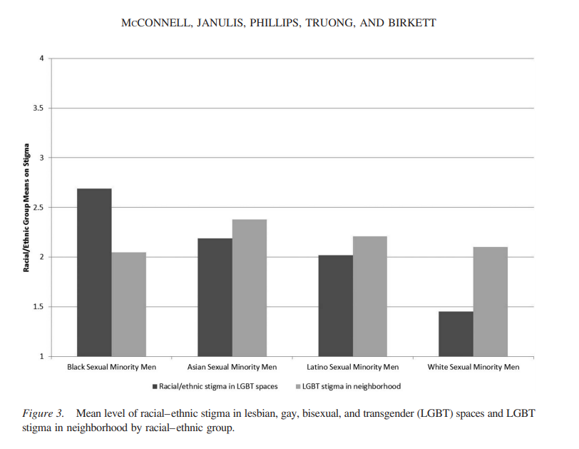
Psychol Sex Orientat Gend Divers. 2018

Slide 20
Examples of anti-LGBT discrimination in Massachusetts
Two cisgender lesbian women in Berkshires reported repeated, systematic misgendering of them in hospital, hardware store, bank by staff
Gay man systematically harassed, mostly by straight women, in senior housing complex in small town near New Hampshire
Gay man accused of sexually assaulting his spouse as they went for a walk outside the assisted living facility he was living in, police called (hypersexualization of gay men)
Source: Cahill, LGBT Aging 2025, Fenway Institute, 2020; GLBTQ Advocates and Defenders case, 2021

Slide 21
LGBT PEOPLE MORE LIKELY TO BE POOR
22% of LGBT vs. 16% of straight, cisgender people
LGBT POC more likely to be poor
Bisexual women, transgender people are poorest
Rural LGBT people (26%) have highest poverty rates (among rural cisgender straight people 16% are poor)
Among urban LGBT people 21% are poor (vs. 16% of straight, cisgender people in urban areas)
Badgett, Choi, Wilson (2019). LGBT poverty in the United States: A study of differences between sexual orientation and gender identity groups (BRFSS data)

Slide 22
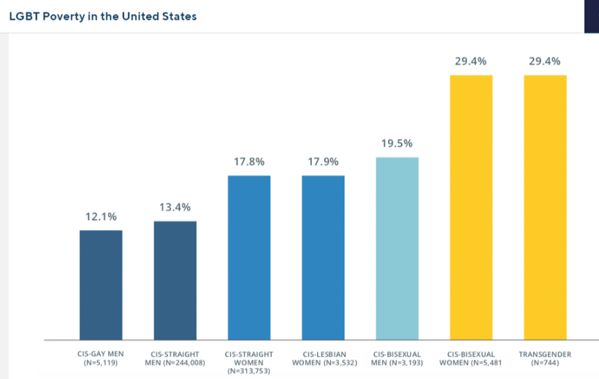

Slide 23
Transgender People Especially Vulnerable to Poverty, Discrimination
29% live in poverty (vs. 14% of US population)
15% unemployed (vs. 5% of US population)
30% lifetime homelessness, 12% in past year
US National Transgender Survey 2015, n=27,715

Slide 24
POVERTY AFFECTS HEALTH INSURANCE COVERAGE, ACCESS TO ROUTINE CARE
2013-2015 National Health Interview Survey:
Compared to heterosexual women, lesbian and gay women were significantly less likely to have health insurance (80.7% vs. 85.2%) and a usual primary care provider (79.6% vs. 84%) .
Lunn MR, Cui W, Zack MM, LGBT Health, 2017

Slide 25
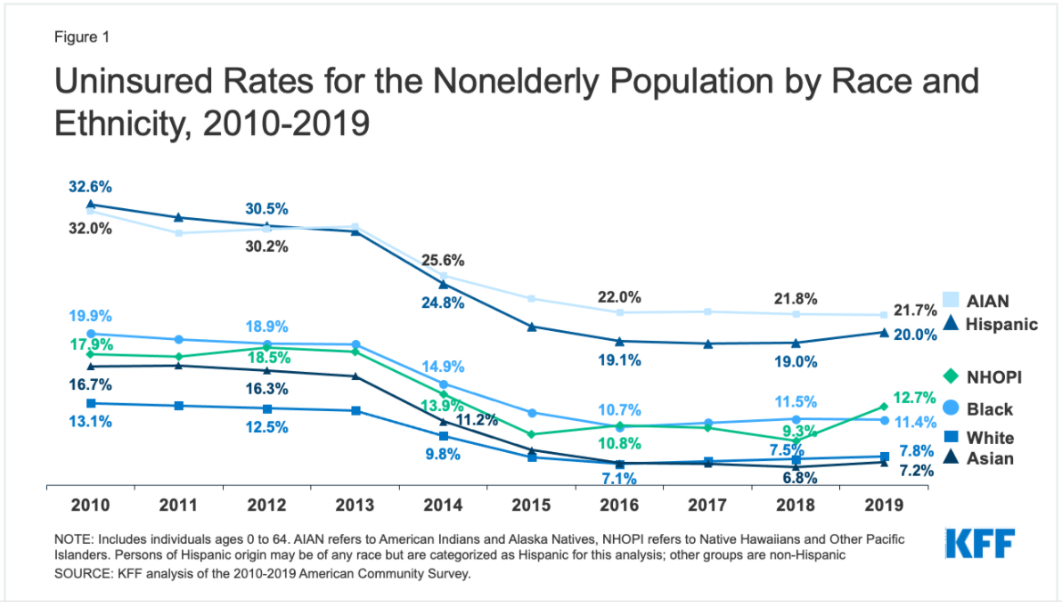

Slide 26
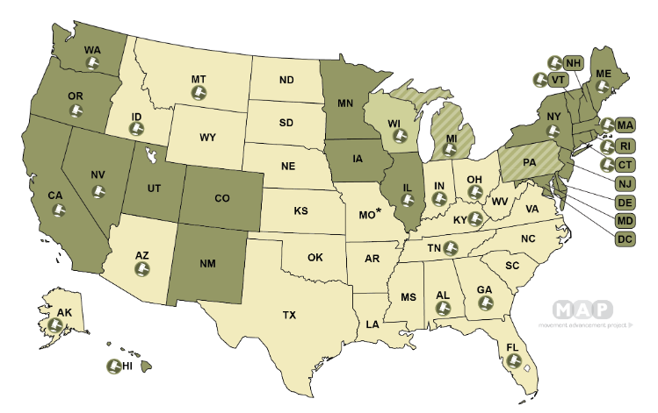
Employment Nondiscrimination Laws

Slide 27
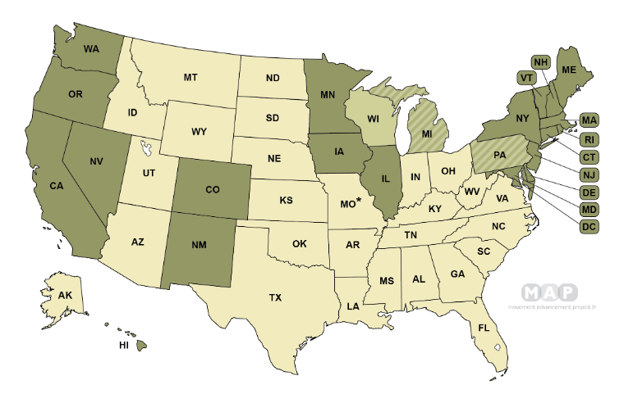
Public Accommodation Nondiscrimination Laws

Slide 28
2016 rule implementing section 1557
2016 final rule states how Section 1557 is to be implemented and enforced by HHS; references Title IX
Explicitly prohibits gender identity discrimination, including discrimination against intersex and non-binary people, across federally-funded health care programs
Prohibits some forms of sexual orientation discrimination that take the form of sex stereotyping
This rule expanded health care access for LGBT people in healthcare facilities across the US

Slide 29
TRUMP ADMIN. REPEALED SOGI NONDISC.
In June 2020 the Trump Administration repealed elements of the 2016 ACA nondiscrimination rule (Section 1557 rule), eliminating nondiscrimination provisions re:
Gender identity (including nonbinary, intersex)
Sex stereotyping, and therefore some forms of sexual orientation discrimination
Termination of pregnancy

Slide 30
ALSO REPEALED 6 OTHER SOGI REGs.
Also removed explicit SOGI nondisc. provisions from:
Regulations governing the health insurance exchanges;
Regulations governing Qualified Health Plans;
Medicaid regs governing Medicaid enrollment, availability of services and culturally competent care
42 CFR § 438.3(d)(4), 42 CFR § 438.206, 42 CFR § 440.262
Regulations governing access to Programs of All-Inclusive Care for the Elderly for nursing home eligible elders
42 CFR § 460.98

Slide 31
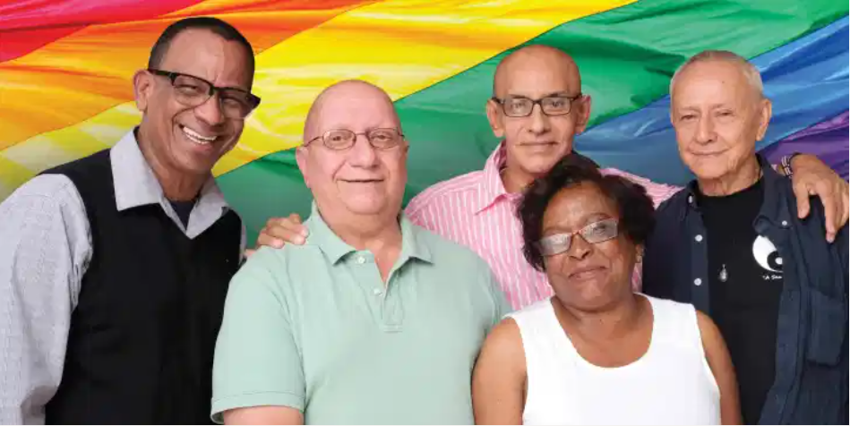
ProgramS OF all-inclusive care for the elderly (PACE)
Social services, health care for frail elders still living in the community
Generally disabled, poor, nursing home eligible
Would exacerbate
social isolation, fear of
discrimination among an
extremely vulnerable
population

Slide 32
REMOVAL OF SOGI NONDISC IN $500B+ A YEAR IN HHS HEALTH CARE, SOCial SVCS.
Covers more than $500B in HHS grants each year funding:
HIV/STI screening, homeless services, youth services, elder services, health professional training, research, anti-trafficking initiatives, etc.
Removes 2016 rule prohibiting discrimination in HHS grant-funded programming based on religion, sex, sexual orientation, gender identity
LGBT people more likely to be poor (22% vs. 16%), may be more dependent on HHS services
Badgett, Choi, Wilson, LGBT Poverty in the United States, 2019

Slide 33
BIDEN REVERSING THESE POLICIES
January 20 (Inauguration Day): Executive Order on Preventing and Combating Discrimination on the Basis of Gender Identity or Sexual Orientation
US Constitution prohibits SOGI discrimination
All sex discrimination laws should be applied to prohibit SOGI discrimination as per Bostock ruling
Agencies should make all rules and policies conform with Bostock v. Clayton County, GA (2020) – anti-LGBT discrimination = sex discrim.
Agencies should address intersectional discrimination, ex: Black transgender women

Slide 34
Bostock v. Clayton Co., GA (2020)
6-3 U.S. Supreme Court decision ruling that anti-gay, anti-trans discrim. violates federal sex nondiscrimination law.
“When an employer fires an employee for being homosexual or transgender, it necessarily intentionally discriminates against that individual in part because of sex.”
A very strong decision written by conservative Gorsuch; also applies to lesbians, bisexuals, nonbinary people
More than 100 federal nondiscrimination laws and regs. reference Title VII of Civil Rights Act
However, Title VII sex discrimination does not apply to public accommodations.

Slide 35
Biden ex. order on SOGI nondisc.
“People should be able to access healthcare and secure a roof over their heads without being subjected to sex discrimination. All persons should receive equal treatment under the law, no matter their gender identity or sexual orientation.”
Calls on federal agencies to “review all existing orders, regulations, guidance documents, policies, programs, or other agency actions” related to Title VII sex discrimination and “consider whether to revise, suspend, or rescind such agency actions, or promulgate new agency actions” to enforce the U.S. Supreme Court ruling in Bostock.
Many agencies adding SOGI questions to forms to document anti-LGBT discrimination.

Slide 36
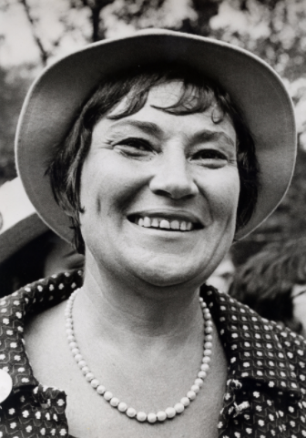
Equality Act
Passed U.S. House, now in U.S. Senate
Would prohibit sexual orientation and gender identity discrimination in: employment, housing, credit, jury service, federally-funder programs, public spaces and services
Retains religious exemptions already in law
9 in 10 Americans support SOGI nondiscrimination, 7 in 10 support SOGI nondiscrimination laws (Kaiser Family Foundation poll, 2020)
First introduced by New York Congresswoman Bella Abzug in 1974

Slide 37
HHS Notice of SOGI nondisc. In H.Care
Notification of Interpretation and Enforcement of Section 1557 of the Affordable Care Act and Title IX of the Education Amendments of 1972
“Today, the Department of Health and Human Services announced that the Office for Civil Rights will interpret and enforce Section 1557 and Title IX’s prohibitions on discrimination based on sex to include: (1) discrimination on the basis of sexual orientation; and (2) discrimination on the basis of gender identity. Section 1557 prohibits discrimination on the basis of race, color, national origin, sex, age, or disability in covered health programs or activities. The update was made in light of the U.S. Supreme Court’s decision in Bostock v. Clayton County and subsequent court decisions.”
May 10, 2021 HHS press release

Slide 38
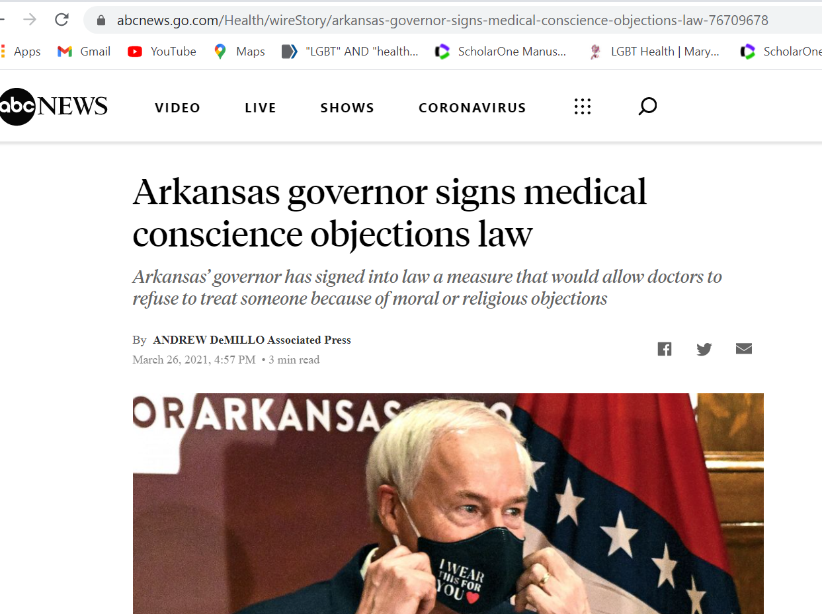

Slide 39
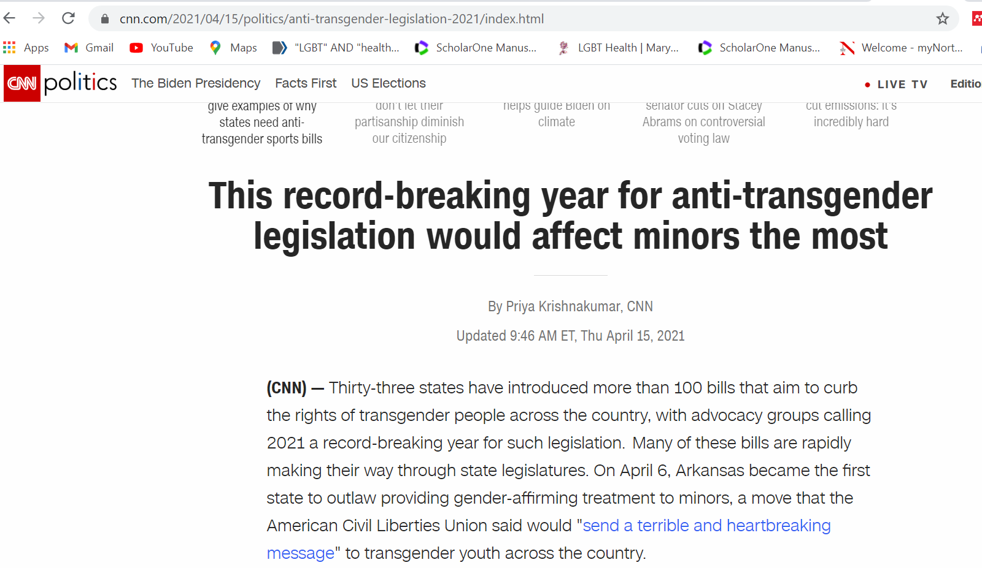

Slide 40
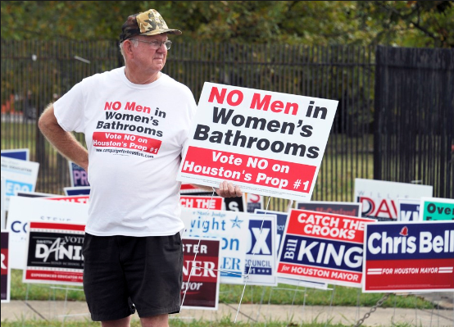
Understand that anti-LGBTQ+ politics creates trauma

Slide 41
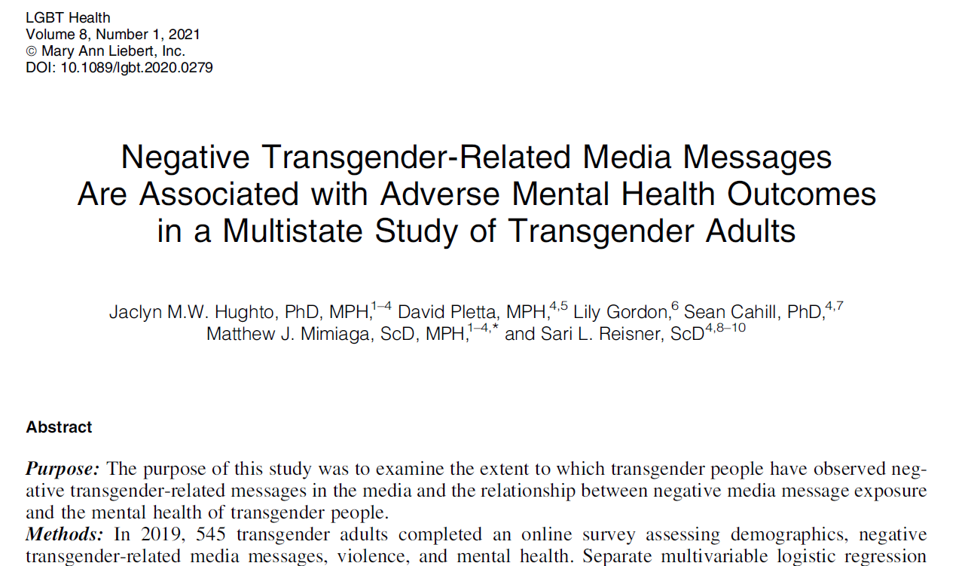

Slide 42
Exposure to negative images of transgender people → negative Behavioral Health effects
More frequent exposure to negative depictions of transgender people in the media was significantly associated with clinically significant symptoms of :
depression (adjusted odds ratio [aOR] = 1.18; 95% confidence interval [CI] = 1.08–1.29; p = 0.0003);
anxiety (aOR = 1.26; 95% CI = 1.14–1.40; p < 0.0001);
PTSD (aOR = 1.25; 95% CI = 1.16–1.34; p < 0.0001);
and global psychological distress (aOR = 1.28; 95% CI = 1.15–1.42; p < 0.0001).

Slide 43

INCORPORATE TRAUMA-INFORMED APPROACHES TO CARE
Look to proven models, such as TIA-CHANGE (Trauma Informed Approach & Coordinated HIV Assistance and Navigation for Growth and Empowerment)
Developed by Christie’s Place in San Diego and AIDS United

Slide 44

What you can do
Train all staff in how to provide LGBTQ+ affirming, culturally competent care
Connect with local LGBTQ+ community groups and learn about ways your organization can support through testimony for or against legislation, policy statements
Refer to LGBTQ+ affirming service providers
Put posters, pamphlets in the waiting room with LGBTQ+ people or same-sex couples to show that LGBTQ+ patients are welcome
Adopt a SOGI nondiscrimination policy, train all staff to uphold it, report violations to mgt.
Hire from the LGBTQ+ community, especially transgender staff

Slide 45

Collect and use voluntary SOGI data
Allows providers to better understand, address LGBTQ+ health disparities
Can inform clinical decision support, preventive screenings, population health management
Combine with racial/ethnic, other data for intersectional analysis
Sends LGBTQ+ patients message that provider understands health equity, values diversity

Slide 46
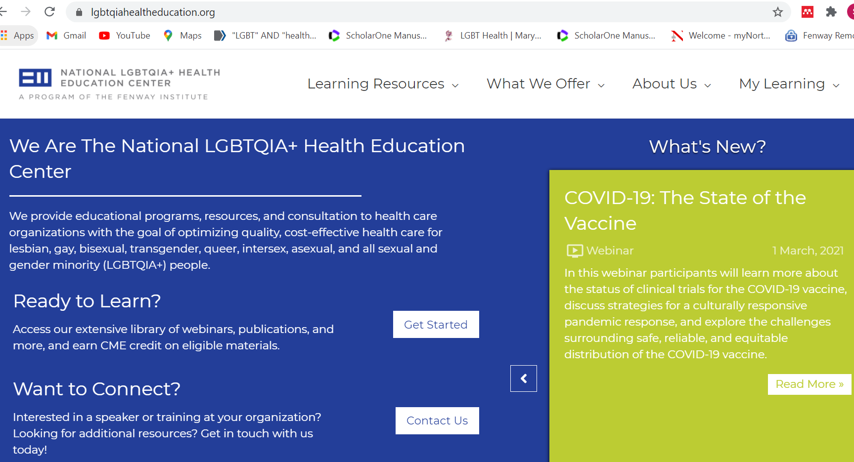

Slide 47
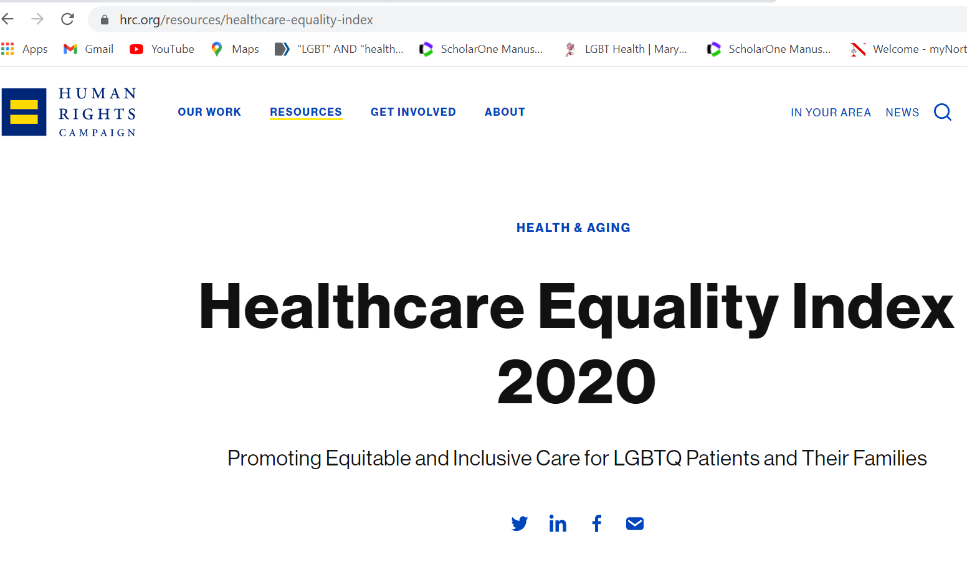

Slide 48
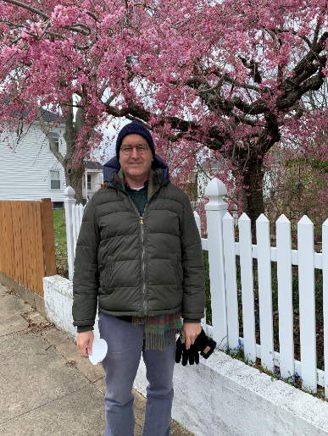
THANK YOU.
Sean Cahill, PhD
Director, Health Policy Research
scahill@fenwayhealth.org
Thank you to Penelope Glynn,
PhD, RN
Thank you to the Sisters of Saint Joseph for your effective public education in support of health care access in the US.

