Slide 1

Shared Attention as
a Psychological Foundation
Garriy Shteynberg
University of Tennessee

Slide 2
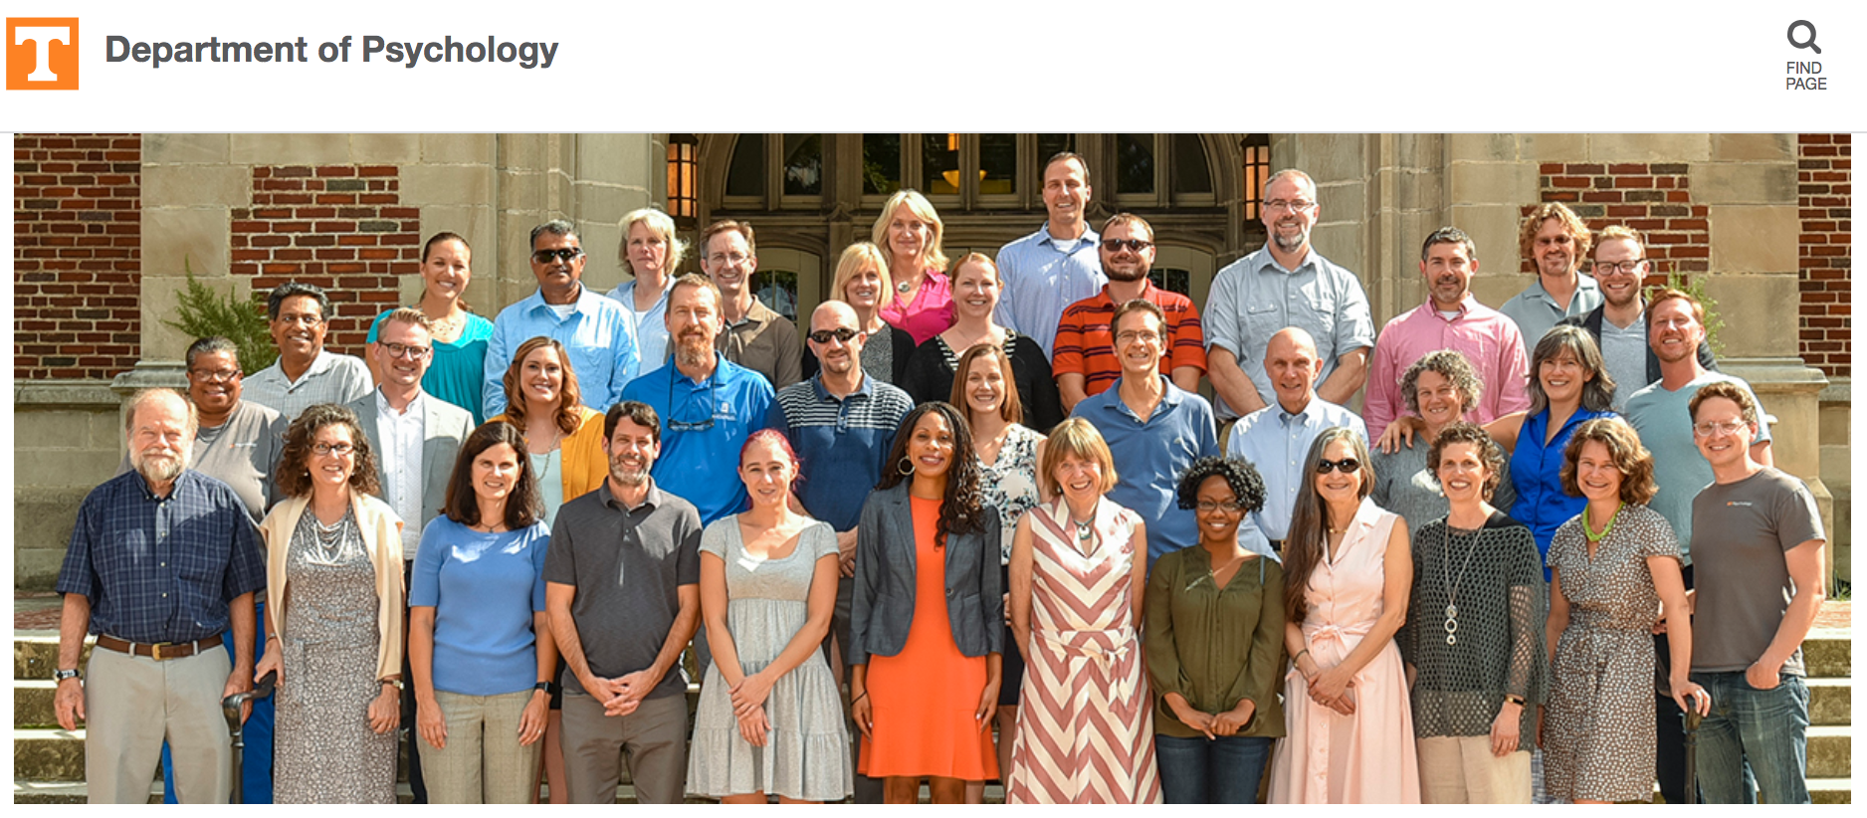

BCS-1749348

Slide 3


Shared Attention
A perception of where
I am attending
A perception of where
We are attending
Shteynberg, 2015; 2018
Notes:
Shared Attention
Let’s say I am walking about and I see a tree, I can have a perception of where I am attending – as in Hey I am looking at this tree. You can think of it as an attentional schema –or a schema of my individual personal attention.
Same scenario, I see the same tree; however this time, I think ‘we are attending to the tree’ – why is that? Well maybe I am hallucinating the others, maybe the others are present, maybe the tree is part of a facebook post that is getting commented by all my friends – so I am aware that “we are attending”. This is a belief state that doesn’t depend on direct observations of others’ behavior

Slide 4
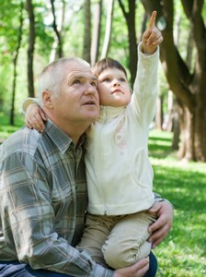

Shared Attention is Human
Notes:
About 9 months of age, children become highly interested in coordinating their gaze behavior with caregivers. This is largely a developmental literature on joint attention -- an important precursor of language development, and often compromised in kids with autism.
This behavior can be seen as manifestation of common knowledge. However, what we are interested the PSYCHOLOGY of COMMON KNOWLEDGE (NOT ITS BEHAVIOR MANIFESTATION)

Slide 5
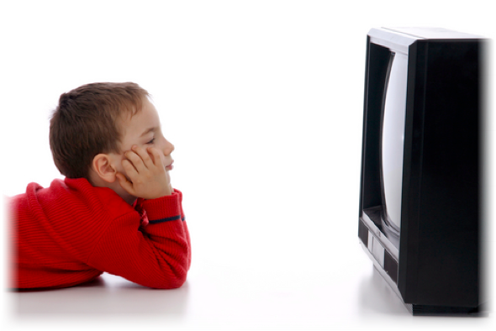

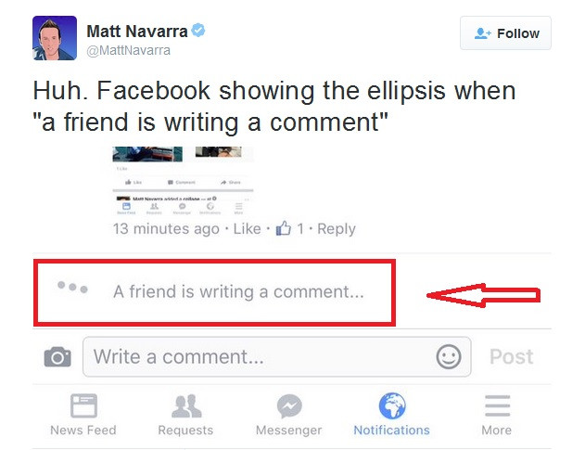
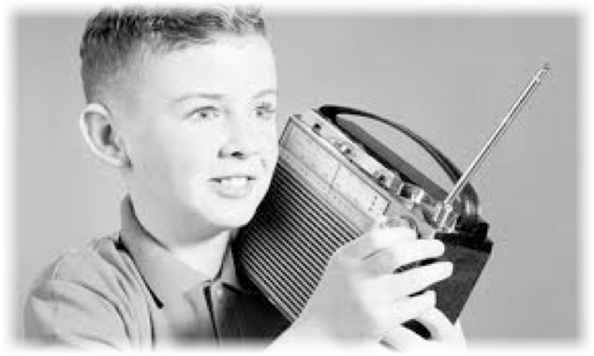
Notes:
So shared attention (like joint attention) can be present in person, but unlike joint attention, it is there when we are watching live television, listening to the radio, or now, increasingly surfing online--around 2015 included this clever feature leaving now doubt that you are not the only one interacting with a post.,
In other words, because shared attention is based on the mere belief of co-attention (rather than direct behavioral cues) it allows for collective experiences that may involve a multitude of group members across vast distances.

Slide 6
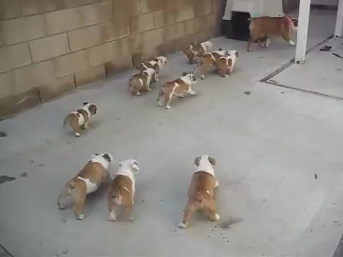
Notes:
Why don’t I should the experiment. In fact you can be participants. Let’s say you come into my lab and I ask you to watch this short video --

Slide 7
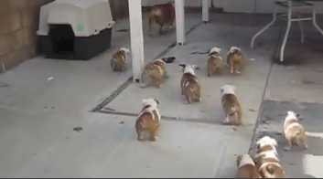


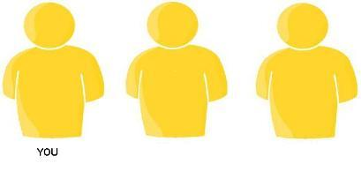
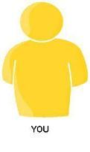
Emotion
Participants saw a 32 second video of cute puppies
Shared Attention
Others see it first
You see it first
Alone
List 12 thoughts that you had during the video (2 minutes)
How happy did the video make you feel?
Notes:
But of course being an experiment, you would have watched the video in one of 4 different conditions.
You watched with 2 other participants.
2 other participants see the video first, and then you see it.
You see the video first, and then the 2 other participants see it.
Or you watch it alone.
One other thing about this particular study is that when others are present, you think you shared some minimal similarity with it (in this case, a color preference)
Ok, so back to the study. After you see the video, I ask you to write down some thoughts that you had when you were watching. And then I ask you how happy you were.
What do we find when we analyze the written thoughts?

Slide 8
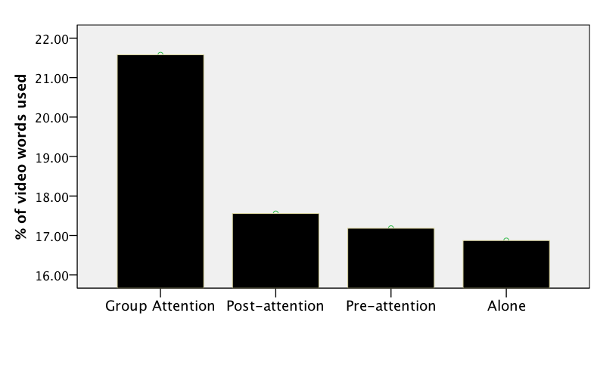
Emotion
Shared attention
Shteynberg et al., Emotion, 2014
Notes:
We find that when you viewed the video under shared attention, you thought more about the video content (presumably because it grabbed your attention to a greater extent). And because the video content, in this case was amusing, you felt happier.

Slide 9
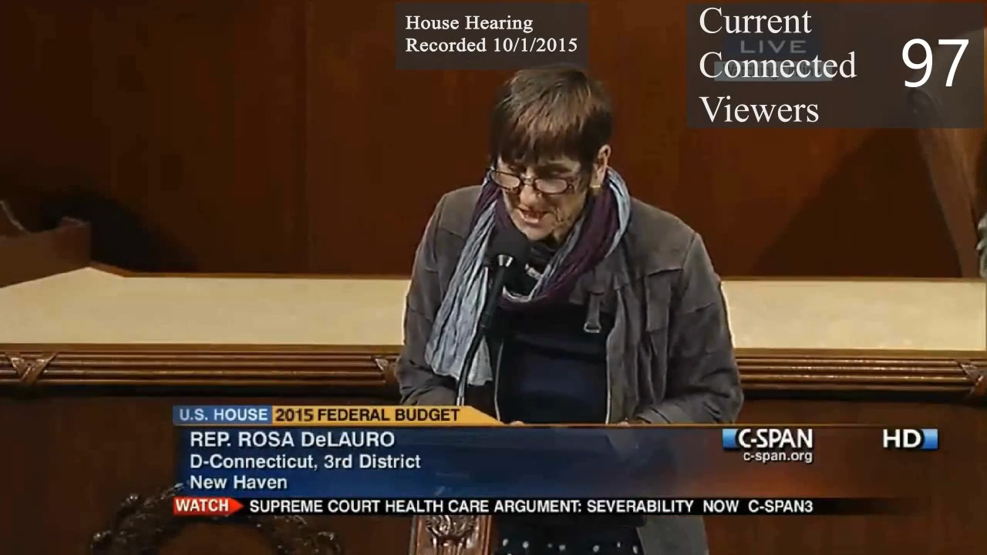
Notes:
Congresswomen Rosa DeLauro from Connecticut (speaking on the Violence against Women act)

Slide 10
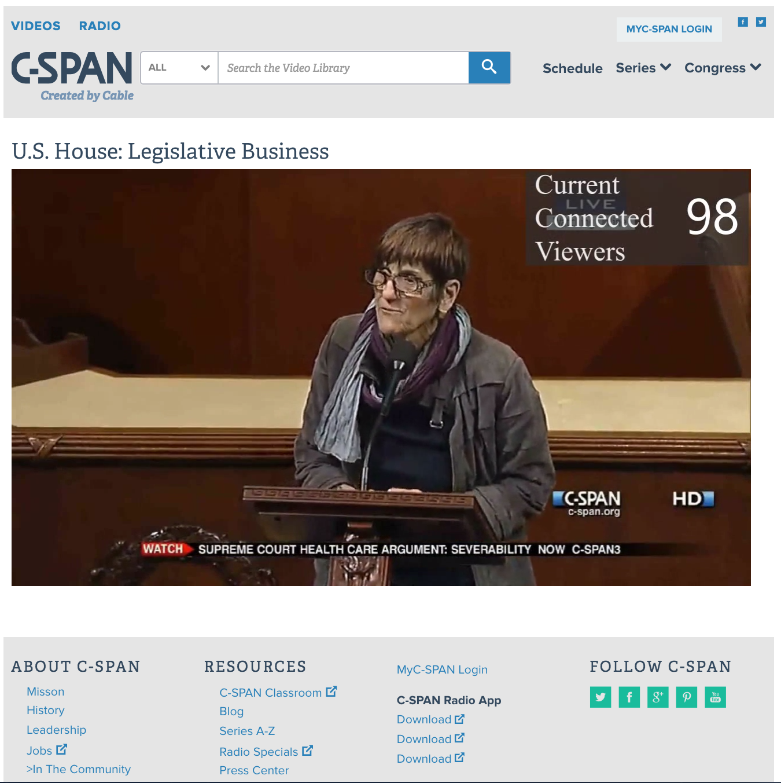
Study 1, 116 participants
Conditions:
a) Live 100
b) Recorded 100
c) Recorded
Outcome: Persuasion

Slide 11
Study 1 Results

Slide 12
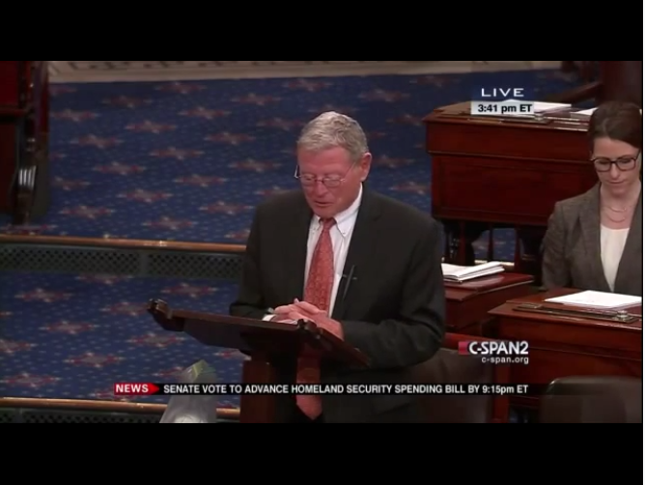
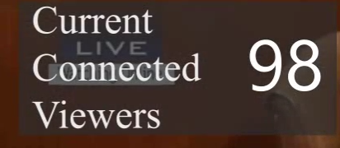
Study 4, 118 participants
Conditions:
a) Live 100 (rec. stream)
b) Recorded 100
c) Recorded
Outcome: Persuasion

Slide 13
Study 4 Results
Shteynberg, Bramlett, Fles, Cameron, JPSP, 2016

Slide 14
Study 5, 280 participants
Conditions:
a) Live 100
b) Live 10
c) Live 3
d) Live 0
Outcomes:
a) Recall Memory
b) Persuasion

Slide 15
Persuasion: t(276) = -2.43, p = .02 Memory: t(276) = -2.51, p = .01
Study 5 Results
Shteynberg, Bramlett, Fles, Cameron, JPSP, 2016

Slide 17
Psychological Embedding
Shared Action
Shared Ideas
Shared Attention

Slide 18
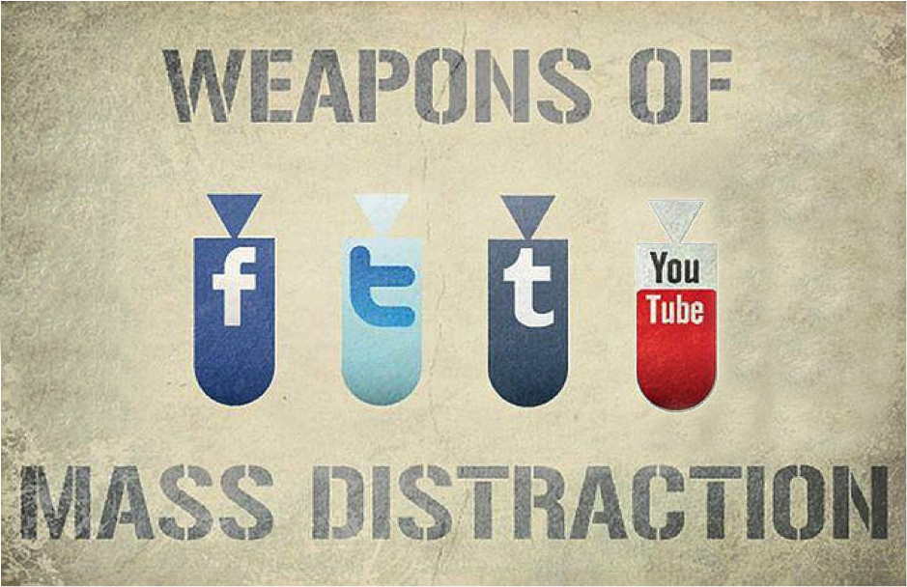
Digital Media
Digital Media
Many participants are fictitious
Designed to capture minds, not facilitate collective action
High information volume limits deep deliberation on any one topic

Slide 19
Thank you!
Email me at gs@utk.edu with questions

