Slide 1
Taking a public Health Approach:
Engagement, Equity, and Empowerment
Regis College
November 10th, 2021
Victor Ortiz
Director of the Office of Problem Gambling Services

Slide 2
VISION
Optimal health and well-being for all people in Massachusetts, supported by a strong public health infrastructure and healthcare delivery.
MISSION
Prevent illness, injury, and premature death; ensure access to high quality public health and health care services; and promote wellness and health equity for all people in the Commonwealth.
DATA
We provide relevant, timely access to data for DPH, researchers, press, and the general public in an effective manner in order to target disparities and impact outcomes.
DETERMINANTS
We focus on the social determinants of health: the conditions in which people are born, grow, live, work, and age, which contribute to health inequities.
DISPARITIES
We consistently recognize and strive to eliminate health disparities amongst populations in Massachusetts, wherever they may exist.
EVERYDAY EXCELLENCE
PASSION AND INNOVATION
INCLUSIVENESS AND COLLABORATION

Slide 3
Problem Gambling: Key Points
National
Problem gambling has a high level of co-morbidity with substance use disorder and mental health (Alegría, Petry, Hasin, Liu, Grant, & Blanco, 2009).
Disproportionately impacts individuals with mental health disorders, substance use disorders, and communities of color (Alegría, Petry, Hasin, Liu, Grant, & Blanco, 2009).
Community-level experiences of gambling and communities of color are often not the focus of problem gambling services and efforts.
Massachusetts
Research demonstrates that the prevalence of Recreational Gambling in MA was 57.4% and gamblers are more likely to: be obese, smoke heavily, use alcohol, and use prescription drugs (Okunna, N. C., Rodríguez-Monguió, R., Smelson, D. A., Poudel, K. C., & Volberg, R. (2016).

Slide 4
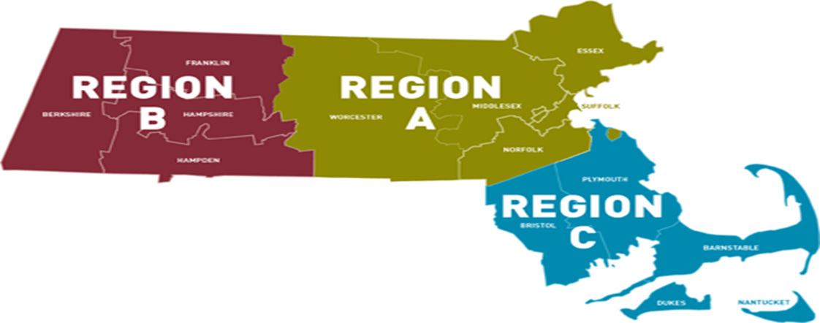
Expanded Gaming in the Commonwealth
The Expanded Gaming Act (2011) allows for up to three destination resort casinos to be opened in three geographically diverse regions across the state. Additionally, a single slots facility can be competitively awarded for one location statewide.
The Expanding Gaming Act established the Public Health Trust Fund (PHTF) to allocate significant resources to research, prevention, intervention, treatment, and recovery support services in order to mitigate the harmful effects of problem gambling and related issues.

Slide 5
Public Health Trust Fund: Strategic Plan - 2016
Priorities Areas/Key Areas of Concern
Prevention for Youth
Prevention for High-Risk Populations
Focus on Community-Level Interventions
Coordination of Problem Gambling Services
Integration of Addiction Services, Mental Health Services, and Primary Care
Decrease in Stigma and Unsupportive Social Norms
Increase in Availability of Support Services
Increase in Availability of Culturally Appropriate Services
Contribution to the Evidence Base for Problem Gambling Services
Establishment of an Evaluation Infrastructure
Expansion of Institutional Capacity to Address
Problem Gambling and Related Issues

Slide 6
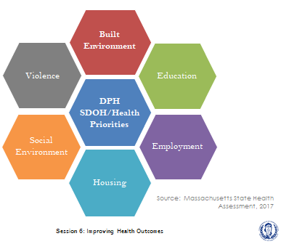
Problem Gambling and SDoH
Problem gambling is governed by a complex set of interrelating factors, causes and determinants ranging from biology and family history to social norms and existing statutes (Messerlian, Derevensky, Gupta, 2005).
The Office of Problem Gambling Services takes a community-driven approach that is rooted in the Social Determinants of Health, with a racial equity lens.

Slide 7
Office of Problem Gambling Services Vision
To ensure a comprehensive and integrated public health response that will include utilization of data to inform initiatives, engagement of communities, and that which ensures cultural intelligence and humility.

Slide 8
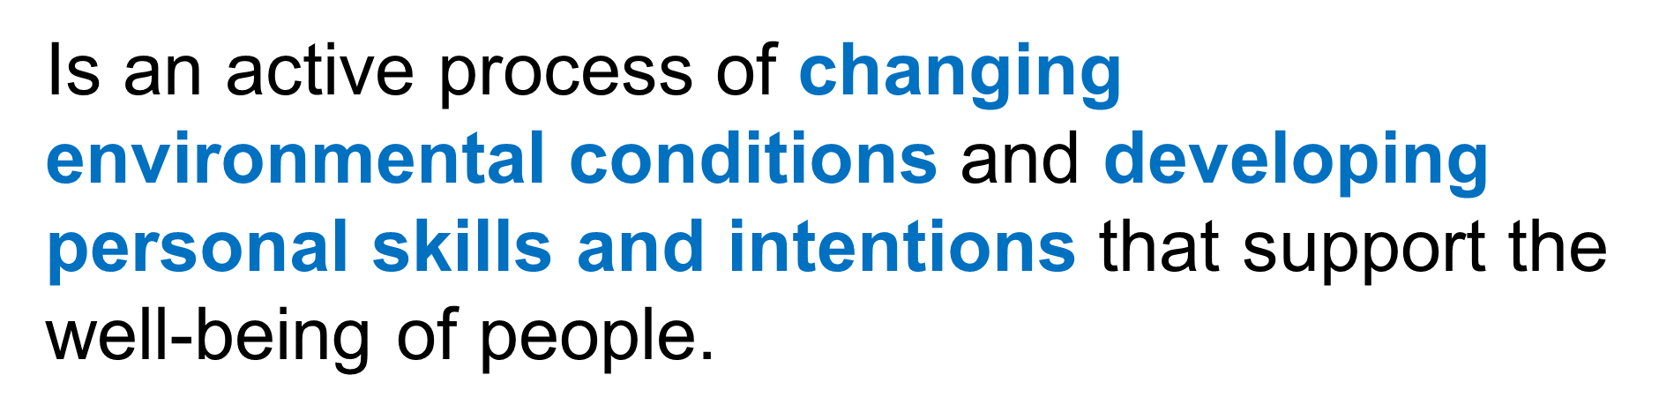
Prevention
(www.samhsa.gov)

Slide 9
Community Engagement and the Public’s Health
Public health requires “public” participation to plan, develop and implement strategies.
Addressing the Social Determinants of Health and associated inequities require broad sectors’ expertise and direct engagement with those impacted by inequities.
A collective impact approach should be employed to address broad sweeping health disparities/inequities which requires deliberate collaboration.

Slide 10

Community Engagement
Community Engagement supports a comprehensive & integrated public health response to gambling
Stakeholders provide cultural & community expertise to inform the implementation & planning of initiatives
Over 1,400 individuals engaged in various communities since 2016

Slide 11
2016-2020: Office of Problem Gambling Services Initiatives
Workforce Development – CHWs and Providers
Suicide Prevention
Laid the groundwork for services to mitigate the harms associated with problem gambling.
Built the capacity of community-based organizations to provide services related to gambling.
Raised awareness of the risks associated with problem gambling.
Engaged community stakeholders.
Prevention – Youth, Parents, and At-Risk Populations
Intimate Partner Abuse Education Program
Communications Campaign

Slide 12

Community Engagement Regional Planning Process
CHW Needs Assessments Stakeholder Listening Session
Primary Prevention
Community Level Health Project
Community: Springfield and Everett
Community Campaigns:
Targeting Youth and Parents
Suicide Prevention:
Community Driven Activities
Secondary Prevention
Photovoice:
Youth and Parents
Ambassador Project:
Men of Color
CHW Community Pilot
Community: Springfield
Tertiary Prevention
Community Campaigns:
Targeting Men of Color with History of Substance Misuse
MassMen:
Gambling Screen
Over 1,400 individuals engaged with 40 community partners across all three regions
Technical Assistance
Provides structured support, guidance & coaching
Evaluation
Community Centered & Culturally Responsive

Slide 13
2020: Community Level Health Project: Springfield
Goal: Work alongside communities disproportionately impacted by gambling to develop and implement a community level plan (building from Community Health Improvement Plans) addressing a gambling-related health concern in the casino host communities of Greater Springfield.
Result:
Provide resources and support to improve youth behavioral health in Springfield and reduce stigma.
FY21
Convene a coalition, including youth, to guide the interventions
Conduct professional development for Springfield Public Schools and host community education sessions
Examine feasibility of evidence-based screening and support interventions within Springfield Public Schools
Full report here: Problem Gambling Evaluation & Community Engagement Reports | Mass.gov
Notes:
Planning and report complete. Implementation now. Contract began in October, pulling together staffing and coalition now to
Professional development for Springfield Public Schools teachers and staff about culturally responsive ways to recognize and respond to trauma and behavioral health issues students are experiencing.
implement Universal Behavioral Health screening and their Multi-Tiered Systems of Support.
promotions campaign to reduce prejudice and discrimination about mental health issues in young people in Springfield. The deliverables and tasks listed below reflect the first phase of FY21 activities.

Slide 14
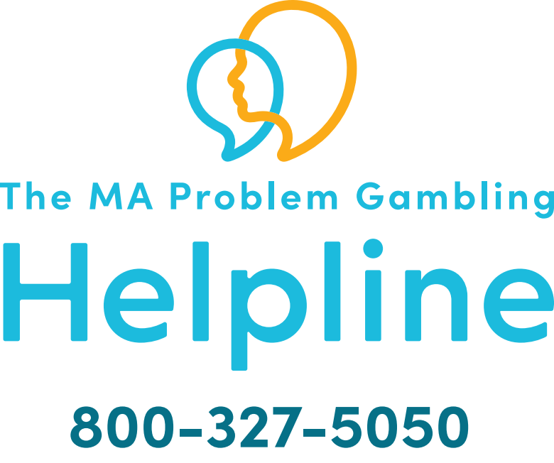
2020: Problem Gambling Helpline Services
As of 7/1/2020, integrating PG within SA helpline will enhance caller experience, maximize cost effectiveness, and expand reach.
Providing 24/7 bilingual services (Spanish) and capacity for additional languages
Screening an estimated 15,000-20,000 annual Substance Use Helpline callers for problem gambling
Conducting direct transfers to referral treatment sources that will improve access and engagement of treatment
Providing follow-up services from Helpline clinicians to callers
Robust quality assurance protocols to ensure efficiency and effectiveness.
MA Problem Gambling Helpline website: GamblingHelplineMA.org

Slide 15
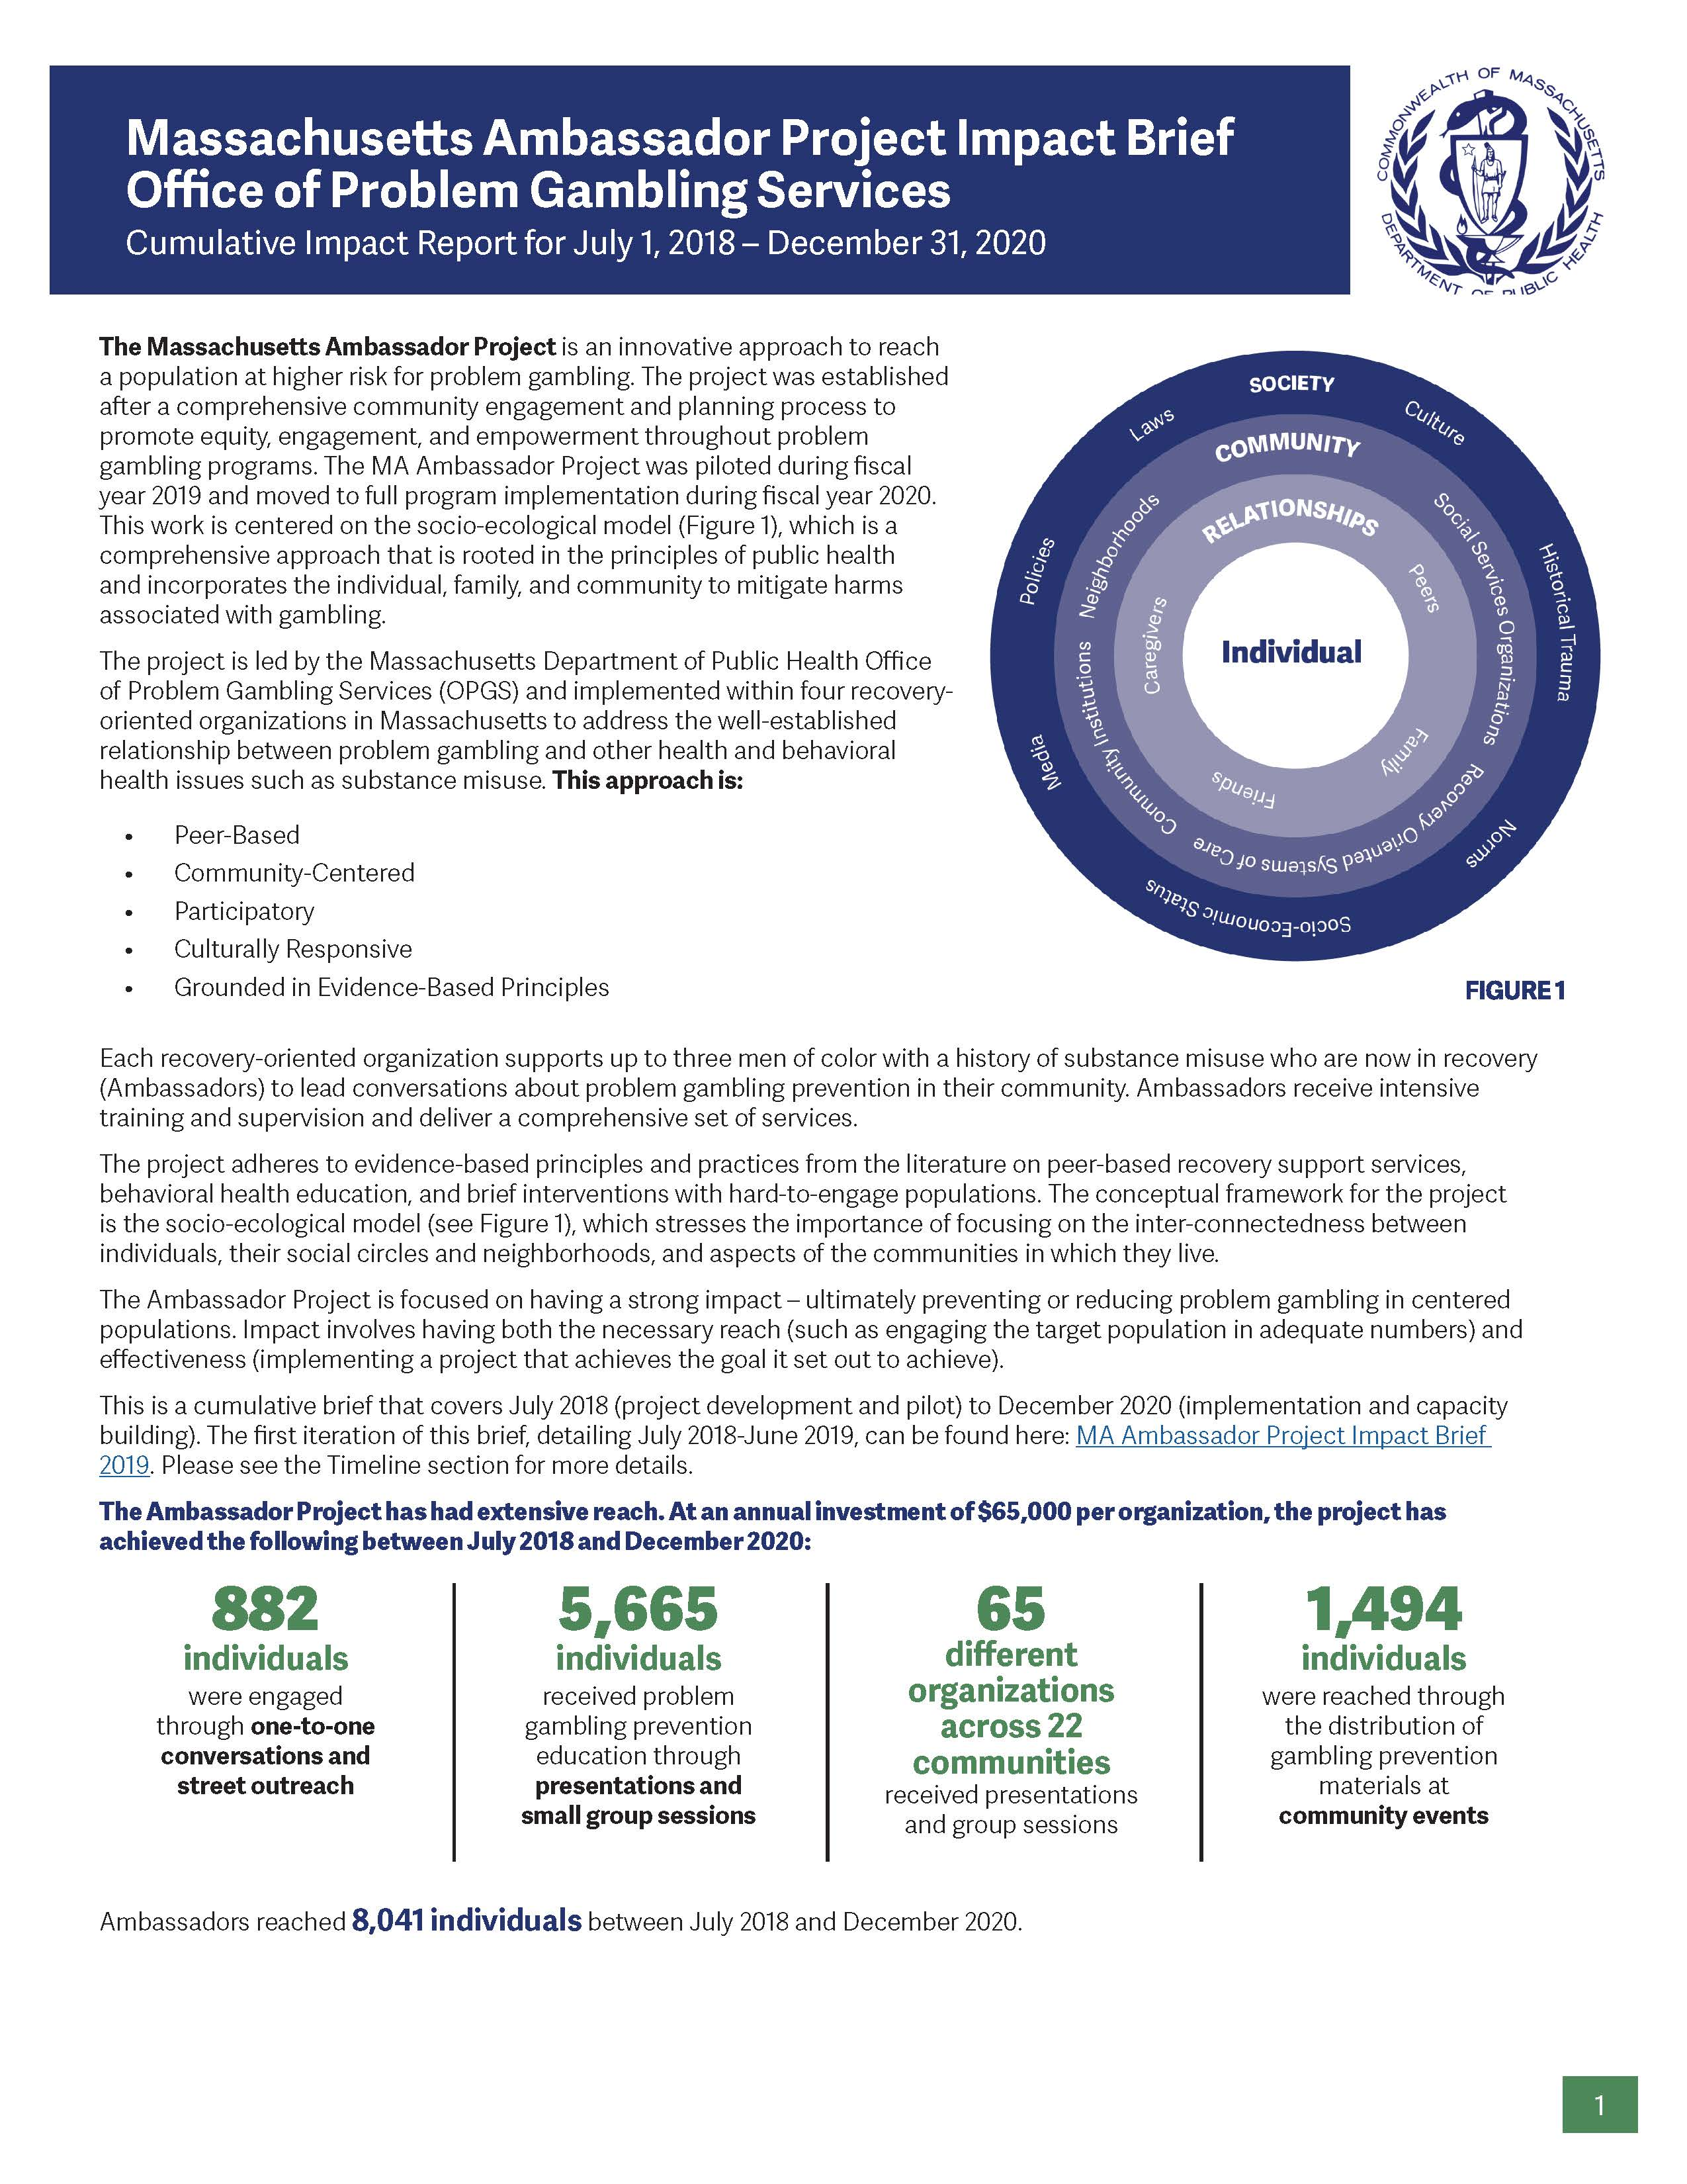
2021: Massachusetts Ambassador Project
Cumulative Impact Report Highlights:
  882 individuals were engaged through one-to-one conversations and street outreach
  5,665 individuals received problem gambling prevention education through presentations and small group sessions
  65 different organizations across 22 communities received presentations and group sessions
  1,494 individuals were reached through the distribution of gambling prevention materials
Full report here: https://www.mass.gov/doc/massachusetts-ambassador-project-impact-brief-office-of-problem-gambling-services-2020/download
Publication - Our Voice Matters: Using Lived Experience to Promote Equity in Problem Gambling Prevention
Notes:
Across four sites, $200,000 total investment

Slide 16
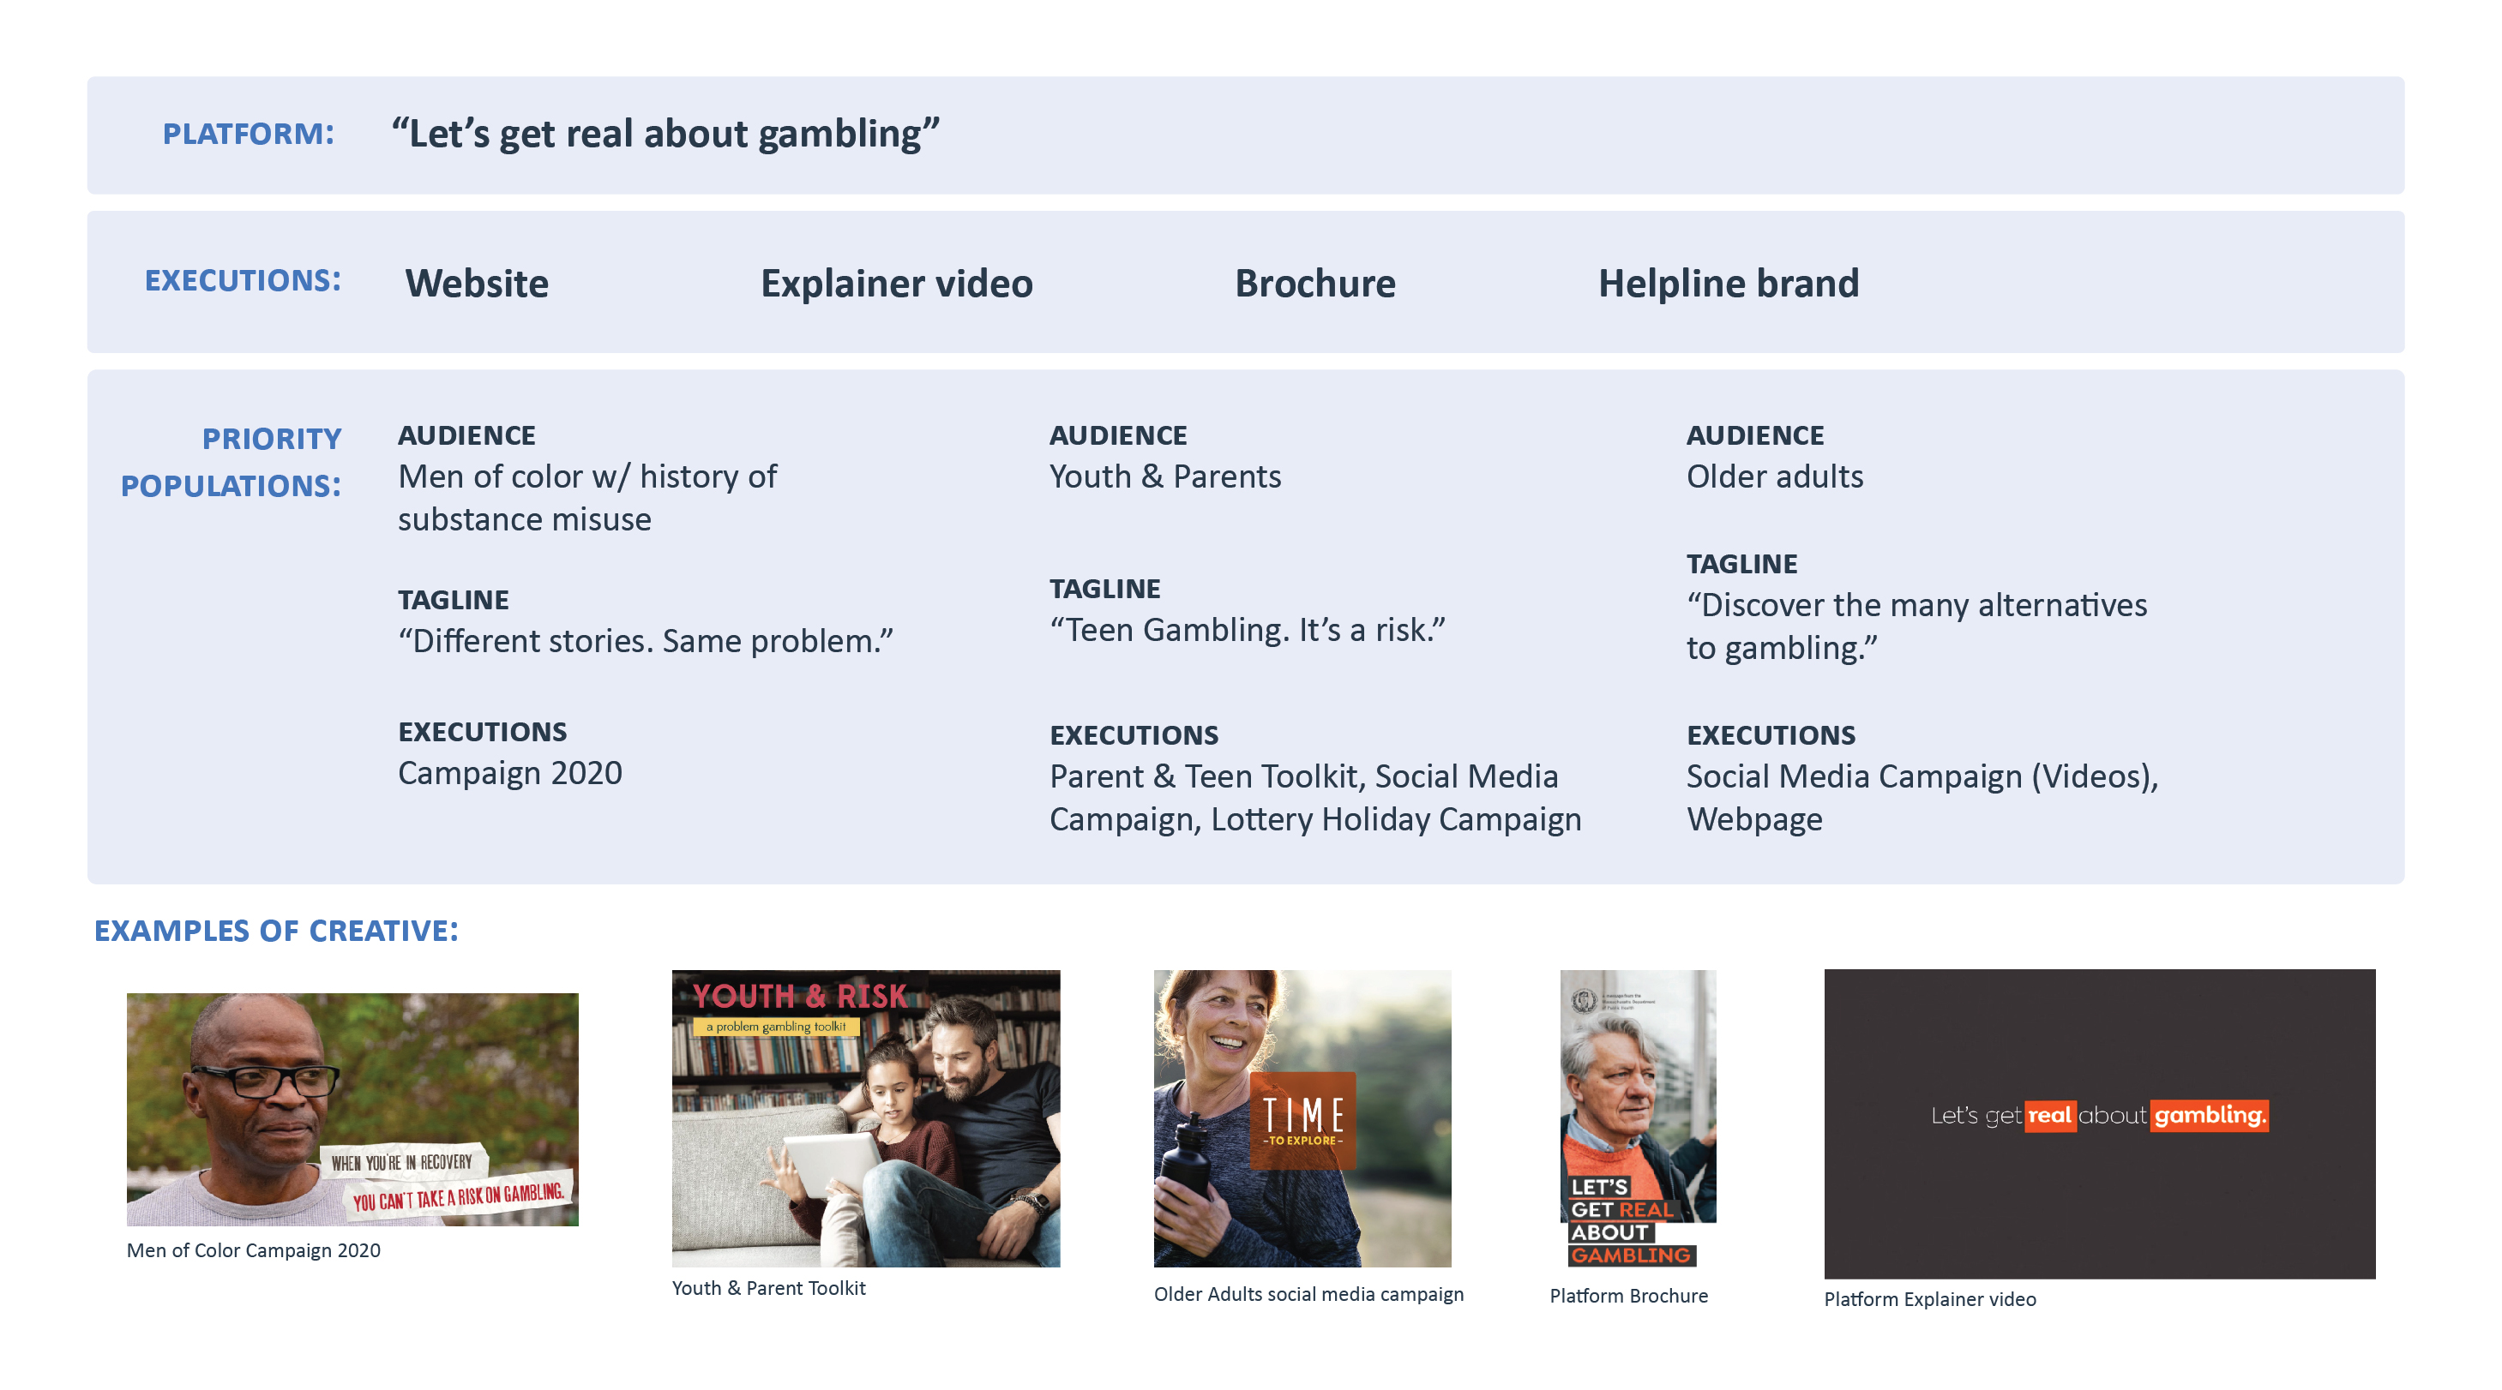
2021: OPGS Communications Campaign

Slide 17
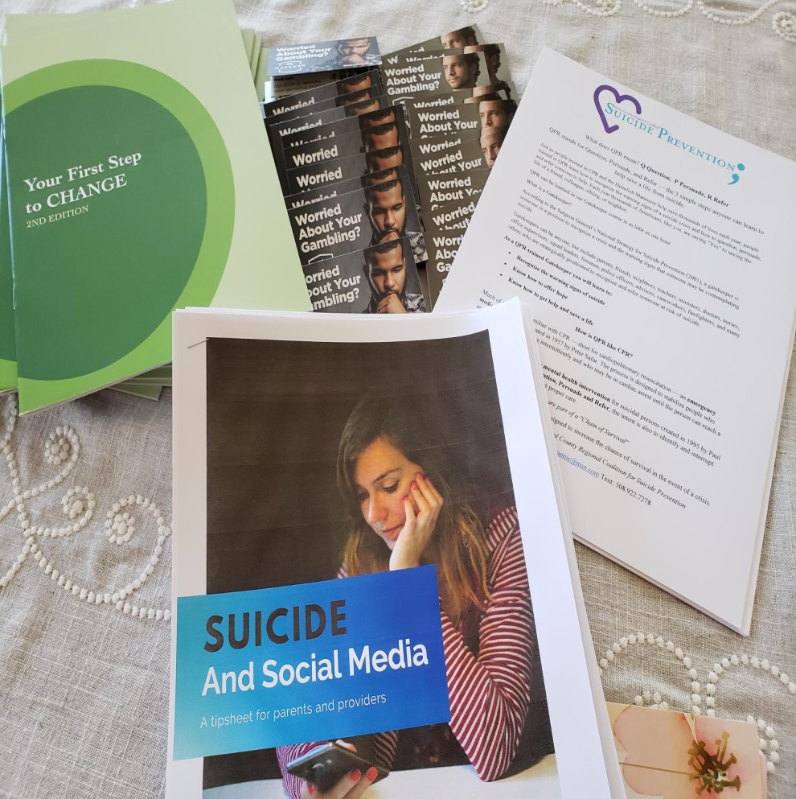
Key Principles for a Public Health Path Forward
Utilize data to inform the allocation of resources for precise public health.
Focus on the social determinants of health to address, plan, and develop problem gambling services.
Engage communities to inform, develop, and implement services with a specific emphasis on marginalized populations.
Break down silos and create meaningful integration that will promote health and wellness for everyone.

Slide 18
Connect with DPH

Slide 19
Work Cited
Alegría, A. A., Petry, N. M., Hasin, D. S., Liu, S.-M., Grant, B. F., & Blanco, C. (2009). Disordered gambling among racial and ethnic groups in the US: Results from the National Epidemiologic Survey on Alcohol and Related Conditions. CNS Spectrums, 14(3), 132–142.
Howard J. Shaffer, PhD, CAS, Debi A. LaPlante, PhD, Richard A. LaBrie, EdD, Rachel C. Kidman, BA, Anthony N. Donato, MPP, and Michael V. Stanton, BA; Toward a Syndrome Model of Addiction: Multiple Expressions, Common Etiology, Harv Rev Psychiatry 2004;12:367–374. 2004
Korn D., Shaffer HJ. (1999) Gambling and the Health of the Public: Adopting a Public Health Perspective. Journal of Gambling Studies Vol. 15, No. 4,
Messerlian, C., Derevensky, J., & Gupta, R. (2005). Youth gambling problems: A public health perspective. Health promotion international, 20(1), 69-79..
Okunna, N. C., Rodriguez‐Monguio, R., Smelson, D. A., Poudel, K. C., & Volberg, R. (2016). Gambling involvement indicative of underlying behavioral and mental health disorders. The American journal on addictions, 25(2), 160-172.
Petry, NM, et al. (2005) Comorbidity of DSM-IV pathological gambling and other psychiatric disorders: Results from the national epidemiologic survey on alcohol and related conditions. Journal of clinical Psychiatry. 66:564-574
Shaffer HJ, Martin R. Disordered gambling: etiology, trajectory, and clinical considerations. Annu Rev Clin Psychol. 2011; 7: 483-510

Slide 20
Thank You!
Victor Ortiz, MSW
Victor.Ortiz@mass.gov
MDPH Office of Problem Gambling Services (OPGS):
https://www.mass.gov/orgs/office-of-problem-gambling-services

