Slide 1
Progress & Peril in US Health Reform
Prof. John E McDonough, Harvard T.H. Chan School of Public Health
for Regis College Public Policy Forum
March 9, 2022

Slide 2
Contents: US Health Reform
Where are we right now?
2010: Affordable Care Act – key components
2021: American Rescue Plan Act (ARPA) – key changes
2022: Build Back Better Plan – key proposals
2023 forward: Looking ahead

Slide 3
1. Where are we, right now?

Slide 4
March 2022: Where Are We Right Now?
2017 “Repeal and Replace” plans are dead—repeal now unlikely
Republican lawsuit to repeal ACA in ‘21 died in SCOTUS–last major lawsuits
Democrats/Bidenworld promoting new health reforms focused on:
Strengthening ACA private insurance Marketplaces/Exchanges
Helping 2-3 million in Medicaid coverage gap, 12 states
Advancing price controls on prescription drugs
Adding benefits to Medicare—and nothing more
American Rescue Plan was game changer for ACA– and time limited
Building Back Better seeks to extend ARPA benefits
Coverage held steady during Covid-19 crisis and economic downturn
Value-based care agenda—evolving and not going away

Slide 5
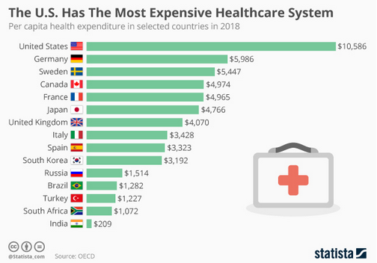
Per Capital Health Spending 2018

Slide 6
U.S. Health Spending as a Percentage of GDP, 1980–2019
Percent (%) of Gross Domestic Product
Notes: Current expenditures on health. Based on System of Health Accounts methodology, with some differences between country methodologies. GDP refers to gross domestic product.
* 2019 data are provisional or estimated for Australia, Canada, and New Zealand.
Data: OECD Health Data, July 2021.

Slide 7
Health Care System Performance Rankings
 | AUS | CAN | FRA | GER | NETH | NZ | NOR | SWE | SWIZ | UK | US
OVERALL RANKING | 3 | 10 | 8 | 5 | 2 | 6 | 1 | 7 | 9 | 4 | 11
Access to Care | 8 | 9 | 7 | 3 | 1 | 5 | 2 | 6 | 10 | 4 | 11
Care Process | 6 | 4 | 10 | 9 | 3 | 1 | 8 | 11 | 7 | 5 | 2
Administrative Efficiency | 2 | 7 | 6 | 9 | 8 | 3 | 1 | 5 | 10 | 4 | 11
Equity | 1 | 10 | 7 | 2 | 5 | 9 | 8 | 6 | 3 | 4 | 11
Health Care Outcomes | 1 | 10 | 6 | 7 | 4 | 8 | 2 | 5 | 3 | 9 | 11

Slide 8
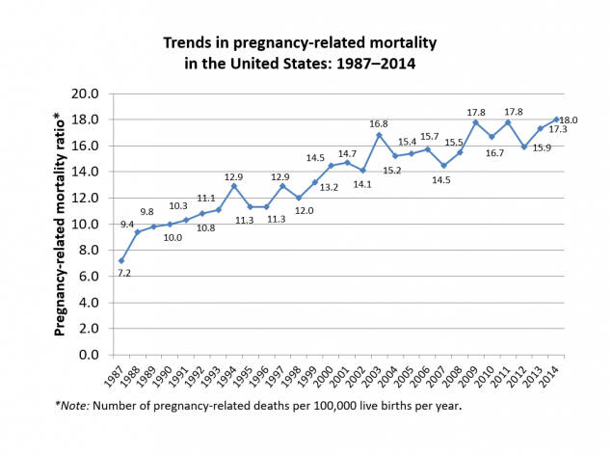

Slide 9
2. Affordable Care Act – key components

Slide 10
The Affordable Care Act (ACA) by Title
# | Title Name | Detail
1 | Quality, Affordable Health Care for All Americans | Private Insurance Reform and coverage expansion
2 | Role of Public Programs | Medicaid expansion/CHIP
3 | Improving the Quality and Efficiency of Health Care | Medicare/delivery system reform
4 | Prevention of Chronic Disease and Improving Public Health | Prevention/wellness/public health
5 | Health Care Workforce | Workforce
6 | Transparency and Program Integrity | Fraud, sunshine, comparative effectiveness research
7 | Improving Access to Innovative Medical Therapies | Biosimilars
8 | Community Living Assistance Services & Supports | CLASS (repealed)
9 | Revenue Measures | New taxes and fees
10 | Reauthorization of Indian Health Care Improvement Act plus Health Care Education & Reconciliation Act | Manager’s Amendment plus HCERA

Slide 11
Key ACA Reforms
Title 1 – Private Health Insurance
Households with income over 138% FPL (1=$17K; 4=$35K) can buy individual insurance via fed/state marketplace/exchange; subsidies 138→400% FPL
Elimination of pre-existing condition exclusions & medical underwriting in individual health insurance policies
Title 2 – Medicaid
Households with income below 138% FPL can obtain Medicaid coverage
Except in 12 rejecting states: AL, FL, GA, KS, MS, NC, SC, SD, TN, TX, WI, WY
Title 3 – Medicare and Delivery System Reform
Programs to move from Fee-for-Service to Value-Based Payments to make US health care higher quality and more efficient, i.e.:
Accountable Care Organizations
Bundled Payments

Slide 12
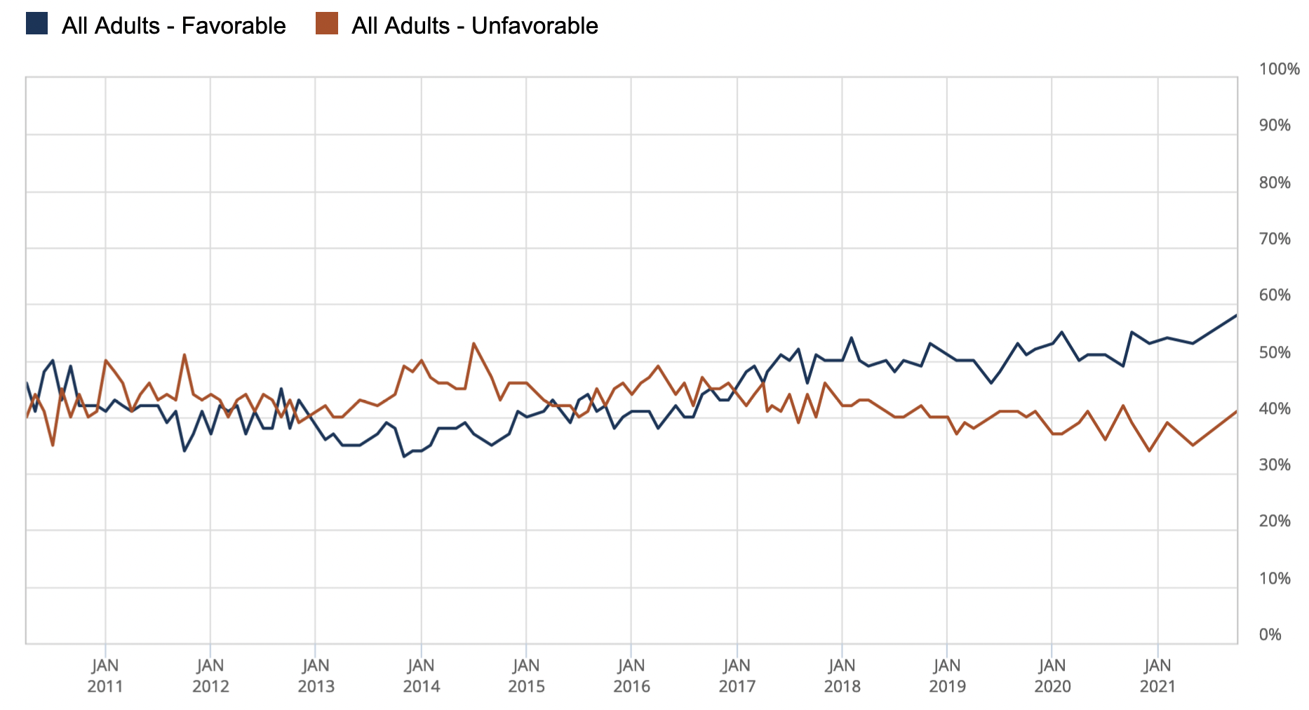
Public Opinion on the ACA: 2010-2021
https://www.kff.org/interactive/kff-health-tracking-poll-the-publics-views-on-the-aca/#?response=Favorable--Unfavorable&aRange=all

Slide 13
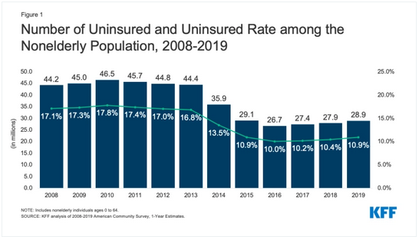

Slide 14
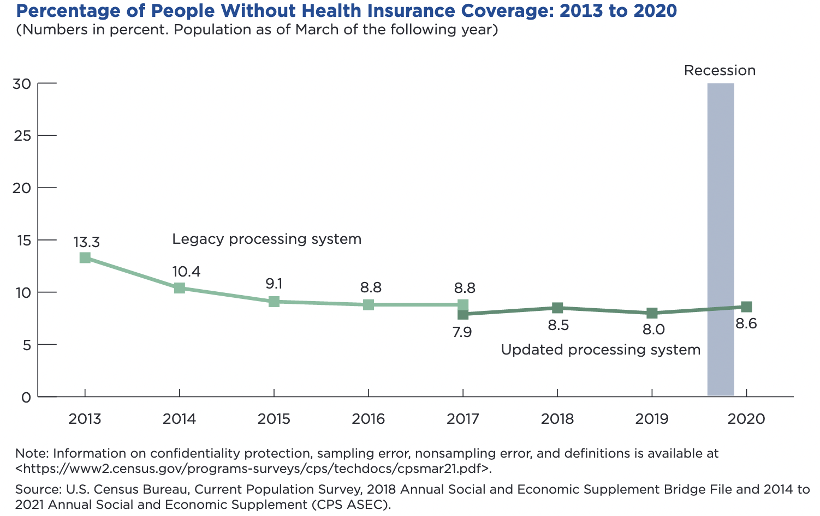

Slide 15
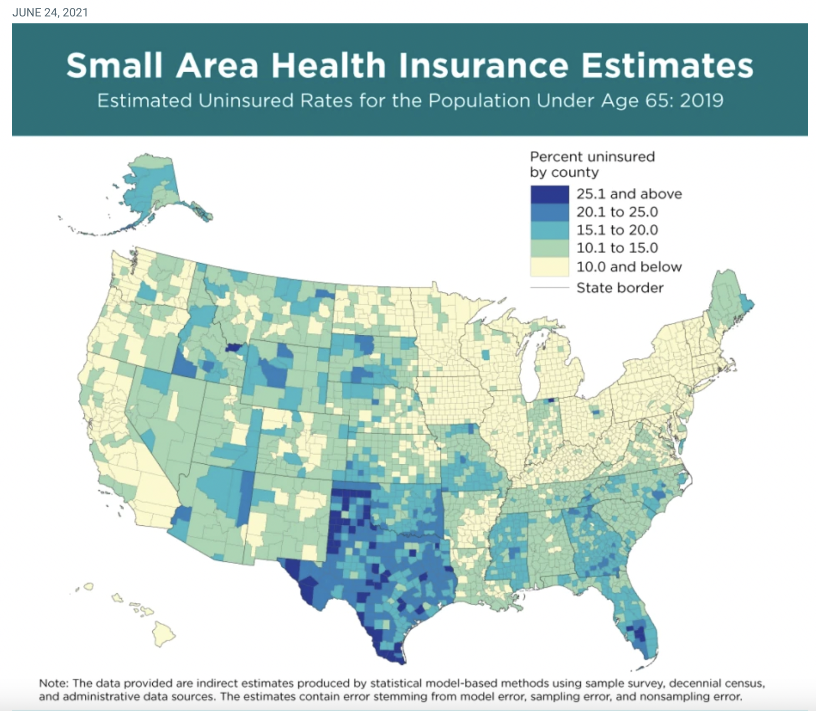
Uninsured Rates by State/County
Source: US Census
Bureau, 2021

Slide 16
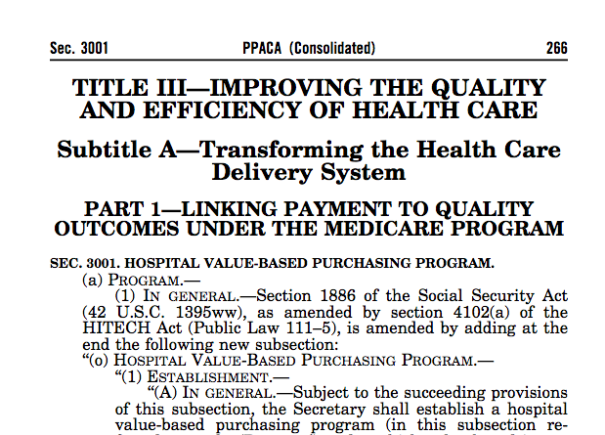
Bold Agenda for Health System Transformation

Slide 17
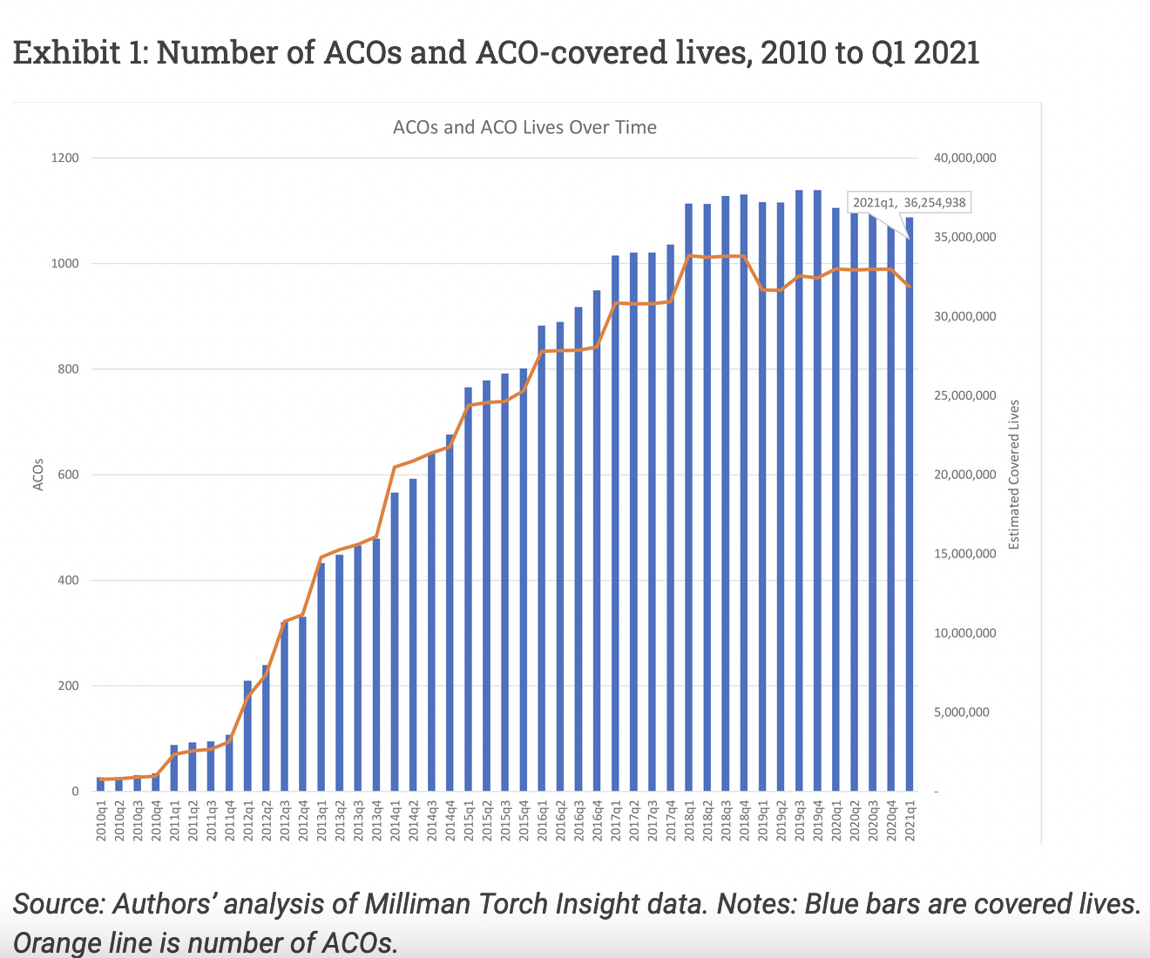
Growth in Accountable Care Organizations (ACOs)
SOURCE: Murhlestein and McClellan. “Accountable Care Organizations in 2016. Health Affairs Blog, 2021

Slide 18
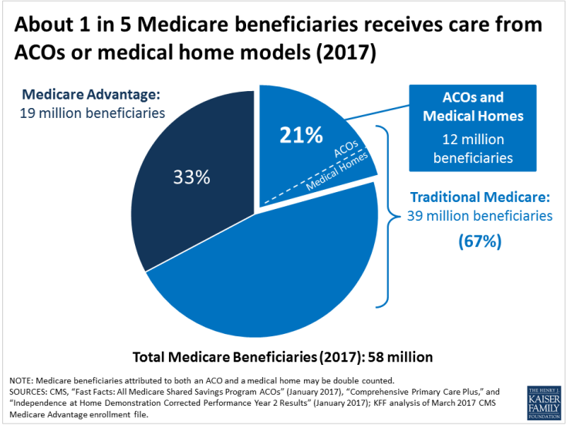
Growth in Medicare ACO Enrollment

Slide 19
3. American Rescue Plan Act (ARPA) – what matters most?

Slide 20
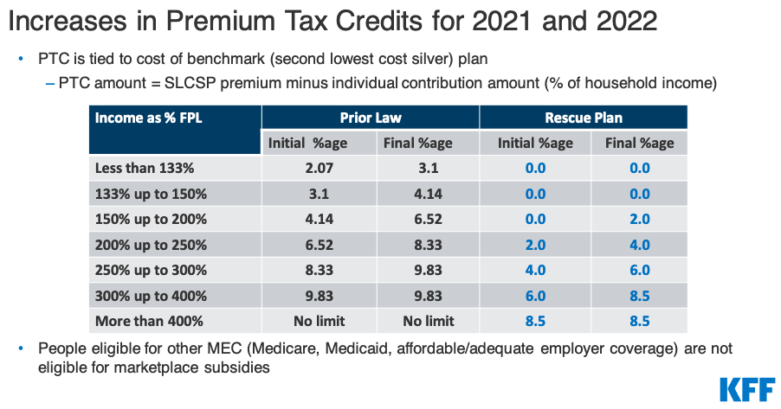

Slide 21
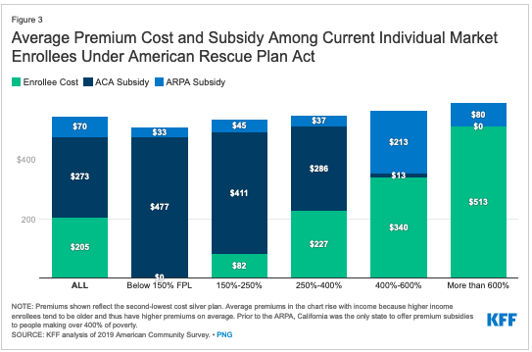

Slide 22
What’s at Stake re: ARPA Subsidy Continuation
ARPA-level subsidies are what designers of ACA originally wanted and were unable to achieve in 2010 because of overall budget constraints in ACA process
As an emergency law, ARPA subsidies only last for 2 years and expire on 12/31/22 unless Congress extends
Build Back Better plan (now on ice) would extend thru end of 2025
D. Sens. Manchin and Sinema support this extension

Slide 23
4. Build Back Better legislation – where is it and what matters now?

Slide 24
Key Health Provisions of BBB Legislation
Continuing ACA Marketplace Subsidy Expansion ($73.9B)
As outlined above, effective 2023-25 inclusive
Adding New Medicare Hearing Benefit ($36.7B)
Benefits for dental services and vision left out because of costs
Lowering Prescription Drug Prices and Spending ($78.8B savings)
Drug price negotiations; Rebates; Insulin cost limits;
Capping on Enrollee Out-of-Pocket Spending in Medicare Part D ($1.5B svgs.)
Filling the Medicaid Coverage Gap in 12 non-expansion states ($57B)
Addressing Maternal Mortality Provisions ($1.2B)
Capping Medicaid costs for Territories at 17%/83% feds ($9.5B)
Funding Family & Medical Leave ($205.5B)
NET COST OF ABOVE PROVISIONS = $303.5
https://www.kff.org/health-costs/issue-brief/potential-costs-and-impact-of-health-provisions-in-the-build-back-better-act/

Slide 25
5. Looking Ahead

Slide 26
5. What’s Coming Up?
Legislative Outlook
In spite of dire outlook, negotiations quietly underway with Manchin & Sinema
Midterm elections
All things being equal, Democrats should lose Senate and/or House
All things are not equal, i.e. COVID19, January 6th, Ukraine, Economy
Public Option
Not on the table
Medicare for All/aka Single Payer
Not on the planet

Slide 27
70+ Years of Universal Coverage Attempts in the U.S.
President | Year of W/L | W. House Party | Congress Control S/H | Policy Ambition | Win/Loss
Harry Truman | 1950 | D | D/D
Lyndon Johnson | 1965 | D | D/D
Richard Nixon | 1974 | R | D/D
Bill Clinton | 1994 | D | D/D
Clinton (CHIP) | 1997 | D | R/R
Barack Obama | 2010 | D | D/D

Slide 28
70 Years of U.S. Universal Coverage Attempts
President | Year of W/L | W. House Party | Congress Control S/H | Policy Ambition | Win/Loss
Harry Truman | 1950 | D | D/D | Comprehensive | Loss
Lyndon Johnson | 1965 | D | D/D | Incremental | Win
Richard Nixon | 1974 | R | D/D | Comprehensive | Loss
Bill Clinton | 1994 | D | D/D | Comprehensive | Loss
Clinton (CHIP) | 1997 | D | R/R | Incremental | Win
Barack Obama | 2010 | D | D/D | Incremental | Win

Slide 29
1981-2020: In this era, how many years of trifecta party control? White House/House/Senate
Control Equation | Results in years (n=40)
Democrats control all 3 | 4 (1993-’94, 2009-’10)
Republicans control all 3 | 6 1/3 (2001, 2003-’06, 2017-’18)
Divided Government | 29 2/3

Slide 30
1933-1980: In New Deal Era, how many years of unified party control? White House/House/Senate?
Control Equation | Results in years (n=48)
Democrats control all 3 | 30
Republicans control all 3 | 2 (1953-’54)
Divided Government | 18 (1947-’48; 1955-’60; 1969-’76)

Slide 31
Premium contributions and deductibles added up to more than 11 percent of U.S. median income in 2020.
EXHIBIT 1
Share of median income (%)
Combined premium contribution + deductible
Premium contribution
Deductible
Note: Combined estimates of single and family premium contributions and deductibles are weighted for the distribution of single-person and family households in the state.
Data: Premium contributions and deductibles — Medical Expenditure Panel Survey–Insurance Component (MEPS–IC), 2010–2020; Median household income and household distribution type — analysis of Current Population Survey (CPS), 2010–2021, by Mikaela Springsteen and Sherry Glied of New York University for the Commonwealth Fund.

Slide 32
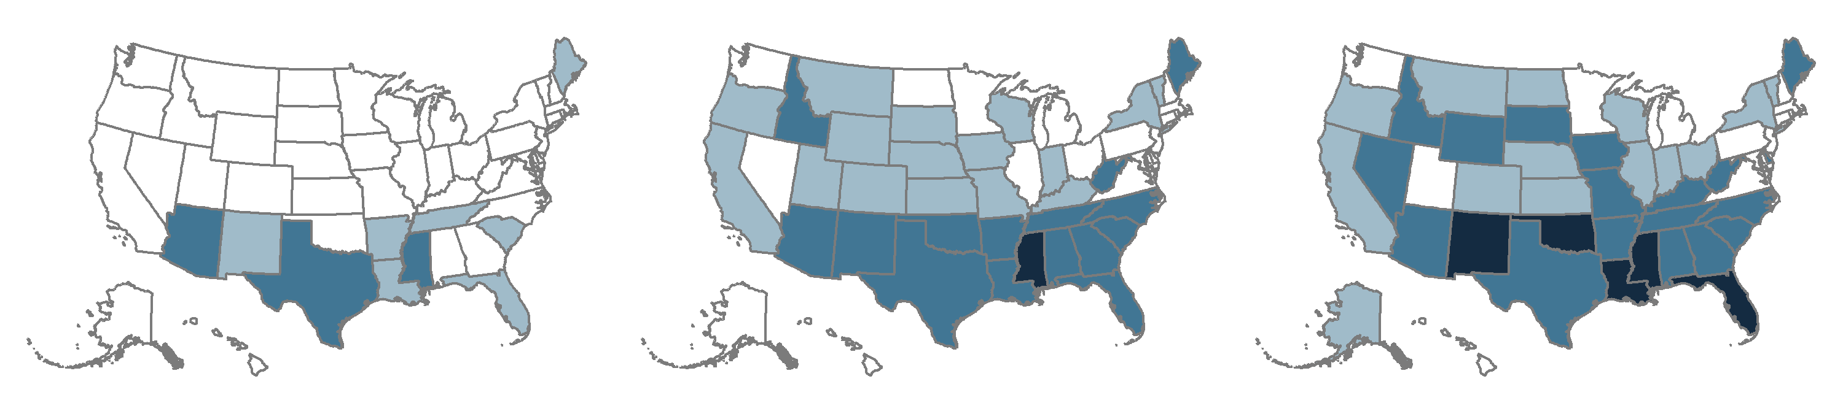
In a growing number of states, worker insurance premium contributions and deductibles make up 10 percent or more of median income.
EXHIBIT 2
2010
2015
2020
Average employee share of premium plus average deductible as percent of median state income
<10.0% (40 states + D.C.)
<10.0% (18 states + D.C.)
<10.0% (13 states + D.C.)
10.0%–11.9% (7 states)
10.0%–11.9% (16 states)
10.0%–11.9% (14 states)
12.0%–13.2% (3 states)
12.0%–14.9% (15 states)
12.0%–14.9% (18 states)
15.0%–15.6% (1 state)
15.0%–19.0% (5 states)
Note: Combined estimates of single and family premium contributions and deductibles are weighted for the distribution of single-person and family households in the state.
Data: Premium contributions and deductibles — Medical Expenditure Panel Survey–Insurance Component (MEPS–IC), 2010–2020; Median household income and household distribution type — analysis of Current Population Survey (CPS), 2010–2021, by Mikaela Springsteen and Sherry Glied of New York University for the Commonwealth Fund.

