Slide 1
Challenges Facing the US Health Care Systems
Brian Rosman
Legislative Director, Sen. Jo Comerford

Slide 2
Truth:
People don’t want health care,
we want health.

Slide 3
The Big 3:
Cost
Quality
Access

Slide 4
StandardLine: Pick 2
Cost
Quality
Access

Slide 5
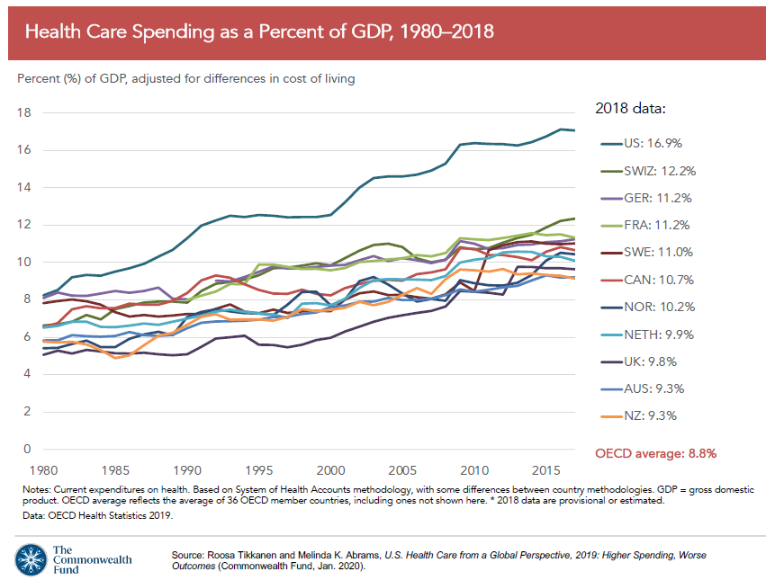
1. Cost

Slide 6
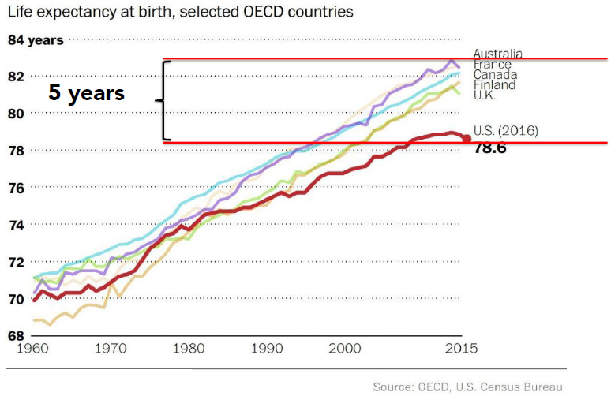
2. Quality

Slide 7
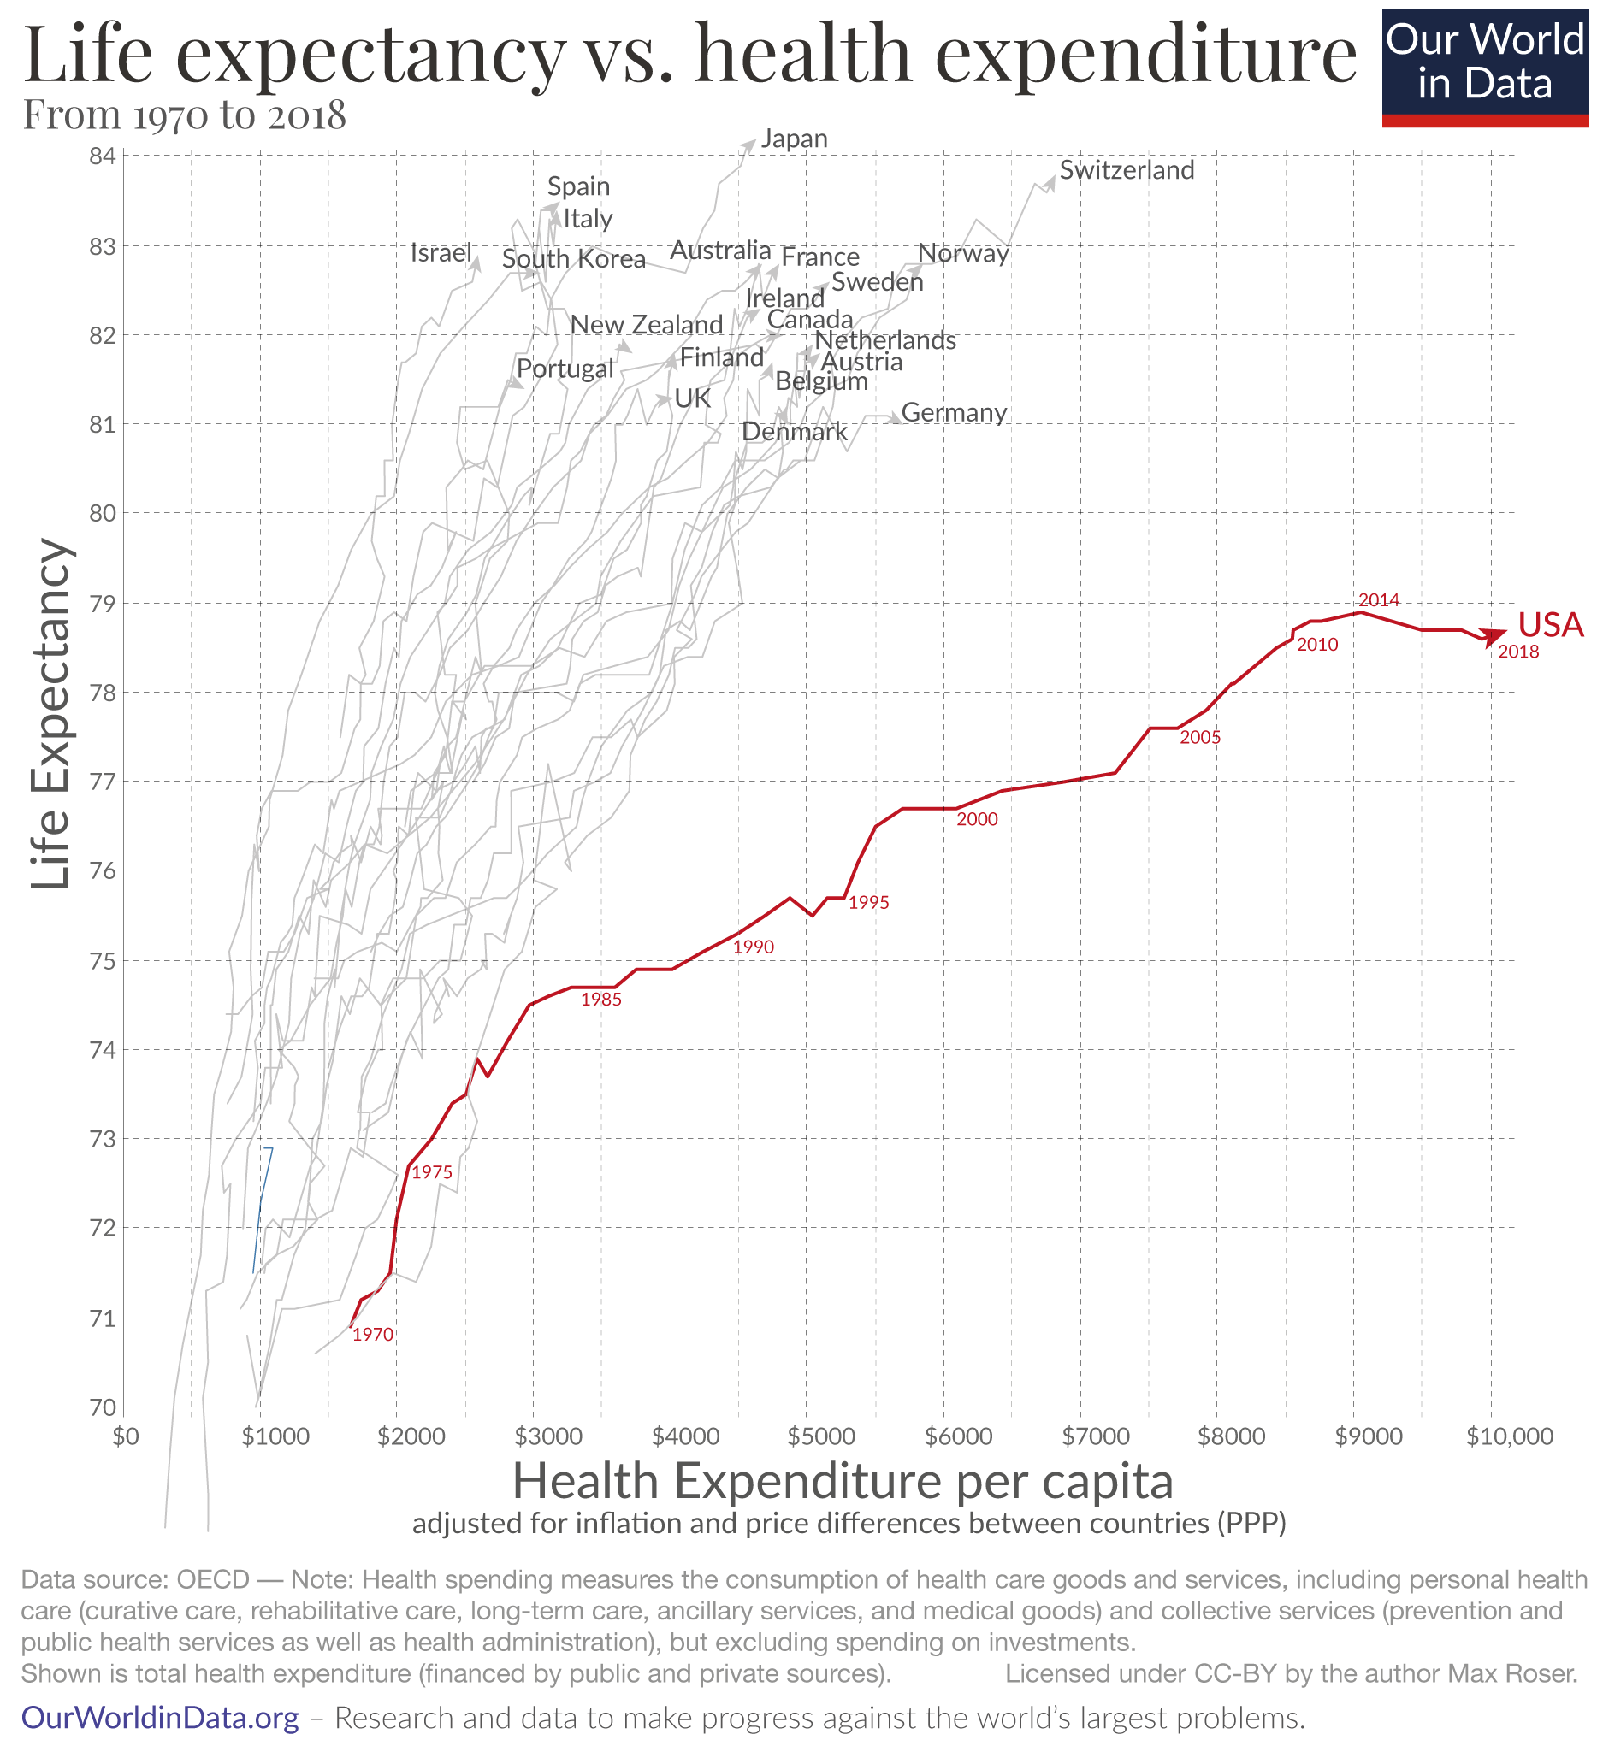
Does more spending lead to better quality?

Slide 8
Quality Measures
Review of 11 largest national health systems by the Commonwealth Fund
US is 5th in Overall Quality
Effective Care: 3rd best
Safe Care 7th best
Coordinated Care 6th best
Patient-Centered Care 4th best

Slide 9
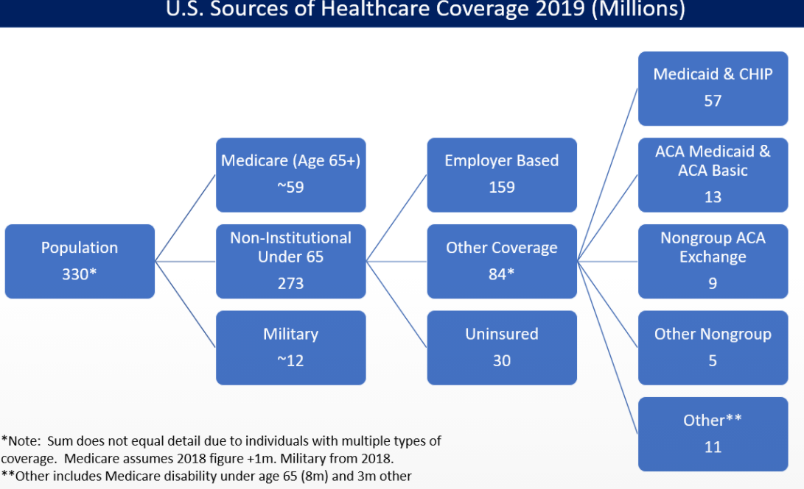
3. Access

Slide 10
Access

Slide 11
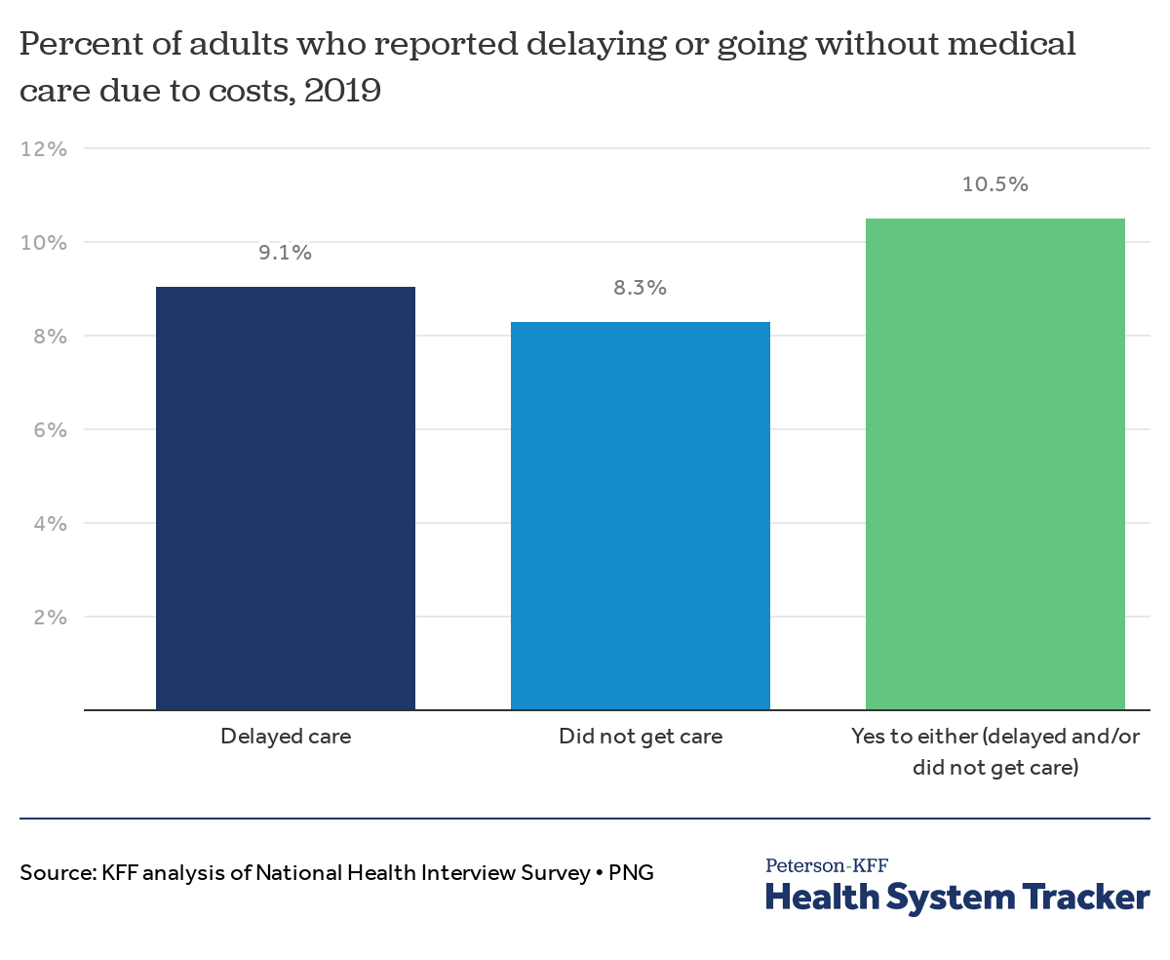
Access does not always mean care

Slide 12
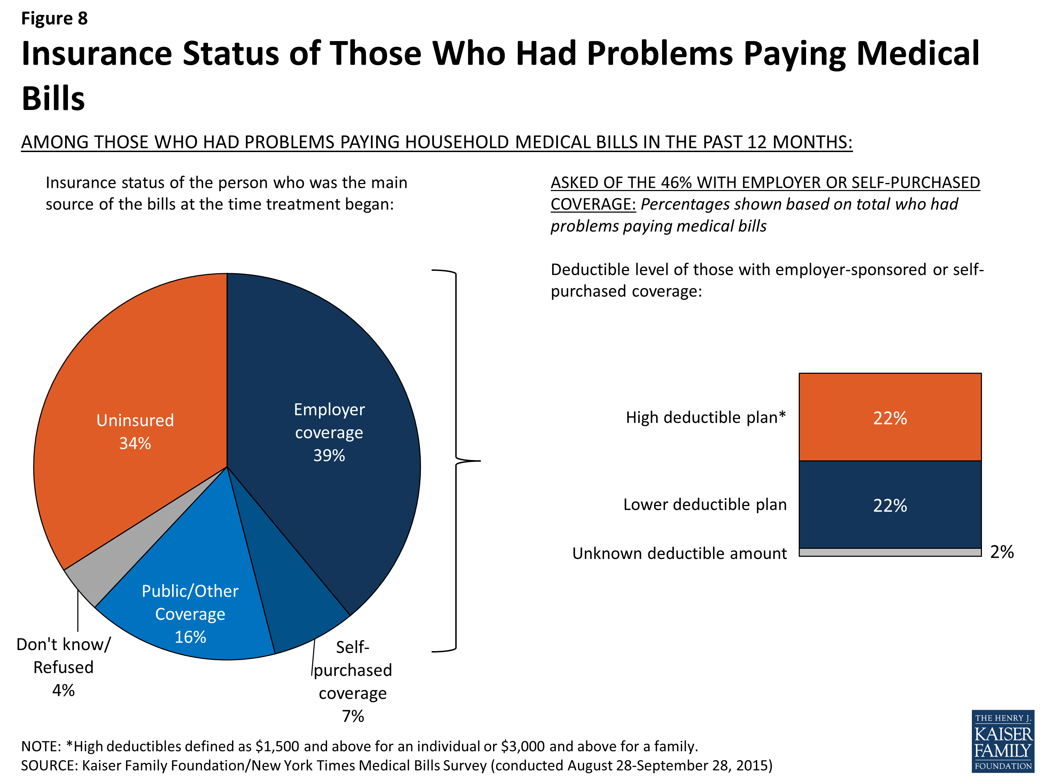
Problems paying medical bills even if insured

Slide 13
Note 1: This is way over-simplified

Slide 14
Note 2: Massachusetts is doing better than the national average - Uninsurance rate: just 3% - best in US - Quality – Top 10 among states - Cost – a lot, but not going up as much - Still, 15% of those insured had problem paying medical bill

Slide 15
The Big 3:
Cost
Quality
Access

Slide 16
Should it be the Big 4?
Cost
Quality
Access
Equity

Slide 17
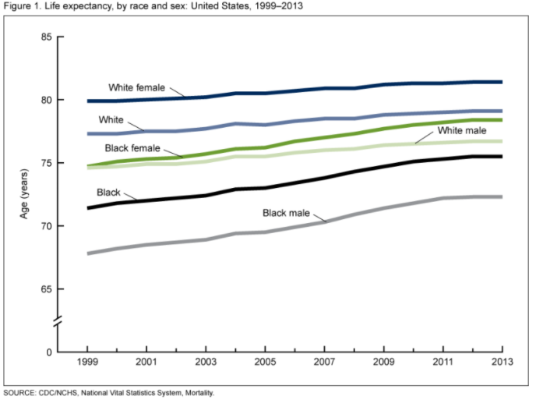
Life Expectancy by race

Slide 18
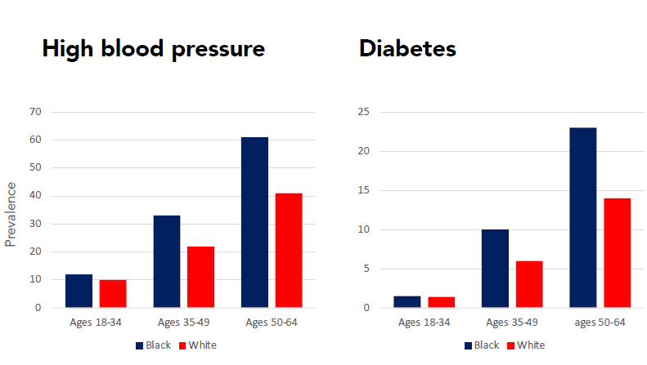

Slide 19
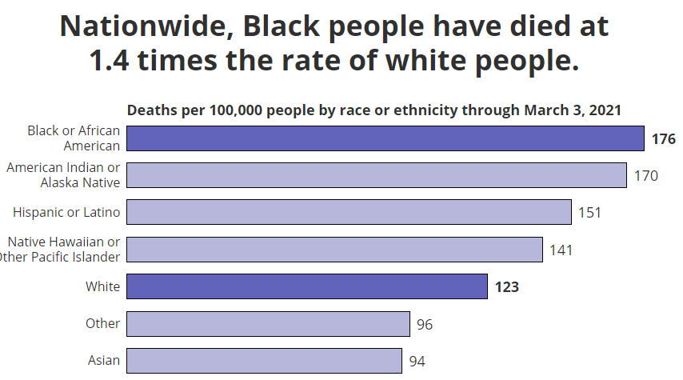
COVID deaths:

Slide 20
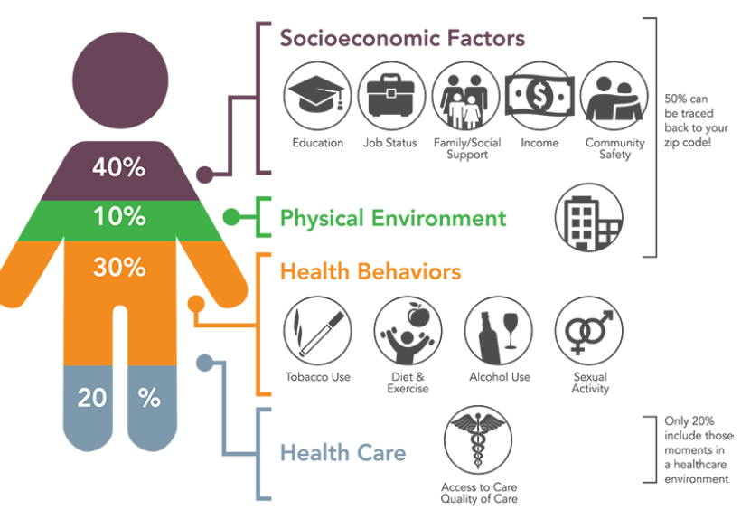
We want health

Slide 21
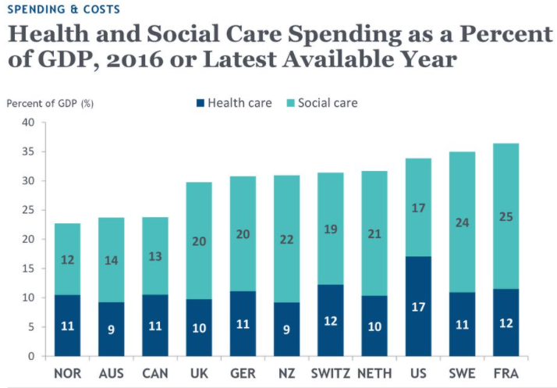
Are our priorities right?

Slide 22
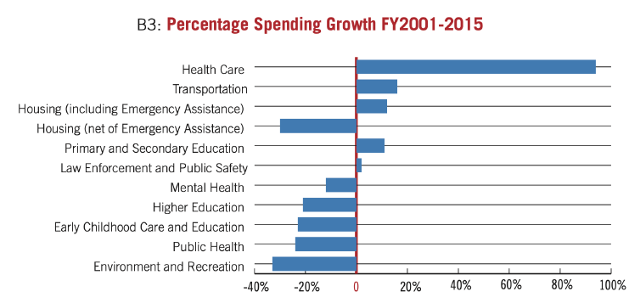
Massachusetts spending priorities

Slide 23
Truth:
People don’t want health care,
we want health.

Slide 24

What I’m working on

Slide 25
What I’m working on
COVID Oversight Committee
Health in all policies bill (HEALING)
Local public health standards
End of life options
Pancreatic cancer plan
Dental care at Community Health Centers
Maternal health disparities
PFAS chemicals in consumer products

