Slide 1
Social and Economic Impact of COVID19 Natalia Linos, ScD Executive Director FXB Center for Health and Human Rights at Harvard University April 7, 2021 Regis College

Slide 2
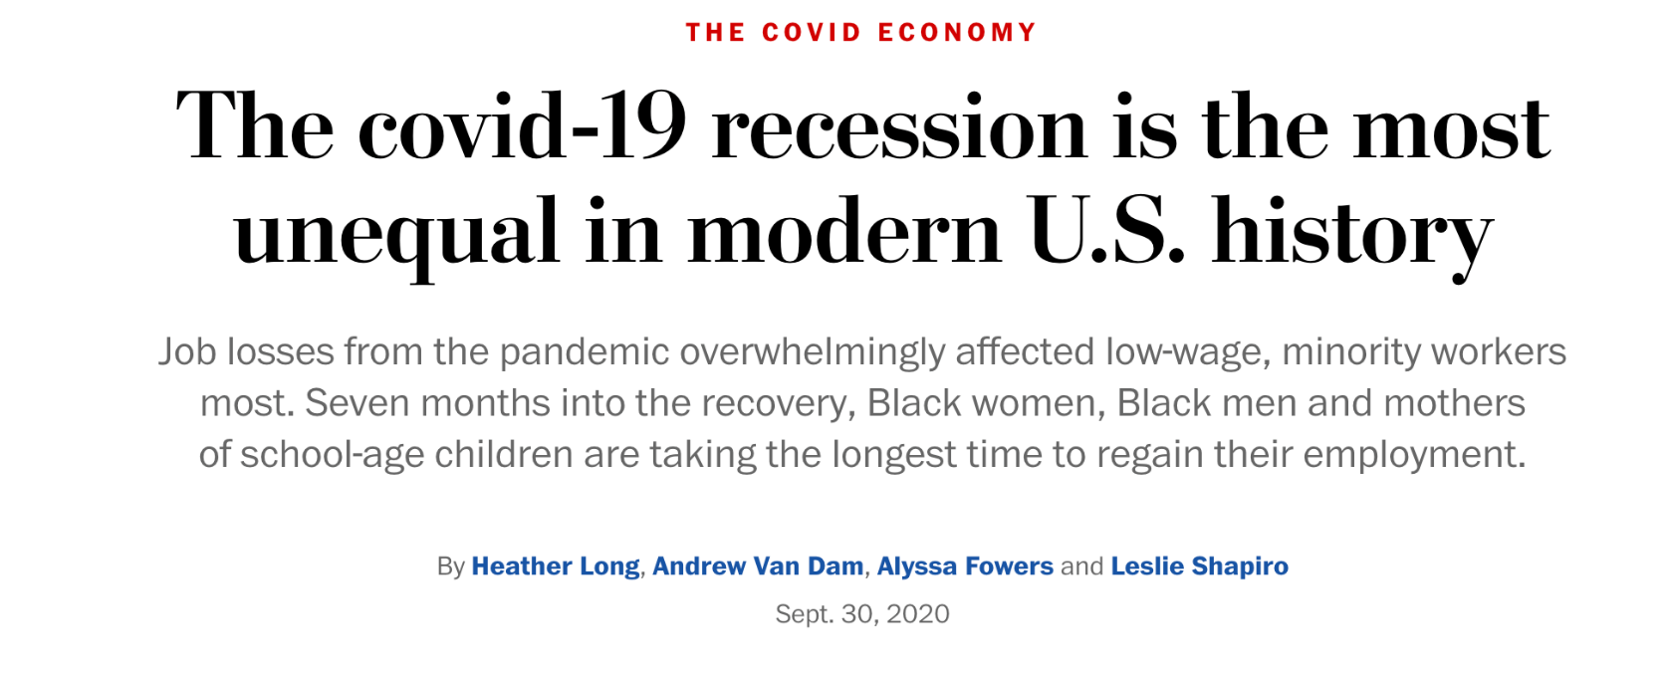
COVID-19 is more than just a health crisis

Slide 3
Who gets sick, who dies, and who suffers long-term socio-economic consequences in the midst and following a pandemic has to do with the way in which we structure our societies, our laws, policies and governance mechanisms.
Actions can be proactively taken to reduce inequities and prevent human rights violations.

Slide 4
An Intersectional and wholistic assessment of impact
Health
Human Rights
Children & Families
Housing & Food
Gender Equality
COVID-19 exposed how deep-seated structural racism & discrimination shapes health & poor outcomes for groups facing discrimination.
Housing eviction impacting marginalized communities more
Spikes in xenophobia, violent attacks and hate crimes;
Uneven educational impact
Disproportionate burden on women leaving the workforce, needing to take care of children, losing employment
Food insecurity
Economy & Jobs
Uneven economic impact by race and ethnicity
Heightened COVID risk for essential workers
Increase in domestic violence
Globally, authoritarian governments acted with impunity, curtailing freedoms.
Notes:
Key Argument:
Without explicit attention to equity and human rights, COVID-19 will exacerbate inequities by race/ethnicity across many sectors from education to employment, deepening and widening inequities.

Slide 5
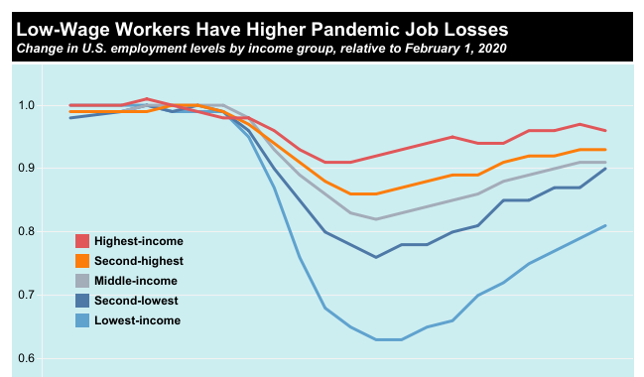
COVID and the impact on jobs and the economy :
Women, adults under age 30, Black and Hispanic adults, and those who have not obtained a college degree are among the most likely to say they have had trouble paying bills, their rent or mortgage, or for medical care. These groups have been especially impacted by higher unemployment rates during the coronavirus recession.
Notes:
https://www.cbpp.org/research/poverty-and-inequality/tracking-the-covid-19-recessions-effects-on-food-housing-and
Updated March 2021

Slide 6
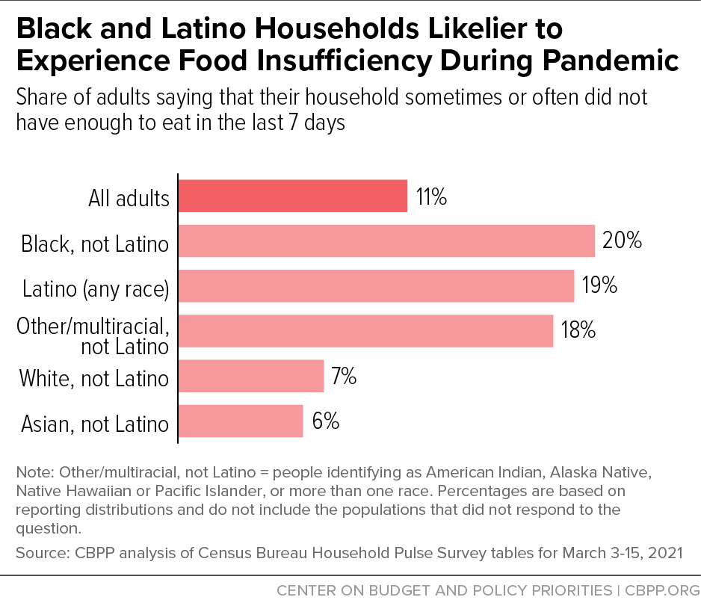
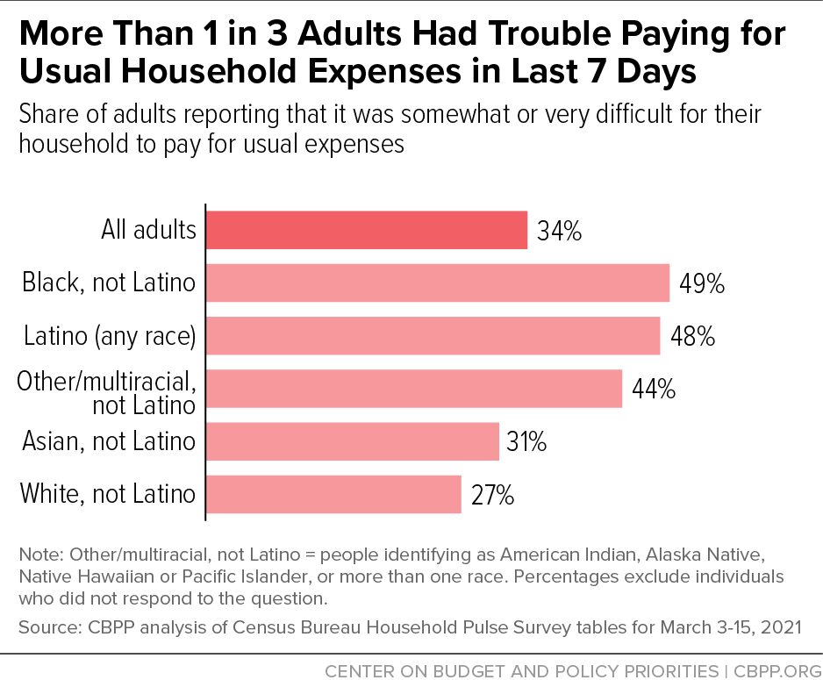
COVID and the impact on food and housing:
Notes:
https://www.cbpp.org/more-than-1-in-3-adults-had-trouble-paying-for-usual-household-expenses-in-last-7-days-2
Published March 2021

Slide 7
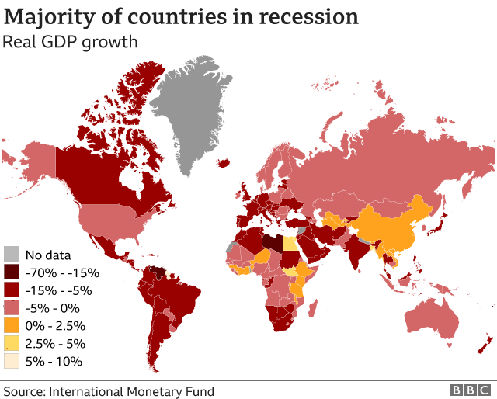
As of Jan 2021
Notes:
A global glimpse, Published Jan 2021
Source: https://www.bbc.com/news/business-51706225

Slide 8
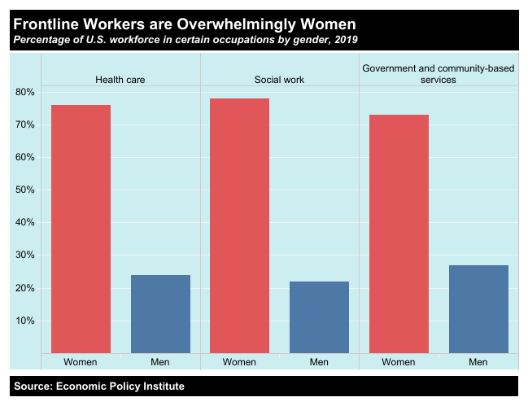
COVID and the gender gap:
Women accounted for 100% of the jobs lost in December 2020, affecting mostly WOC
The time it will take for the gender gap to close grew by 36 years in the space of just 12 months (from 99 years to 135)
Globally, the UN predicts that COVID-19 will contribute to the worsening of gender-poverty gaps
Notes:
https://www.cbpp.org/research/poverty-and-inequality/tracking-the-covid-19-recessions-effects-on-food-housing-and
Updated March 2021

Slide 9
EDUCATION
UNICEF/Chris Farber/UNICEF via Getty Images
UNICEF’s ‘Pandemic Classroom’ at the UN Headquarters in New York. Each empty desk and chair represents the million children living in countries where schools have been almost entirely closed.

Slide 10
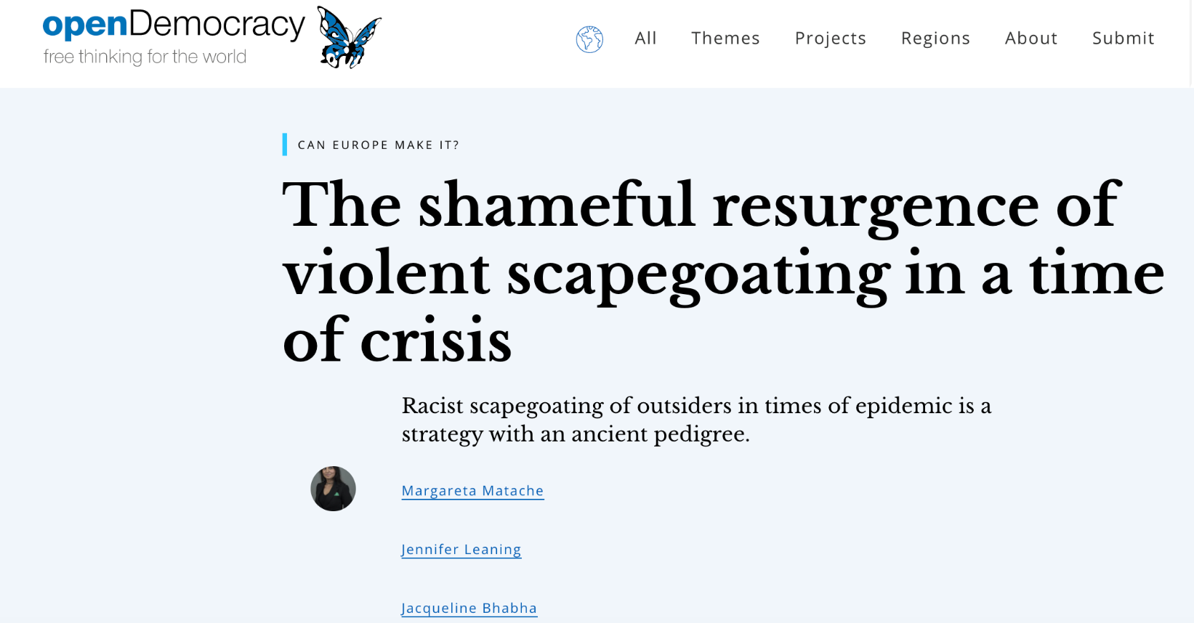
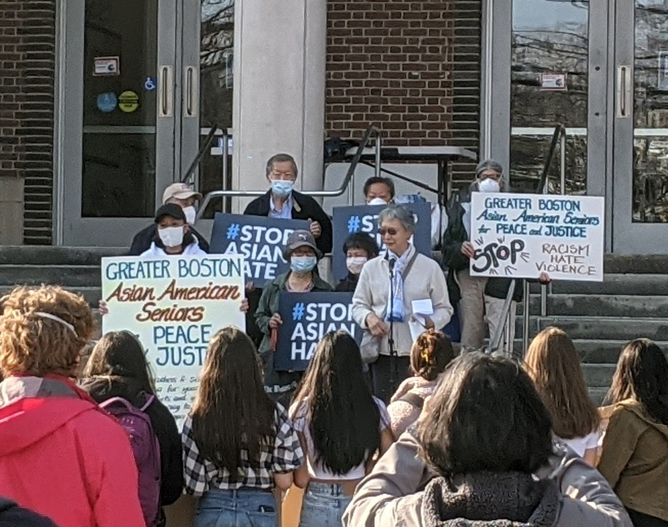
HUMAN RIGHTS FRAME

Slide 11
Building back better… What shall we do?
Notes:
COVID-19 response and investments are a critical opportunity to advance equity and right longstanding wrongs linked to structural racism and discrimination throughout society

Slide 12
Historical Perspective
Social epidemiologists have long recognized that disease distribution is patterned by structures of disadvantage, marginalization, exclusion and and discrimination) that have historical roots and present-day manifestations (Bassett and Linos, 2020; Krieger, 2003)
*Lessons from 1918 Influenza Pandemic

Slide 13
Getting to Root Causes of COVID-19 Disparities
Economic Injustice and Occupational Health Inequities
Environmental Health, Housing Inequities and Residential Segregation
Political Exclusion,
Xenophobia &
State-sanctioned Violence
Inadequate Access to Health Care and Social Protection
Air pollution exacerbates COVID-19
Overcrowding and vulnerabilities of informal settlements (no access to running water etc.)
Indigenous communities excluded from recovery bills
Restricted access to health care and testing (US uninsured; migrants etc.)
Exclusion from welfare systems
Precarious work conditions (no access to PPE; no paid sick leave ; inability to ‘work from home;)
Over-representation of racial and ethnic minorities among poor
Justification of increased immigration control
COVID-19 in correctional facilities
GOVERNANCE FAILURES
Notes:
RACISM NOT RACE
XENOPHOBIA NOT MIGRANTS
DISCRIMINATION AND EXCLUSION NOT INHERENT/BIOLOGICAL VULNERABILITY
Migrants are more likely to be excluded from welfare systems that protect workers who lose their jobs and incomes due to lockdown-related closure and/or failure of businesses. This is often despite their disproportionate contributions to social safety net systems.

Slide 14
Address What has made us so vulnerable…
Societal and Legislative
Introduce workplace protections
Guarantee a living wage, paid sick leave
Ensure Housing affordability
Build trust in institutions and science
End discrimination in policies and practice based on social identities
Introduce a long-term view on human rights issues
Health System
Invest in public health infrastructure
Research and address structural racism in healthcare settngs
Push for universal health care access
Focus on pandemic preparedness (especially for zoonotic diseases)

Slide 15
Questions?

