Slide 1
COVID-19: Causes for change and optimism panel presentation: Healthcare related fallout
Presented by Matthew C. Germak, MD, MPH
Chief Quality and Safety Officer
Beth Israel Lahey Health Primary Care
Regis College President’s Lecture Series
April 7, 2021

Slide 2
Rapid Response and Preparedness: Overnight Shift to Virtual Care Delivery
BILH Primary Care Visit Volume: March 2020 – February 2021
Telehealth is currently ~40% of total BILH Primary Care visit volume
Video visits are currently 75% of total telehealth visits. In March 2020, video visits were only 30% of total telehealth visits
Historical (Pre-COVID) volume ~75,000 visits per month

Slide 3
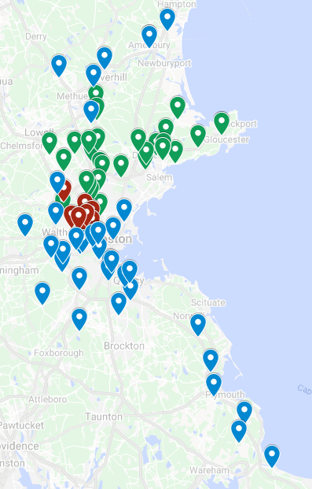
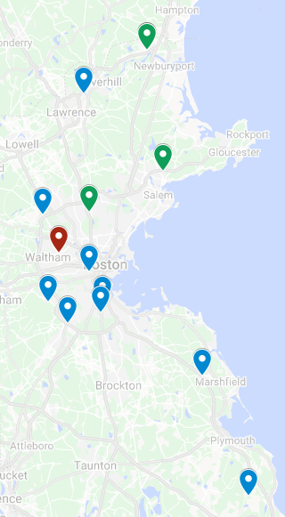
Rapid Response and Preparedness: Seismic Shift in Care Delivery Model
BILH Primary Care: COVID-19 Surge Cohort Model Approach
All BILH Primary Care Practices
COVID-19 Cohort Sites
BILH primary care providers are located at over 85 practices throughout Eastern Massachusetts, within 3 legacy organizations
In the first surge and lockdown phase, BILH moved to a cohort site model to see patients in-person (14 cohort sites open)
Cohort Approach: March 2020 – June 2020

Slide 4
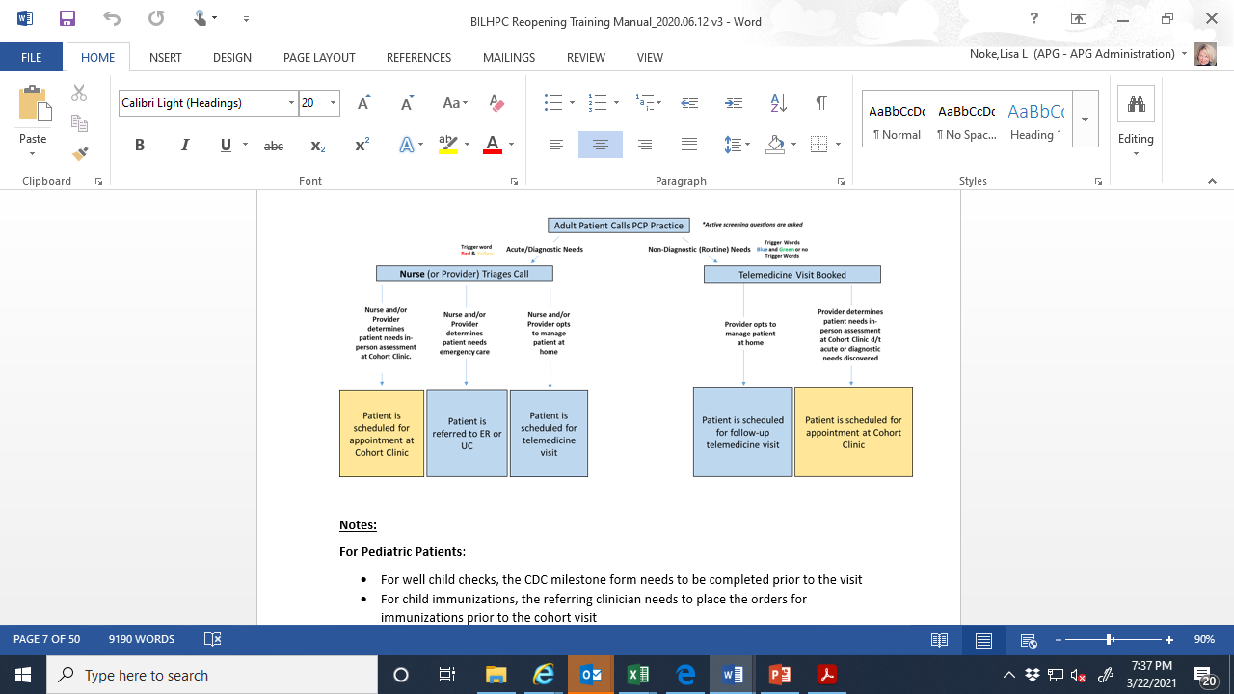

Slide 5
Rapid Response and Preparedness: Safety Protocol Implementation
Numerous new protocols and workflows to support patient and workplace safety
Rapid development and implementation, as well as sustainability:
Three-point pre-visit COVID-19 screening
Virtual rooming, check-in, check-out
Visitor restrictions
Personal Protective Equipment
Enhanced disinfection protocols
        Waiting rooms closed, plexiglass installed
Implications:
Operational: increased visit length, reduced number of team members on-site, decreased throughput
Care team safety and wellbeing: stress, fatigue, need for enhanced structured team communication (e.g., huddles)

Slide 6
Pandemic Focusing a Lens on Health Disparities
MA DPH COVID Data by Race/Ethnicity: 2/28/21 – 3/13/21
MA DPH Data: Cases, Hospitalizations, and Deaths by Race / Ethnicity
2/28/21 – 3/13/21
MA Race/Ethnicity Demographics:
White: 70.5%
Black: 7%
Hispanic: 12.4%
Asian: 6.7%
American Indian/Alaska Native: 0.2%
Other
Asian
(7)
Black
(7)
White
(70.5)
Hispanic (12.4)
Unknown
White, non-Hispanic
Black or African American, Non-Hispanic
Hispanic
Asian, non-Hispanic
Other race, non-Hispanic
Unknown, missing, or refused
Notes:
Isolation & recovery site
142,000 (cases unknown), 1,600 (hospitalizations unknown), 69 (69 unknown) → likely an issue with race/ethnicity data capture (e.g., not required in order to get COVID testing but typically is standard workflow for hospital admission and even more likely recorded for deaths)

Slide 7
BILH Patient Vaccination Outreach Approach
Focus on highly impacted communities
Considered measures such as cumulative incidence of COVID
Continuous improvement approach to addressing language barriers and vaccine hesitancy
Initial outreach utilized a combination of text and email invitations
  Many patients booked appointments through text responses
For eligible patients without an email or cell phone, BILH sends out computer-assisted phone messages inviting patients to call the BILH scheduling assistance line
Patient materials are translated into several languages and interpreter services are available

Slide 8
The Silent Pandemic
Multi-factorial Increased Risk for Worsened Mental Health
Bereavement - loss of someone or something due to the pandemic
Social isolation - not being able to meet with family, friends, neighbors, colleagues
Loss of income - unemployment, insurance, child care
Front line workers - trauma associated with work
Remote learning - families impacted by change in routine
Media - politically induced stress
Underlying mental health conditions –
  exacerbated or triggered by the pandemic (anxiety and depression, major mental illness)
  Surge in suicide rates and domestic violence
  Increased levels of alcohol and drug use

Slide 9
Light at the End of the Tunnel…
Behavioral health issues to the forefront-ex. Michelle Obama, Carson Daly, Kevin Love, Michael Phelps
Providers have come together to address impact of the pandemic-some clinicians offering free services. https://www.emotionalppe.org/
BILH and other employers are offering EAP programs, support groups for employees, moments of reflection
Insurance companies offering free wellness programs virtually
Virtual therapy and psychiatry, as well as online programs such as AA, Partial and Intensive Out-Patient Programs are most likely here to stay
Hope and Resilience

Slide 10
Patient Experience During the COVID-19 Pandemic
From March – June 2020, performed patient outreach calls to assess patients’ engagement and satisfaction with telemedicine visits (600+ calls)
-98% were “satisfied or very satisfied
In summer of 2020, performed outreach call to assess patients’ engagement and satisfaction with in-person visits at re-opened practices (1,000+ calls)
-99.5% reported feeling safe during their visit
-98.3% of patients reported being “satisfied” or “very satisfied”
In the fall of 2020, created QR codes which were displayed in the practices to get real time patient feedback (400+ digital responses)
-93% reported they were “very satisfied” with their health care needs being met.
In the winter of 2021, performed patient outreach calls and sent digital surveys to patients receiving vaccines at our clinics (3,000 responses)
-87.4% reported they felt safe in our care

